Slide 1
Learning from regulatory challenges in the UK regulatory community ESPO conference, June 2025
Marcial Boo, Chair Institute of Regulation

Slide 2
Marcial Boo Chair of Institute of Regulation
Chief Executive, Insolvency Practitioners Regulator
Previously:
Chief Executive, Equality and Human Rights Commission
Chief Executive, Independent Parliamentary Standards Authority
Chief Executive, UK Public Health Register
Director, National Audit Office
Director, Audit Commission
Senior Civil Servant, UK Government (Home Office, Dept for Education, Downing St)

Slide 3
The Institute of Regulation- home of good regulation
Established in 2021
We exist to:
provide and promote education and training in the theory and practice of regulation
research, develop and promote good practice in regulation
We are an inclusive community of regulatory professionals and experts.
New members can expect a warm and supportive welcome.

Slide 4
Challenges in UK regulation
Definition: what is regulation?
Scope: who are regulators?
Professionalism: where do regulators learn?
Bureaucracy: too much or too little regulation?
Data: how to respond to AI?
Systems: what is the future of regulation?

Slide 5
1. Definition: What is regulation?
Is it:
A rule or directive made and maintained by an authority. (e.g. ‘planning regulations’)?
Or
The action or process of regulating or being regulated. (e.g. ‘the regulation of financial markets’)?
Or both?

Slide 6
1. Definition: What is regulation?
Regulation is the management of complex systems
according to clear rules and the law
Regulators apply rules fairly and consistently to balance:
Protection for consumers and users of services
Opportunities for business innovation and public service improvement

Slide 7
2. Scope: Who are regulators?
Public Service Regulation
Health, housing, justice, education, social work
Economic Regulation
Utilities: water, energy, transport, telecoms
Professional Regulation
Law, medicine, vets, engineering, statistics, built environment
Ethics Regulation
Constitutional and standards watchdogs
Financial Regulation
Banking, finance, insurance, competition
Business Regulation
Food, products, health & safety, environmental health
International Regulation
Internet, climate, cross-border, EU directives post-Brexit

Slide 8
2. Scope: Who are regulators?
Health and Social Care: Care Quality Commission; Food Standards Agency; Health Research Authority; Human Fertilisation and Embryology Authority; Human Tissue Authority; Medicines and Healthcare Products Regulatory Agency (MHRA); Professional Standards Authority for Health and Social Care (PSA); General Chiropractic Council; General Dental Council; General Medical Council; General Optical Council; General Osteopathic Council; General Pharmaceutical Council; Health and Care Professions Council; Nursing and Midwifery Council

Slide 9
2. Scope: Who are regulators?
Health and Social Care: Care Quality Commission; Food Standards Agency; Health Research Authority; Human Fertilisation and Embryology Authority; Human Tissue Authority; Medicines and Healthcare Products Regulatory Agency (MHRA); Professional Standards Authority for Health and Social Care (PSA); General Chiropractic Council; General Dental Council; General Medical Council; General Optical Council; General Osteopathic Council; General Pharmaceutical Council; Health and Care Professions Council; Nursing and Midwifery Council
Business and Trade: Association of Chartered Certified Accountants (ACCA); British Hallmarking Council; Certification Officer;
Competition and Markets Authority; Financial Reporting Council; Groceries Code Adjudicator; Insolvency Service; Institute of
Chartered Accountants in England and Wales (ICAEW); Office for Product Safety and Standards; Office of the Regulator of
Community Interest Companies; Pubs Code Adjudicator; Companies House; Trade Remedies Authority; Advertising Standards Authority; Panel on Takeovers and Mergers
Culture, Media and Sport: Charity Commission; Gambling Commission; Historic England; National Archives; Sports Grounds Safety Authority; British Board of Film Classification
Defence: Defence Safety Authority
Education: Education and Skills Funding Agency; Ofsted; Office for Students; Ofqual; Office of the Schools Adjudicator; Social Work England; Teaching Regulation Agency
Energy Security and Net Zero: Coal Authority; Committee on Climate Change; North Sea Transition Authority; Ofgem
Environment: Animal and Plant Health Agency; Drinking Water Inspectorate; Environment Agency; Forestry Commission; Marine Management Organisation; Natural England; Office for Environmental Protection; Veterinary Medicines Directorate; Ofwat; Farriers Registration Council; Royal College of Veterinary Surgeons
Home Affairs: Forensic Science Regulator; Gangmasters and Labour Abuse Authority; HM Inspectorate of Constabulary and Fire & Rescue Services (HMICFRS); Independent Chief Inspector of Borders and Immigration; Independent Office for Police Conduct; Office of the Immigration Services Commissioner; Security Industry Authority
Justice: Bar Standards Board; CILEx Regulation; Commission for Judicial Appointments; Costs Lawyer Standards Board; Council for
Licensed Conveyancers; HM Crown Prosecution Service Inspectorate; HM Inspectorate of Prisons; HM Inspectorate of Probation; Independent Monitoring Authority for the Citizens Rights Agreement; Intellectual Property Regulation Board; Legal Services Board (LSB); Master of the Faculties; Solicitors Regulation Authority
Housing and Communities: Architects Registration Board; HM Land Registry; Planning Inspectorate; Regulator of Social Housing
Northern Ireland: Equality Commission for NI; Northern Ireland Human Rights Commission; Parades Commission for NI
Public Administration and Constitutional Affairs: Civil Service Commission; Commissioner for Public Appointments; Registrar of Consultant Lobbyists; UK Statistics Authority
Public Accounts: National Audit Office
Science, Innovation and Technology: Information Commissioner’s Office (ICO), Intellectual Property Office, Ofcom; Phone-paid Services Authority
Parliament: Electoral Commission; Independent Parliamentary Standards Authority (IPSA); Parliamentary Commissioner for Standards
Transport: Civil Aviation Authority, Driver and Vehicle Licensing Agency, Driver and Vehicle Standards Agency, Northern Lighthouse Board, Office of Rail and Road, Street Works Qualification Register, Traffic Commissioners and Deputies, Trinity House, Vehicle Certification Agency
Treasury: Financial Conduct Authority; Office for Budget Responsibility, Office for Professional Body Anti-Money Laundering Supervision; Payment Systems Regulator, Prudential Regulation Authority
Women and Equalities: Equality and Human Rights Commission
Work and Pensions: Health and Safety Executive; Office for Nuclear Regulation; Pensions Regulator

Slide 10
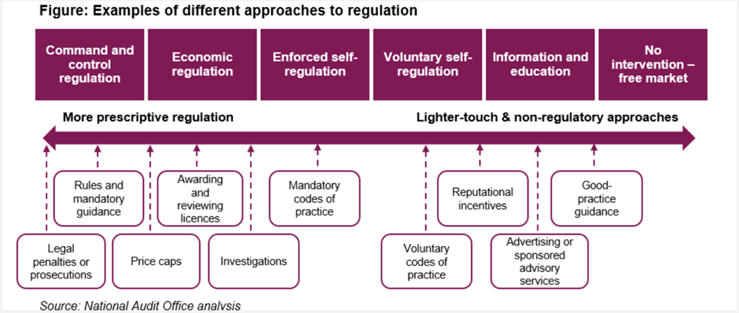
3. Professionalism: where do regulators learn?

Slide 11
3. Professionalism: where do regulators learn?
Introduction to Regulation
Understanding Regulation
Fundamentals of Regulation
Masterclasses in Regulation

Slide 12
4. Bureaucracy: Too much or too little regulation?
UNREGULATED
Known to be safe
REGULATED
Known to be safe,
if used with conditions
BANNED
Known to be unsafe

Slide 13
4. Bureaucracy: Too much or too little regulation?
UNREGULATED
Known to be safe
Known to be safe
Higher risk
UNREGULATED
Higher cost
REGULATED
Known to be safe,
if used with conditions
Known to be safe,
if used with conditions
REGULATED
BANNED
Known to be unsafe
Known to be unsafe
BANNED

Slide 14
5. Data: How to respond to AI?
Data underpins risk-based regulation
What’s going on?
Where are the risks?
How do we prevent harms?
Evidence based decision making
Frontline judgments
Strategic prioritisation
Data as a regulatory influencing tool
Influencing both regulated entities and wider stakeholders
Positive competitive incentives

Slide 15
5. Data: How to respond to AI?
Best: AI
Better: data
Good: technology

Slide 16
6. Systems: what is the future of regulation?
AUTHORITY
RULES
CONSEQUENCES
REGULATORY AGENCIES
GOAL
REGULATED GROUPS
CULTURE
Clear, well-defined goals
Strong, legitimate authority
Well-understood groups whose actions or behaviour is to be managed
Fair, proportionate, well-communicated, agile rules
Fair, proportionate, consistent consequences
Effective, efficient enforcement and regulatory agencies
A culture of compliance

Slide 17
Learning from UK regulation
Take a broad view
Work collaboratively
Become professional
Understand your context
Build data capability
Think about systems

Slide 18
Thank you – and good luck!
Chair: Marcial Boo chair@ioregulation.org

