Slide 1
What to learn from the new approaches of internal regulation in hospital care?
Laura Indrikova
06.2025
Laura.Indrikova@stradini.lv

Slide 2
Pauls Stradins Clinical
University Hospital
Latvia, Riga
Who we are?

Slide 3
Founded in 1910, a center of medical excellence with over 115 years of tradition
Leading hospital in Latvia for multi-profile care, research, and education
30 clinics and centers delivering advanced, innovative, and comprehensive care
Key specialties
Cardiology, cardiovascular surgery, organ transplantation, vascular surgery, occupational and radiation medicine, pregnancy pathology, oral and maxillofacial surgery, and more

Slide 4
Clinics and centers
Surgery Clinic | Neurology Clinic | Clinic of Otorhinolaryngology | Center for Occupational and Radiation Medicine | Physical Medicine and Rehabilitation Center | Latvian Cardiology Center | Nephrology Center | Joint Laboratory
Internal Medicine Clinic | Neurology Clinic | Women's and Child Health Clinic | Vascular Surgery Center | Center for Gastroenterolo-gy, Hepatology, and Nutrition Therapy | Latvian Transplanta-tion Center | Center for Pulmonary Diseases and Thoracic Surgery | Cabinet of Rare Diseases
Anesthesiology and Resuscitation Clinic | Ophthalmo-logy Clinic | Ambulatory Surgery Center | Urology Center | Cardiac Surgery Center | Center for Oral, Maxillofacial Surgery | Institute of Diagnostic Radiology | Infectious Diseases and Hospital Epidemiology Advisory Service
Neurosurgery Clinic | Oncology Clinic | Rheumatolo-gy Center | Endocrinology Center | Breast Disease Center | Emergency Medical Center | Institute of Pathology

Slide 5
Hospital in numbers 2024
Beds
824
Employees
3 367
Patients
48 682
Transplants
94
Bed Occupancy
80,69%%
Average
Inpatient days
5,0
Revenue
201,3M EUR
Nursing
1160
Physicians
871
Support
1268 (593 care)
Administration
99
Inpatient stays
48 682
Outpatient visits
606 795
Day clinic
26 372
Emergency visits
61 429
Kidney
56
Corneal
28
Liver
6
Heart
4

Slide 6
Internal regulations
Where we’re going?
Goals, challenges, new ways forward

Slide 7
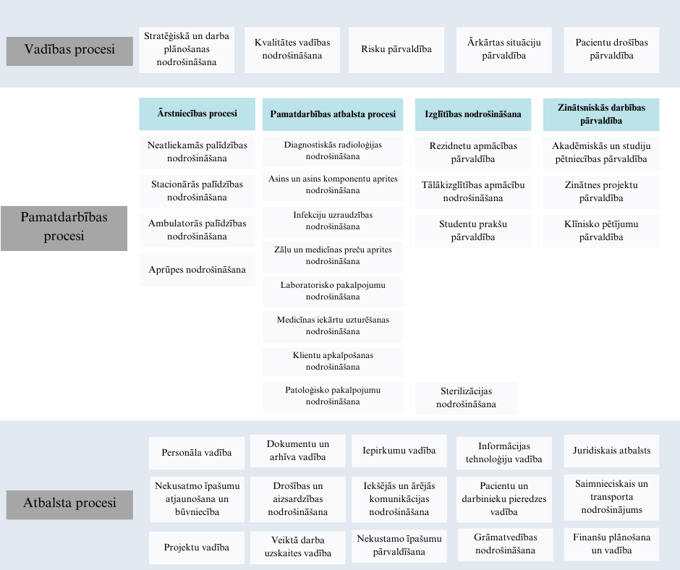
Our main goals in developing internal procedures:
to ensure high-quality healthcare services,
to comply with external regulations,
to maintain continuity and consistency across processes, and
to clearly describe all essential workflows, especially those involving multiple departments.

Slide 8
Our challenges
Staff prefer familiar routines over new systems, there can be lack of motivation to follow updates
Resistance to change
Information overload leads to confusion, old procedures remain in use alongside new ones, hard to pass updates between colleagues
Poor information flow
Tasks like updating documentation, attending quality trainings, participating in audits are often postponed or deprioritized in favour of clinical work
Competing priorities
Insufficient training
Not everyone understands new procedures fully, unclear responsibilities

Slide 9
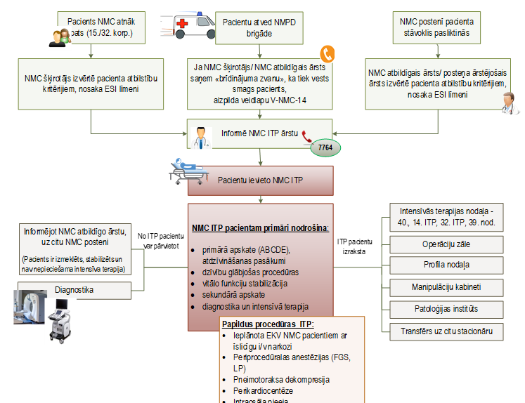
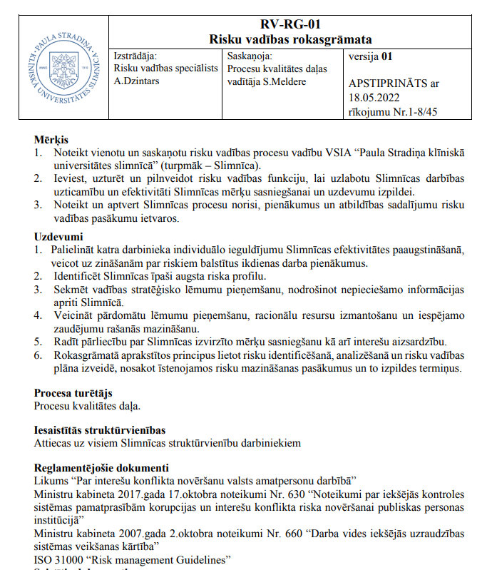
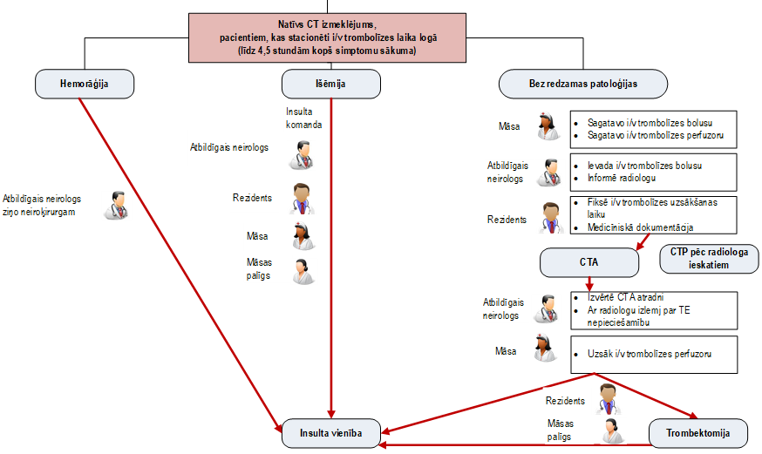
What we have done in new ways?
Process flows

Slide 10
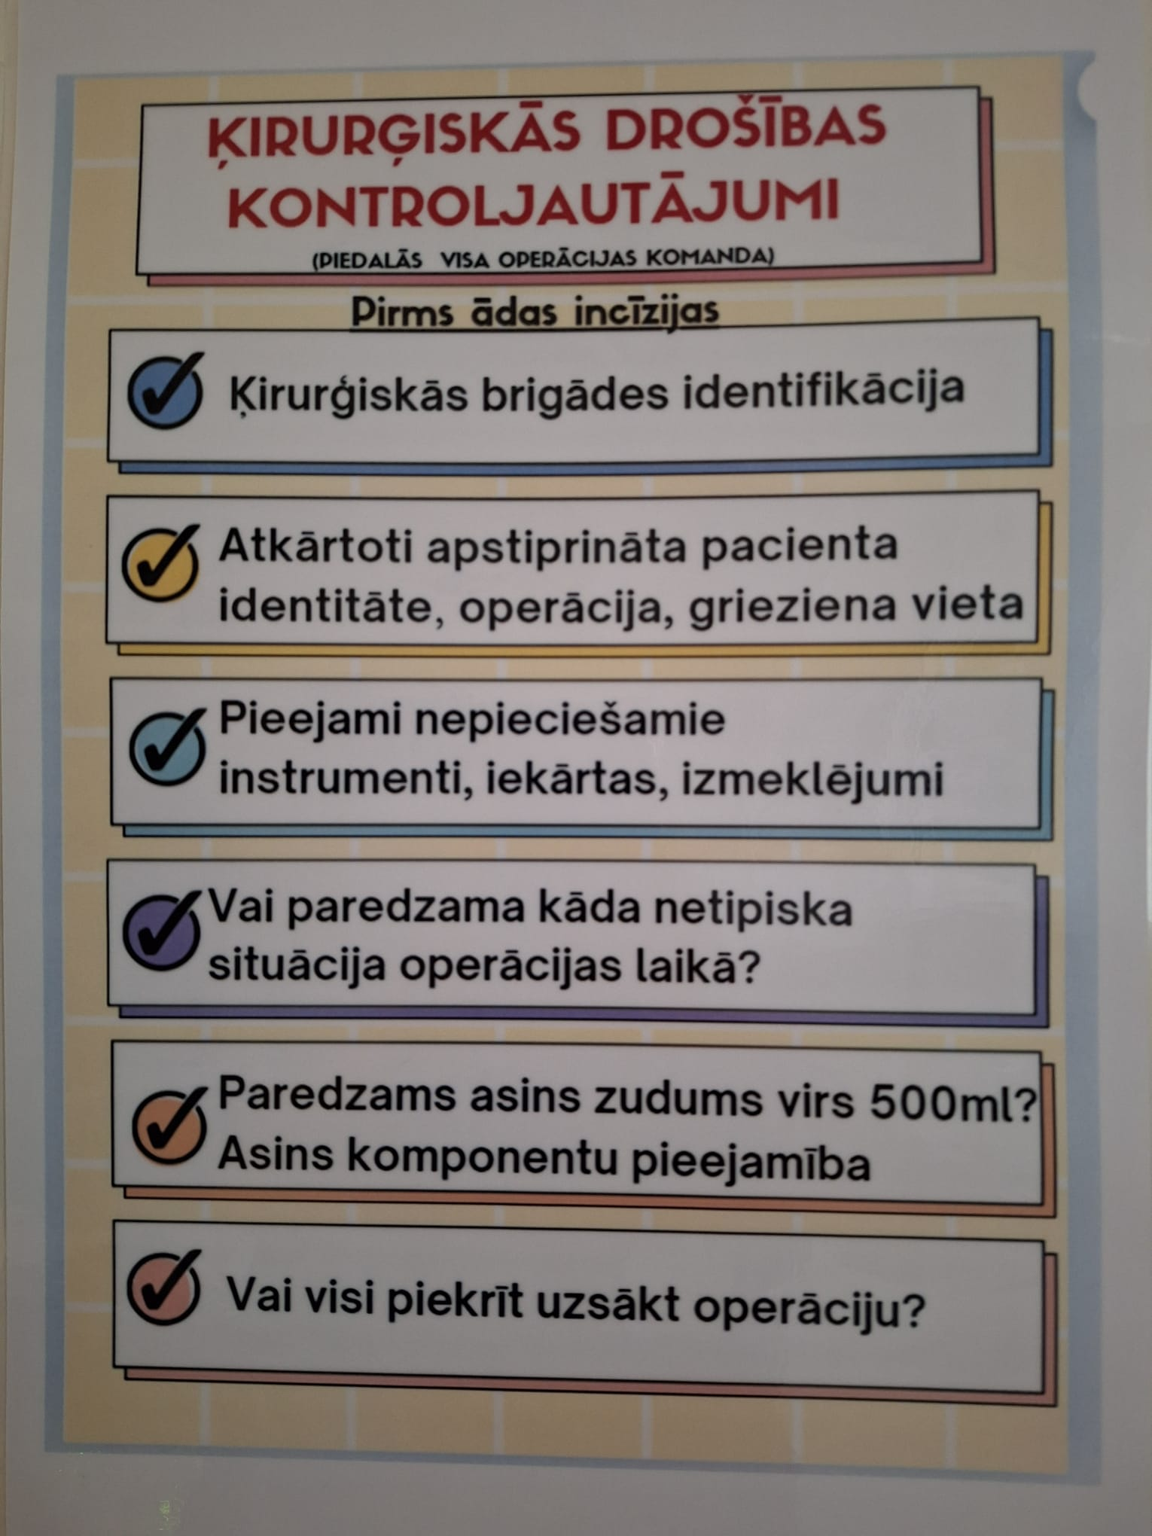
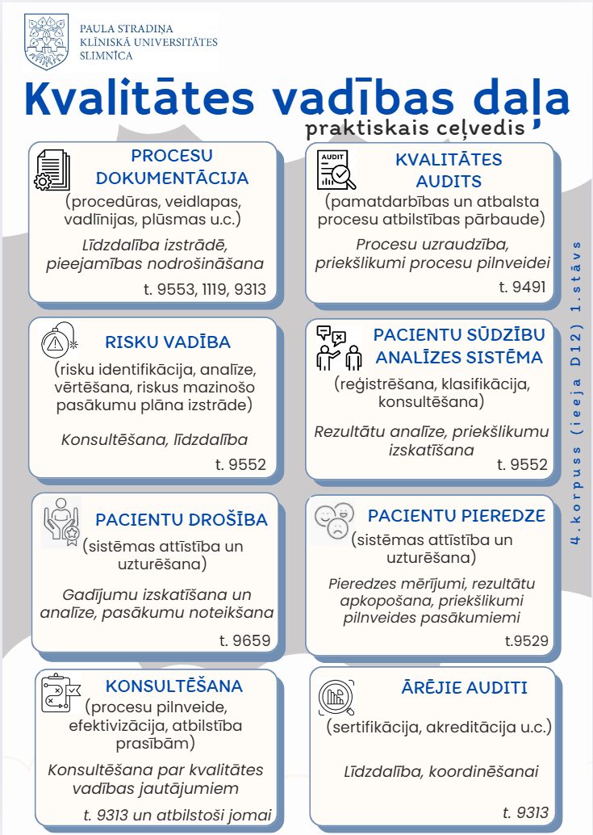
What we have done in new ways?
Visual materials

Slide 11
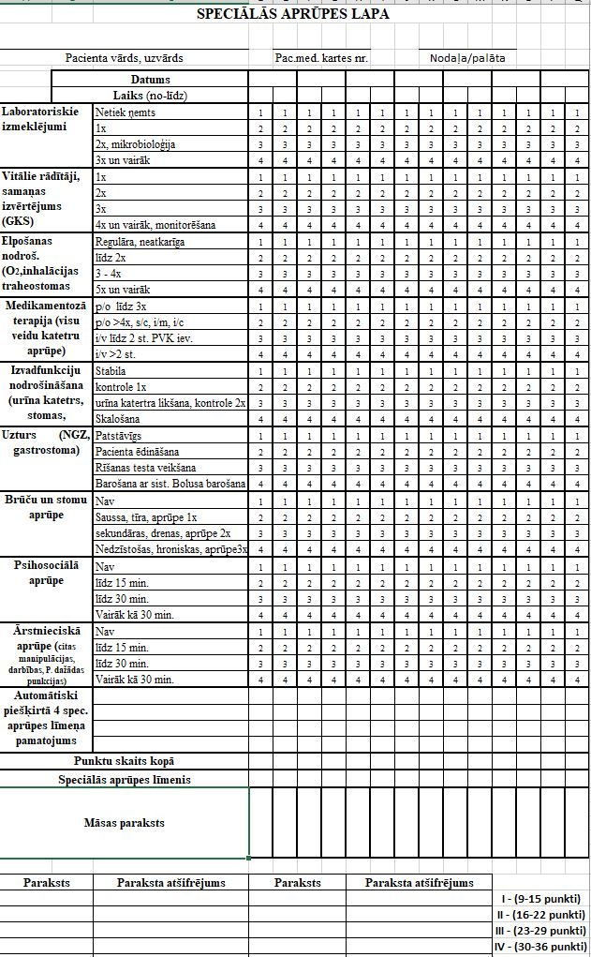
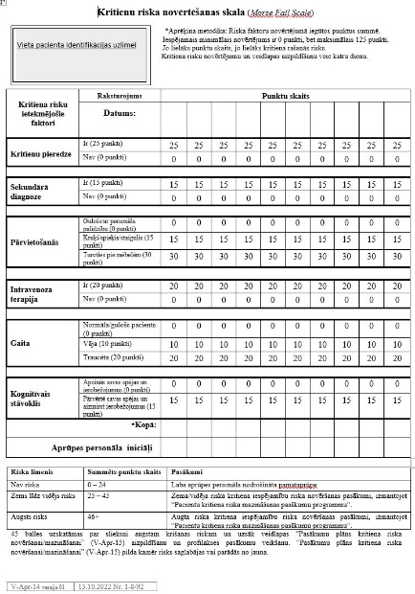
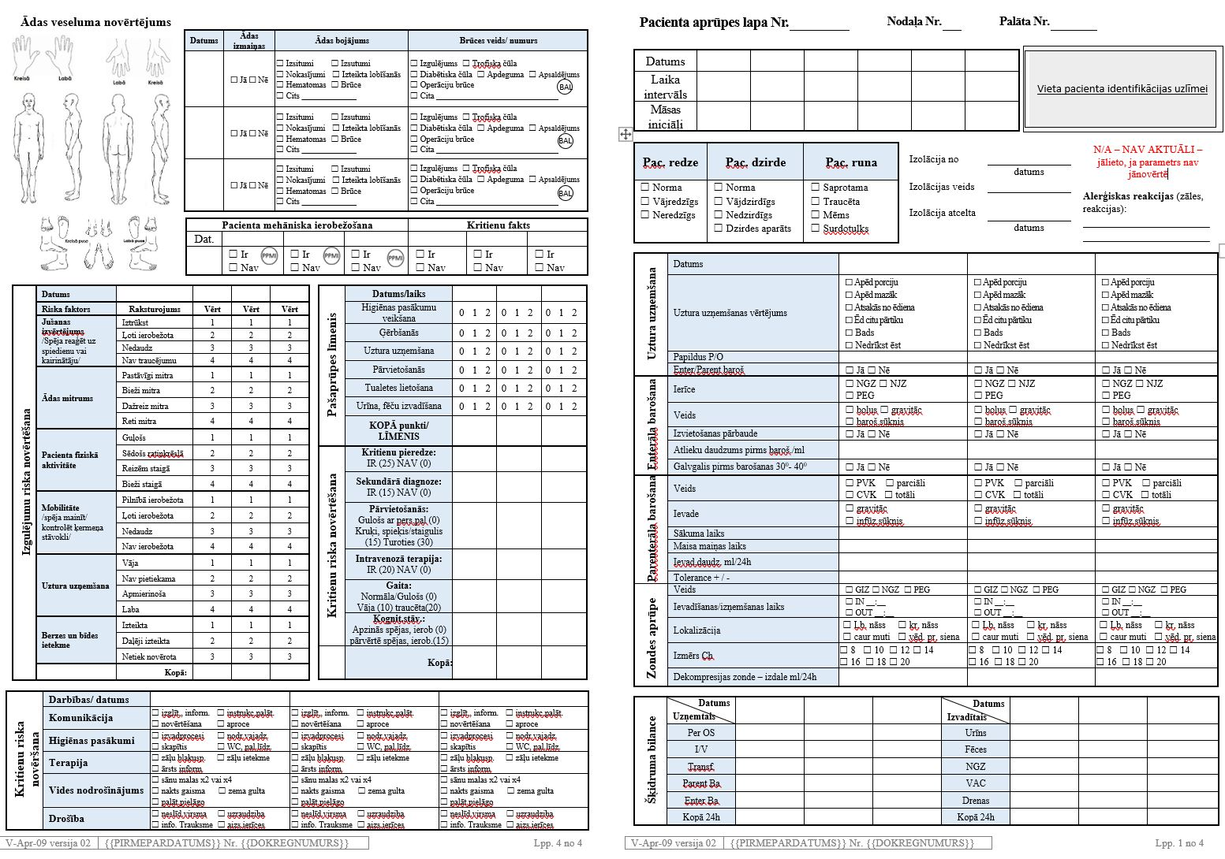
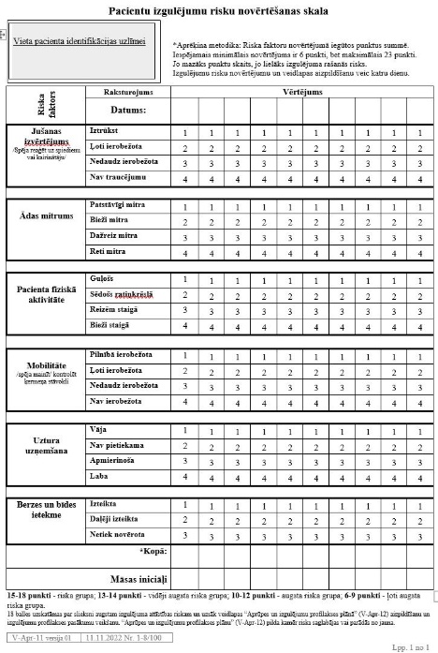
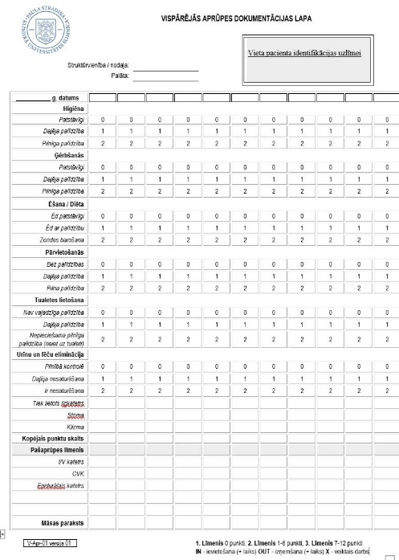
What we have done in new ways?
Reducing documentation

Slide 12
What we have done in new ways?
Digital internal regulations
Digital forms for daily workflows
e-Approval for procedures & documents
Digital infromation for patients
Self-service portals for staff

Slide 13
Roule of internal audit

Slide 14
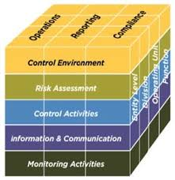
v
Internal control system –COSO model
Control environment
Risk assessment
Control activities
Information and communication
Monitoring activities

Slide 15
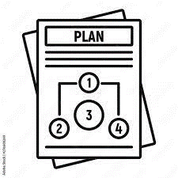
Crises management – internal audit
Framework
Cooperation
Risk identification
Reserves
Training
Internal regulations

Slide 16
What we found in practice?
Examples
Training
User-friendly
Definitions
Different training types we can use to be prepared for crises, how can we effectively give feedback after training
Discrepancies
Are the existing guidelines for action in various crises easy to use and will employees be able to perform the relevant actions?
Plan
Clear understanding of what is what, e.g. critical personnel, critical services
One combined plan form 3 different
Inconsistencies found in the plan

Slide 17
What changed?
One unified regulation document
Clear and easy-to-use guidelines
Less duplication, better ownership
Structured analysis approuch
Fresh eyes can see what familiar ones overlook

Slide 18
Can we go fully digital?
Key challenges, present situation, growth paths

Slide 19
Challanges
Multiple systems
Limited complex integration
Funding- dependent
Manual and duplicated data entry
Paper records
External requirements
Complex processes
We use information form systems during audits

Slide 20
How we use IT systems during audits?

Slide 21
Digital solutions
Digital forms & documentation
Integrated digital tools
IS applications for performance analysis
Digital information for patients
Artificial Intelligence
Digital quality management system

Slide 22
Digital quality management system
Clear and visual reports
User-friendly dashboards and summaries for better understanding and faster decisions.
Access to quality documents for all staff
Real-time access
Everyone can find up-to-date procedures, policies, and guidelines in one place
Immediate insight into reported incidents and trend in patient safety.
Centralized access to patient feedback and complaint handling status.
Structured overview of risks across departments with regular evaluation.
Activity tracking
Faster internal communication
Monitor whether quality actions and corrective measures are implemented
Quality-related updates, alerts and reminders available in-system.

Slide 23
Thank You!

