Slide 1
Towards value-driven regulation – insights from Dutch research
Roland Bal

Slide 2
Developments in Dutch healthcare
Increasing scarcity – workforce, medication, appliances
Moving from competition to planning and cooperation
Increasing centralisation of (complex) care
Moving towards integrating acute, long-term and social care
Increasing regional cooperation
‘Appropriate care’ policies
Ageing-in-place; eHealth; task shifting; person-centered care; etc.
Increased attention for resilience in case of external threats (climate, war)

Slide 3
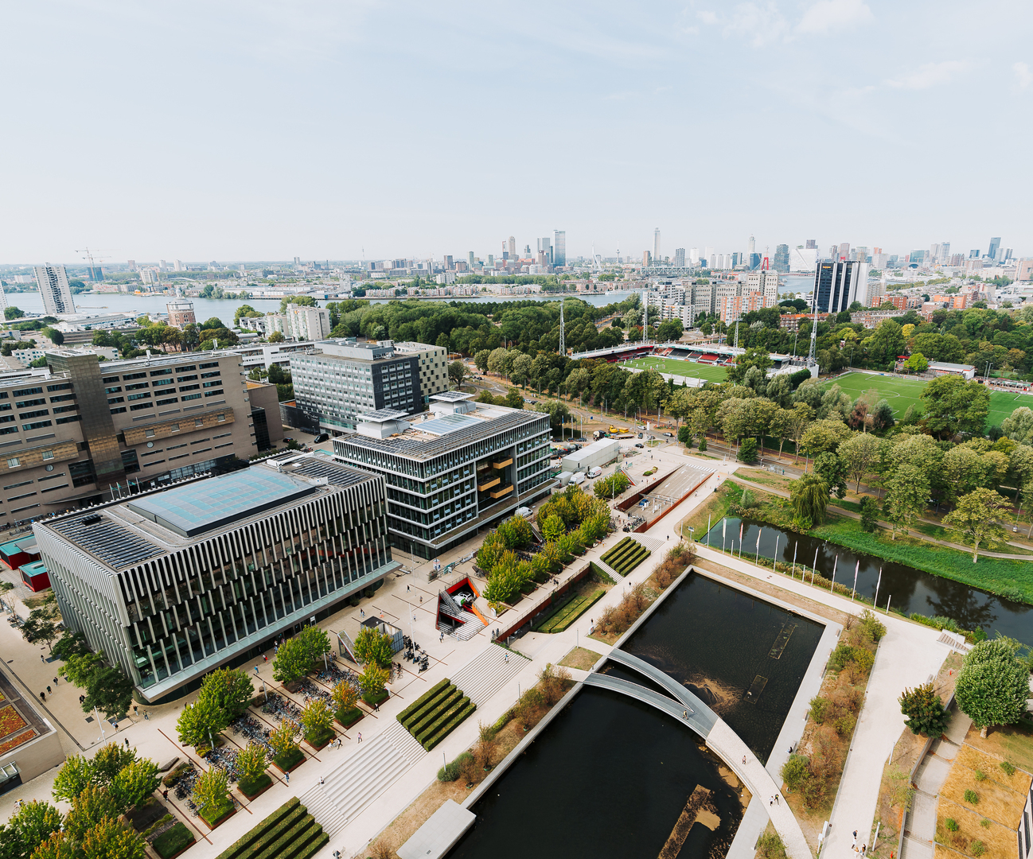
Expert Group on Health & Care Regulation
RESEARCH | 15+ years research on regulating quality and safety in health and care | embedded research at the Dutch Health and Youth Care Inspectorate
TEACHING | Erasmus International Regulator course in collaboration with UK, Norwegian and Dutch regulators | trained 76 regulatory professionals from 11 countries
ENGAGEMENT | Advisory and leadership roles with bodies such as the Dutch Health Council, WHO, Lancet, International Forum and Health Standards Organization
More information? Visit our website or email us

Slide 4
Consequences for regulation
Traditional assumptions of regulation and oversight no longer hold
Current quality standards hard to use
due to scarcity problems, networks, new themes (person-centeredness)
Who to hold to account for networked care?
Changing societal expectations
Decreasing trust & increasing expectations
Creating regulatory uncertainty

Slide 5
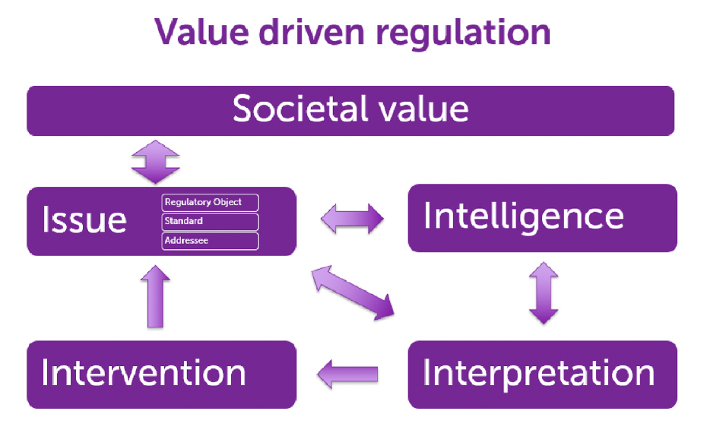
Regulating under uncertainty
Translating societal values
See regulation as including whole cycle – including defining regulatory object & addressee
Reassess regulatory strategies regularly (reflexivity)
Leistikow, Pot & Bal, Social Science & Medicine 2022

Slide 6
Regulating scarcity (1)
Societal values: equitable access; quality & safety; population health
Diversification of addressees and regulatory objects:
Health and social care facilities – what are they doing to cope? No scapegoat for bad quality!
Regulatory actors – redesigning regulatory frameworks
National government – changing policies, budgets

Slide 7
Regulating scarcity
Diversification in regulatory styles and skills needed
Reflexive regulation / narrative approaches
Move from checkbox to situated improvisation
Focus on soft signals and cultures
Example: RUN project

Slide 8
Reflexive regulation
Reflexive regulation – taking effects of regulation into account
Both ‘intended’ and ‘non intended’ effects
Considering possibilities of regulatees to comply
With an eye for ones’ own framings and how these affect regulatees
And on the network of other regulators
Especially important with people in vulnerable positions
Network effects unclear
No obvious addressant for regulation
Little knowledge about ‘good’ care
Lack of standards

Slide 9
RUN-study
Furthering reflexive regulation through narrative accountability
Focussed on people in vulnerable positions:
People with dementia living at home and their partners
Young people with severe mental issues
People with ‘distance to the labour market’
Collecting client stories
Reflexive sessions with regulators
Experimenting with narrative accounting
In cooperation with six regulators and client
organisations
More info, see project website

