Slide 1
“Wicked problems” - learning from regulatory challenges at the Care Quality Commission in England and other regulators
38th EPSO conference – 16/17 June 2025 - Jersey
Kieran Walshe
Professor of Health Policy and Management
University of Manchester, UK
kieran.walshe@manchester.ac.uk

Slide 2
Mission and purpose: compliance vs improvement
Compliance vs improvement in regulation – a false dichotomy
Compliance only regulation – “safety net” focused mainly on the worst providers, use regulations for enforcement, low/minimal impact and probably poor value for money
Compliance and improvement regulation – still deals with poor performance but also seeks to raise performance for all providers – more impact but what does this mean?
Maximal standards – ambitious and stretching, co-produced, with lots of clear, implementable guidance
Differentiation – a common approach but sector-specific, sensitive to organisation type, size, context, range of regulatory interventions
More routes to impact – regulatory direction plus exemplars of good practice, peer support and learning, engagement and advice

Slide 3
Regulatory impact: programme theory…

Slide 4
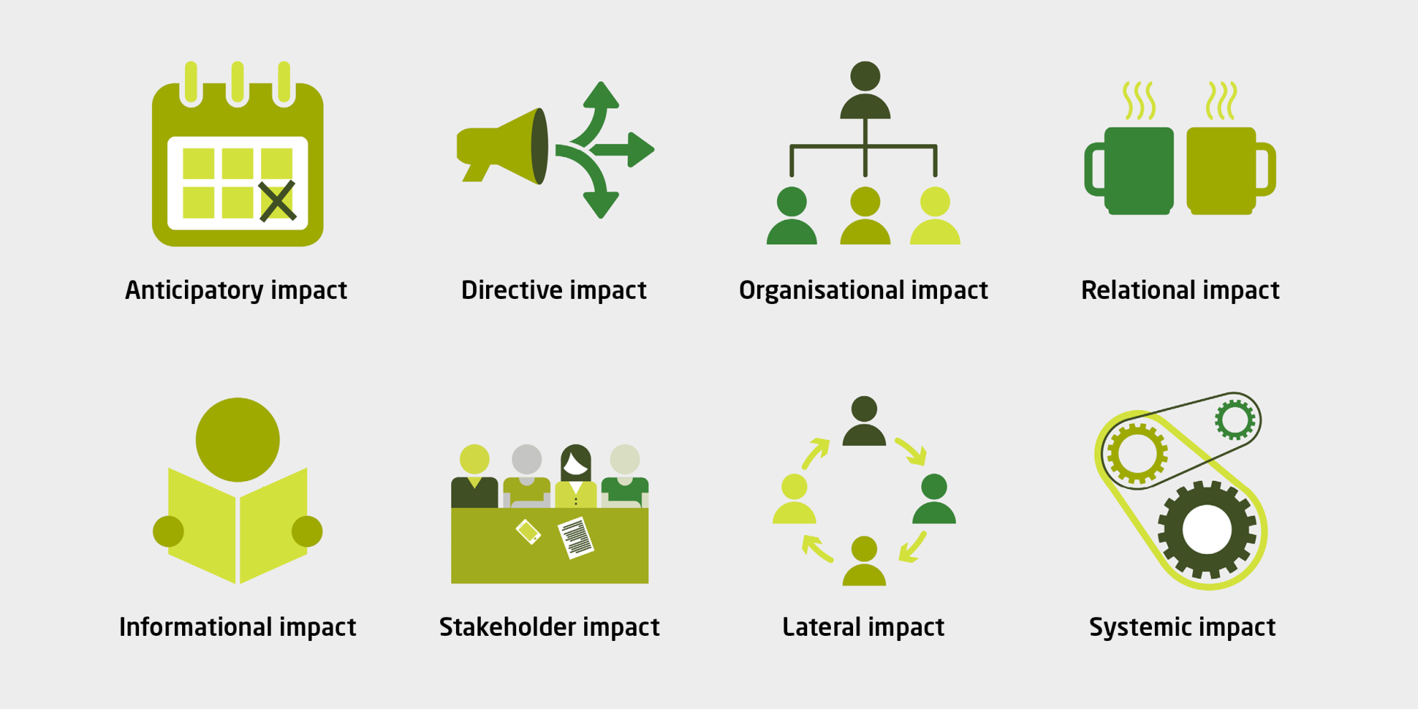
Regulatory impact: programme theories

Slide 5
Making and using regulatory judgements and ratings
Evidence –> Narrative judgement –> Quantitative rating
Ratings and judgements are a means to an end – impact and improvement
The need for professional judgement and discretion - does not mean relying on an instinctual, unevidenced approach – can be made manifest and consistent through peer review, training, calibration exercises, reviews
Quantitative ratings – the more granular and frequent, the more work and cost to produce and update – but may actually reduce reliability/consistency
Aggregation of ratings is problematic and complex – mechanistic additive aggregation rules produce results which are often at odds with professional judgement/face validity
Importance of narrative judgements alongside ratings – explainabiliity and credibility of judgements is key to improvement

Slide 6
People and relationships in regulation
However good the regulatory model, standards and processes – impact depends crucially on the people who enact and experience it
Regulatory workforce – need content expertise in sector, regulatory methods/process expertise, and relational/social skills in the team
Importance of training and professional development, career structures and opportunities for the regulatory workforce
Regulatory relationships with providers are important – value of continuity, expertise, mutual respect and trust – but can still maintain critical distance
Use of external professional advisors – bring vital content expertise and credibility but need to be supported, trained and deployed effectively (and to want to do it)

Slide 7
So many other things to learn as well…
Regulatory governance and leadership – balancing independence and accountability, getting stakeholder engagement, avoiding capture, securing strong board leadership
Regulatory reform – creating space for experimentation, testing and piloting, incremental vs wholesale changes, mainstreaming reforms, building in routine evaluation
Problem oriented regulation – horizon scanning and foresight, identifying and responding to future/upcoming regulatory risks and issues

