Slide 1
The role of regulatory authorities in investigating and addressing serious adverse events in healthcare
Dilemmas and possibilities
Einar Hovlid

Slide 2
Background
Adverse events are a significant and persistent challenge in healthcare that affect patients and their families.
What role should regulatory authorities have in investigating and following up serious adverse events in healthcare?
Norway is in the middle of a process where we are revising the law and developing new strategies for following up adverse events.

Slide 3
Serious adverse events in Norway
Service providers are mandated by law to report serious adverse events to the Norwegian Board of Health Supervision
Patients and families have a right to report both serious adverse events and less serious incidents to the Norwegian Board of Health Supervision
Norway has a patient injury compensation scheme where patients receive financial compensation in cases of malpractice or unexpected outcomes and side effects

Slide 4
Purpose
The purpose of supervision following notification of serious incidents is to quickly identify situations and conditions posing a risk to patients so that these can be followed up.
Upon receiving the notification, the Norwegian Board of Health Supervision conducts preliminary investigations to determine how the cases should potentially be followed up.

Slide 6
Key points in the proposed law
Frontline Changes:
  Enhancing safety in healthcare requires changes at the frontline where services are delivered.
Responsibility of Service Providers:
  Service providers hold the primary responsibility for examining and implementing suitable measures to reduce risks and enhance future safety.
Role of Regulatory Authorities:
  Regulatory authorities, through our oversight activities, aim to ensure that necessary changes are made to strengthen patient safety.

Slide 7
Background
The needs and expectations of society, patients and their families do not always align with the available resources
It is not possible to attend to all needs and expectations
We are about to developed a policy and strategy based on the premise that our main mission is to contribute to necessary improvements in healthcare. At the same time, this approach must be balanced against society's desires and expectations.
Reflect on some dilemmas

Slide 8
Case
A 40-year-old male admitted to the hospital with non-specific chest pain.
No other significant findings.
After initial assessment, he was placed in a room by himself in the ER.
The clinical guideline states that patients with chest pain should be monitored every 10 minutes.
The guideline was not followed.
The man was found dead in his room one hour later.

Slide 9
Psychological meaning-making purposes of investigations of adverse events
Epistemological: establishing what happened.
Preventive: identifying pathways to avoidance.
Moral: Accountatbility and need for restorative processes
Existential: finding an explanation for the suffering that occurred.
Sidney W.A. Dekker (2015) The psychology of accident investigation: epistemological, preventive, moral and existential meaning-making, Theoretical Issues in Ergonomics Science, 16:3, 202-213, DOI: 10.1080/1463922X.2014.955554l: finding an explanation for the suffering that occurred.

Slide 10
Establishing what happened
When a serious adverse event occurs in healthcare, the organization where it happened is best positioned to investigate because they know their own organization best
However:
Do they have the necessary experience and knowledge to do it?
Can the public trust what they find?
Will the system perspective receive adequate attention, or will the management responsible for the investigation focus on individual 'failures' to shift attention away from their own responsibility for systemic issues?

Slide 11
Preventive: identifying pathways to avoidance.
When a serious adverse event occurs in healthcare, the organization where it happened is best positioned to implement appropriate measures because they know their own organization best.
Is the organization capable and willing to implementing necessary change?
Public trust
Regulators can oversee that necessary improvement works takes place, but how should we prioritize our efforts and resources?
Notes:
What are sufficent improvement measures. How can we assess their effect, especially if they are designes to mitigate rear risks.

Slide 12
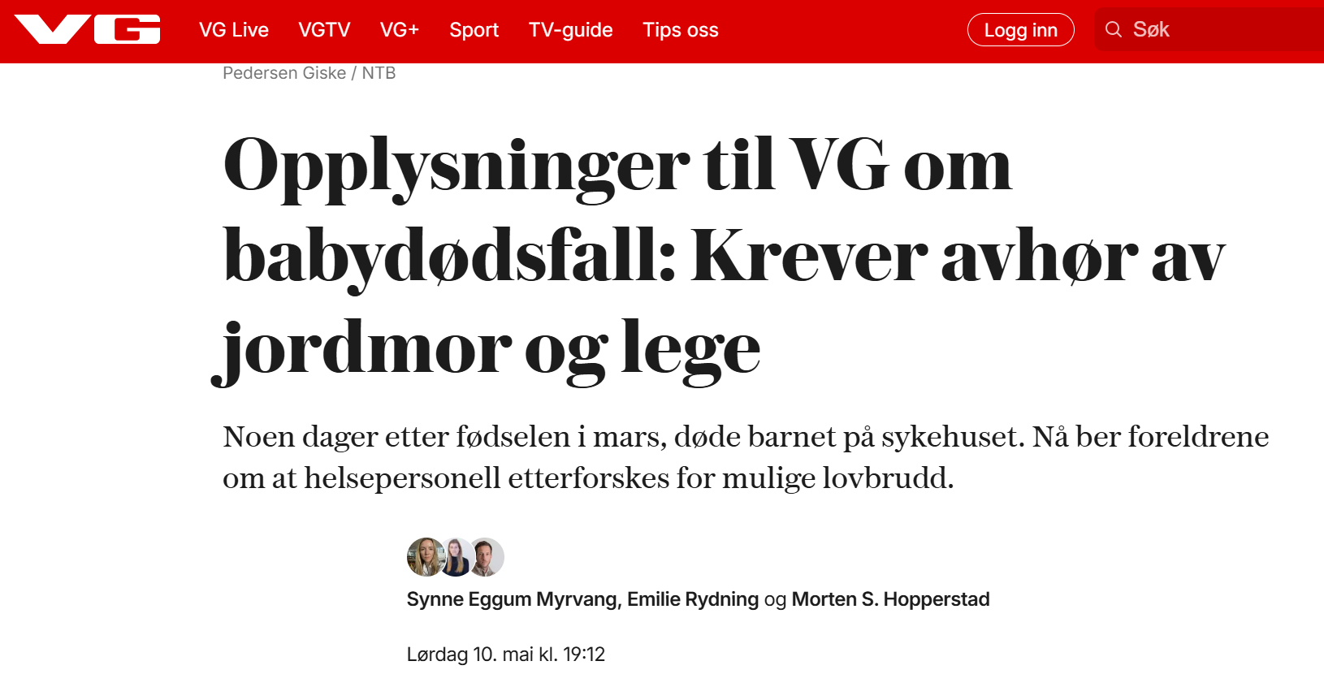

Slide 13
Moral: Accountatbility and need for restorative processes
Many patients and their families experience inadequate follow up and restorative processes after a serious event in the healthcare system
They might call upon the authorities to hold the service provider morally accountable
Establishing “right and wrong” and accountability after an adverse event is resource demanding
How can we best contribute to restorative processes?

Slide 14
Existential: finding an explanation for the suffering that occurred.
Adverse events can be incomprehensible
Dekker states that in a hyper-rational and largely post-secular society we have less strategies and “rituals” for dealing with the incomprehensible, but the need to do so still exists.
In line with the philosopher Augustine Dekker points out that:
people would rather feel guilty than helpless. (Dekker p 209)
people would be willing to accept versions of disaster where human suffering occurs because of human fault. (Dekker p 209)
If everything and everyone is responsible for ‘causing’ the mishap, then nothing or nobody really is. If ‘normal work by normal people’ lies behind the bad event then there is no reasonable way in which those people can be held to account. (Dekker p 210)
Notes:
Should and can reugluators play a role in this psychological need.?
Dekker states that : Implied in this is the conviction that the suffering caused by accidents is not supposed to happen; that a world in which risk is controlled, contained and its consequences absent is not only desirable but feasible.
This understanding and expectations can divert attention away from the system perspective that schoolars of safety science point out is vital to understand and improve safety.
When and how should we engage in “ritual” investigation and follow up to attend to the needs of society?

