Slide 1
WELCOME to Jersey by EPSO
* Jooske Vos
* Indra Dreika
Thank you, States of Jersey!
And thank you Minister Steve Luce, for welcoming us at your beautiful, interesting, well organised and healthy Island !
TH
38 EPSO CONFERENCE
JERSEY
JUNE 16-17 2025
Thank you JCC ! - Becky Sherrington and Team- for making this conference possible at this extraordinary location
#EPSOJersey2025

Slide 2
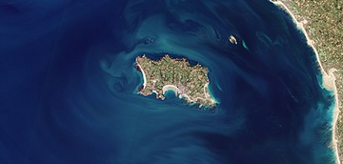
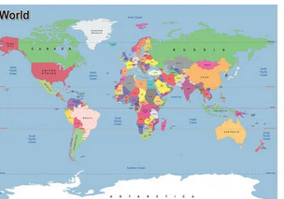
38 EPSO CONFERENCE, JERSEY
TH
What a challenge for such a small Island
to invite the EPSO colleagues
from all over the world
However: What a result !
#EPSOJersey2025

Slide 3
38 EPSO CONFERENCE, JERSEY
TH
Thanks to our host Becky Sherrington & her well organised team this conference is setting history in many aspects:
This is the first conference in our history ‘sold out’ already 2 month’ in advance!
For the first time we have prepared in advance online all panel discussions and moderation; a great improvement for our procedures in the future as well.
And another kind of innovation…for the first time we have a Museum tour combined with an overwhelming choice of activities to prepare for that tour ! How many things can you see/ learn in one hour 🙃we will find out🤔
#EPSOJersey2025

Slide 4
38 EPSO CONFERENCE, JERSEY
TH
But it wasn't always easy to fit all 55 of us into this small island!
First, the challenge of the date
we had to change our conference dates 😂😂
Then we had the challenge with the dinner
No staff on Mondays; So, we had to change the dinner location overnight
Even at this small island we found an extremely helpful and flexible Royal Yacht hotel to fill the gap. Thank you, Royal Yacht, Thank you Valter Fernandes!!
#EPSOJersey205

Slide 5
38 EPSO CONFERENCE, JERSEY
TH
Finally, we had the challenge with our traditional 50-seat-long U-shape EPSO table;
Suddenly there were pillars standing in the conference room 🤔🤔
We solved this problem nicely by inviting some of you to sit in the heart of our U-shape as if it was a canal boat 😂😂😂😂 Nice and Cosy.
You are welcome to complain with me about this 😎😎.
#EPSOJersey2025

Slide 6
38 EPSO CONFERENCE, JERSEY
TH
Again, all of this has been made possible thanks to the continued flexibility and dedication of Becky Sherrington and her team,
Thank you, Becky !
Hopefully, we will say afterwards all together:
What a great result !
#EPSOJersey2025

Slide 7
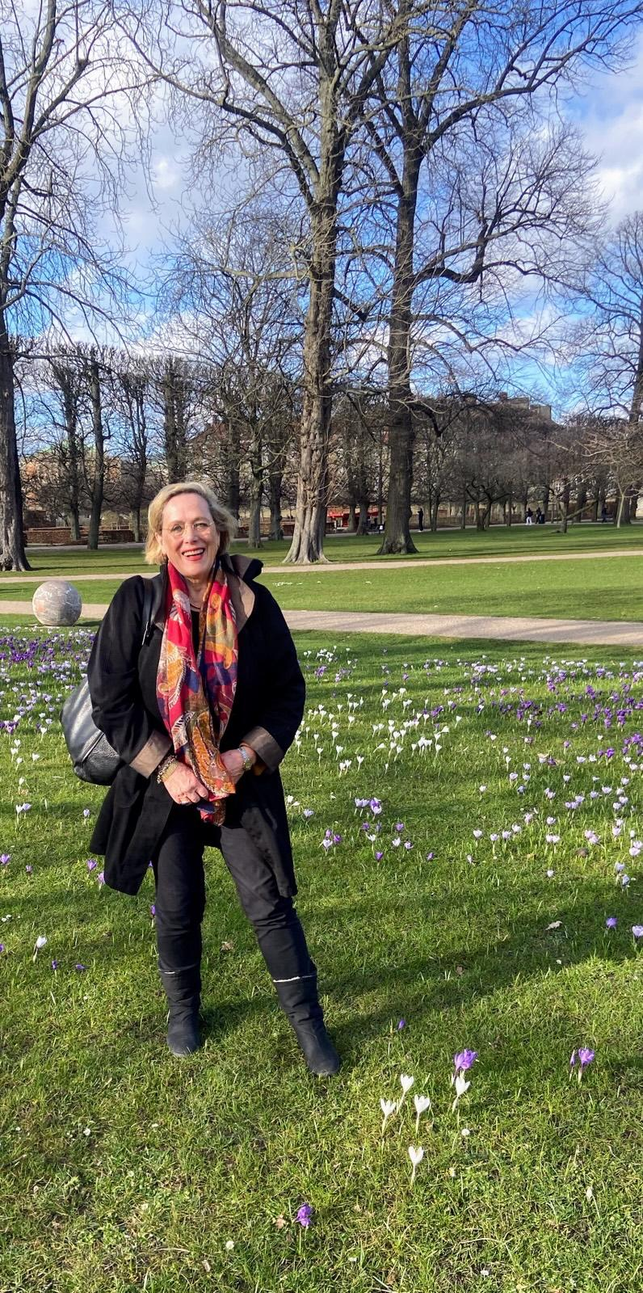
38 EPSO CONFERENCE, JERSEY
TH
But before we start this 38th EPSO conference I was asked to reflect briefly on EPSO and share some of my personal impressions
based on my own history of 33 conferences with EPSO since 2008.
based on the main characteristics of our EPSO Conferences.
#EPSOJersey2025

Slide 8
38 EPSO CONFERENCE, JERSEY
TH
My history with EPSO
The interesting thing about my first EPSO conference in 2008 in Denmark
EPSO MEETING (5th)
COPENHAGEN DENMARK
22ND AND 23RD OCTOBER 2008
PROGRAMME
HOTEL NEPTUN 28. august 2008
Wednesday 22nd OCT 2008 Thursday 23rd OCT 2008
EPSO MEETING (5th)
COPENHAGEN DENMARK
22ND AND 23RD OCTOBER 2008
PROGRAMME
HOTEL NEPTUN 28. august 2008
Wednesday 22nd OCT 2008
17:00 Welcome session
Discussions of outcomes of ISQUA conference and networking
19:00 Dinner
Thursday 23rd OCT 2008P
09:00 International scene - accreditation research
Prof J Braithwaite
10:00 Coffee break
10:30 Presentation of Danish model for accreditation
Anne Mette Dons
12:00 Presentation of current situation in UK
13:00 Lunch
14:00 Service level accreditation - stroke pilot project
M Cheshire
#EPSOJersey2025

Slide 9
38 EPSO CONFERENCE, JERSEY
TH
My history with EPSO (5th EPSO conference in 2008 in Denmark)
At the start: all are very very different
At the end of the day: everyone had so much in common, much more than thought before:
Problems and Questions often the same;
Solutions often in same direction;
Cooperation and Learning are key !
Result: EPSO focuses on common ground for various ways to learn from each other, find solutions and go for improvement of regulation!
#EPSOJersey2025

Slide 10
38 EPSO CONFERENCE, JERSEY
TH
Looking at topics at our conferences over the years,
two observations:
The topics at our conferences are surprisingly similar and have not changed significantly over time.
EPSO has been always in the forefront of developments and innovation (but also here an enormous continuity in topics over time in our conferences)
#EPSOJersey2025

Slide 11
38 EPSO CONFERENCE, JERSEY
TH
Some examples of continuity of topics in our conferences
- Integrated care started in 2017 and continued
- Adverse events and effectiveness started in 2018 and continued
- End of life care started in 2023 and continued
- Patient participation and involvement started 2013 and continued
AI- Cyber and E- health started in 2015 and continued
Digital Health started in 2022
Climate change and implications for health started in Singapore 2022
Ambulance care started in Malta in 2023 with digital health in Australia
#EPSOJersey2025

Slide 12
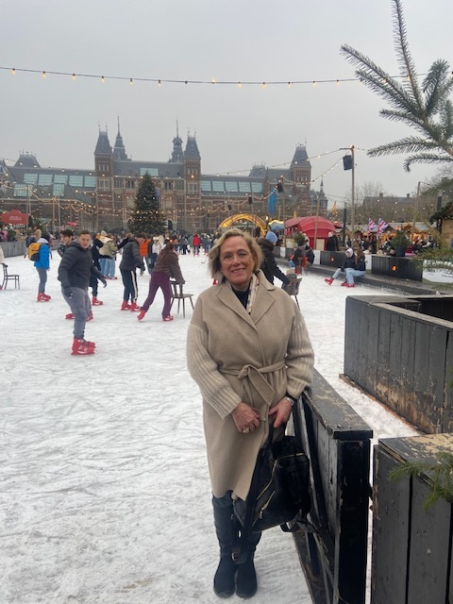
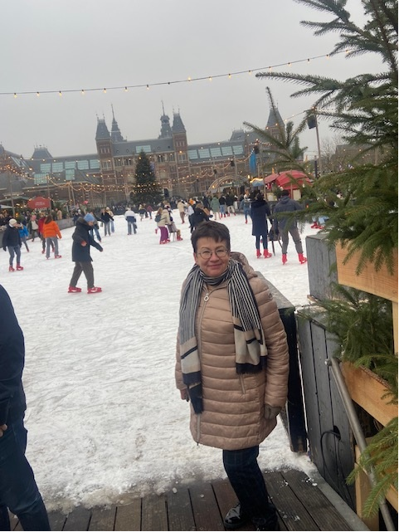
38 EPSO CONFERENCE, JERSEY
TH
But most important:
All 33 EPSO conferences had one thing in common:
It is fun to get together with colleagues in a safe and welcoming international environment ; to be able to talk freely with colleagues about what is on your mind.
Wish you the best conference ever ! Have fun !
#EPSOJersey2025

