Slide 1
Adverse Events
Leading quality health and care for Scotland
Notes:
Thank you for inviting us today. We plan to offer a brief summary of the work we are doing and our plans for this year. If you wish to know more about our work please do drop us an email

Slide 2
Learning is key
A National Framework for Reviewing & Learning from Adverse Events in NHS Scotland
National Adverse Events Learning Group
Community of Practice
Notes:
Learning from adverse events is always at the heart of our quality management system and at the core of the adverse events team programme.
In February this year we published the new adverse events framework – A national framework for learning from adverse events in NHS Scotland . I will tell you more about our new framework in a moment.
In addition to the publication of the framework we have relaunched our adverse events network as a national adverse events learning group. We want to ensure there is a national focus on learning – so we will include spotlight sessions, deliver webinars and create an opportunity for a peer support session after each meeting.
Our online community of practice is an interactive platform that also seeks to create and promote a culture of learning and improvement. It is based on the ethos; everyone has something to share, everyone has something to learn and the opportunity to contribute. Our hope is that through fostering this culture it will support in reducing the potential of future harm occurring and will support the sharing of learning. Initially we will welcome learning summaries being uploaded by Scottish NHS Boards, these can then help inform improvements in other boards. As the community of practice develops, we would hope it will expand and grow to allow for searches of adverse event categories, create and share events and promote news items.

Slide 3
The framework
Patients and Family
Staff
Implementing Learning
Governance
Revised Risk Matrix
Patient, family & caregivers
Standardised national reporting
Systems for learning
Support for staff incl. psychological safety
Appropriate timelines
Good quality reviews
Partnership working
Notes:
In February of this year, we published our new framework - ……..
The new framework has a focus on
patients and families – and ensuring that they are included in the review, from establishing the terms of reference and identifying questions they want answered, to being informed throughout the process and included in factual accuracy checks when the report is drafted. The appointment of a named person aims to ensure the patient/family are supported and well informed throughout
Supporting staff is a key aspect of the framework, from ensuring psychologically safe working environments, to a culture where recognising near misses and identifying adverse events is the norm, to supporting staff when an AE occurs
There is also a focus on implementing learning - moving beyond the development of an action plan to ensuring that there is accountability and ownership of the implementation of recommendations and evaluation of their impact

Slide 4
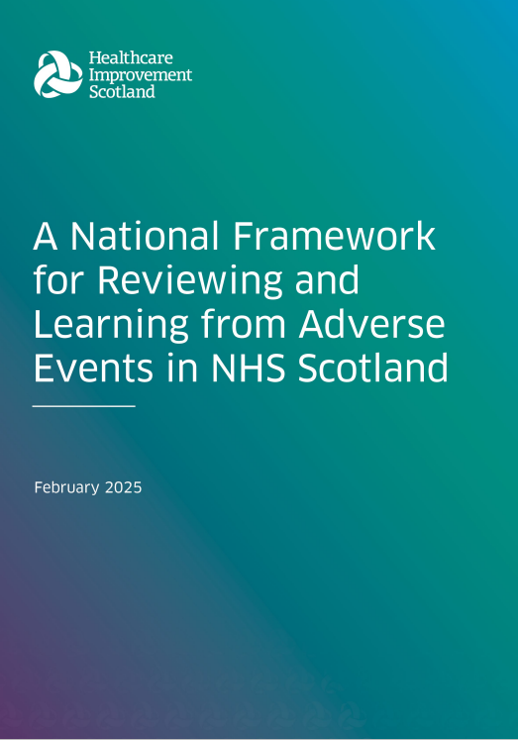
The framework
Patient, family & caregivers
Standardised national reporting
Systems for learning
Support for staff incl. psychological safety
Appropriate timelines
Good quality reviews
Partnership working
Notes:
For the first time we included our priorities and our aims in the framework
We also included practical tools to support boards. We have
A SAER template and guidance,
A learning summary
A quality assurance checklist
And a revised risk matrix
These are all on our website alongside an animation for patients and families

Slide 5
HIS priorities
Use data to maintain and improve quality.
Thematic and qualitative analysis.
Maintain and plan for quality.
Publicly reporting on performance.
Patient, family & caregivers
Standardised national reporting
Systems for learning
Support for staff incl. psychological safety
Appropriate timelines
Good quality reviews
Partnership working
Notes:
We have set our aims out within the framework clearly which includes: to seek to ensure greater transparency about adverse events. To use data and intelligence about adverse events to inform priorities for improving the safety and quality of care in NHS Scotland
We have identified and published priorities which we believe will support us in delivering that aim.
These include the:
use of data from the national reporting to inform a range of interventions and initiatives undertaken across Healthcare Improvement Scotland
• undertake thematic and qualitative analysis of data (including learning from AE reviews) that we receive to improve quality.
•and publicly reporting on the performance of significant adverse event reviews and adherence to our framework, including the engagement of patients and families and completion within the specified timescales

Slide 6
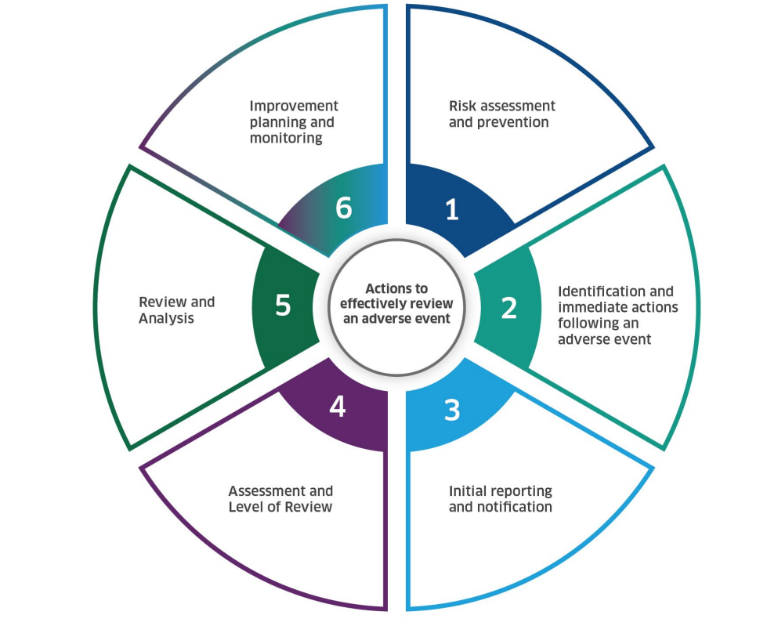
The way forward
Notes:
In our revised framework we included the methodology which was in the 2019 framework, which consists of the 6 stages of review and the levels of review. However, we recognised that the use of categories to trigger levels of review was subjective, and there is a lack of consistency. We have heard form NHS boards that a proportionate review process would mean that both harm, or potential harm combined with the potential for learning should determine the type of review to ensure the best outcome for patients, families and staff.
We also know that we need national oversight of the number of Significant adverse events that occur, so that we can monitor trends and provide a national response for patient safety. Our current system monitors the number of SAERS, not the number of significant adverse events. To avoid confusion I must explain that a SAER is the term we use for the top level of review in NHS Scotland.
While we review the categorisation of reviews we are exploring a notifiable events system. This notifiable events system would aim to gather information from every Scottish NHS board on the occurrence of a range of significant adverse events, and the type of review undertaken, and, in time the contributing factors identified.
This would give us more data and intelligence to allow for more analysis and monitoring over time to support the safe and effective delivery of care.For example we could monitor medication events, the type of medication and the BNF category. If there is a tend emerging in a board or across the country our specialist team would provide support and guidance.

Slide 7
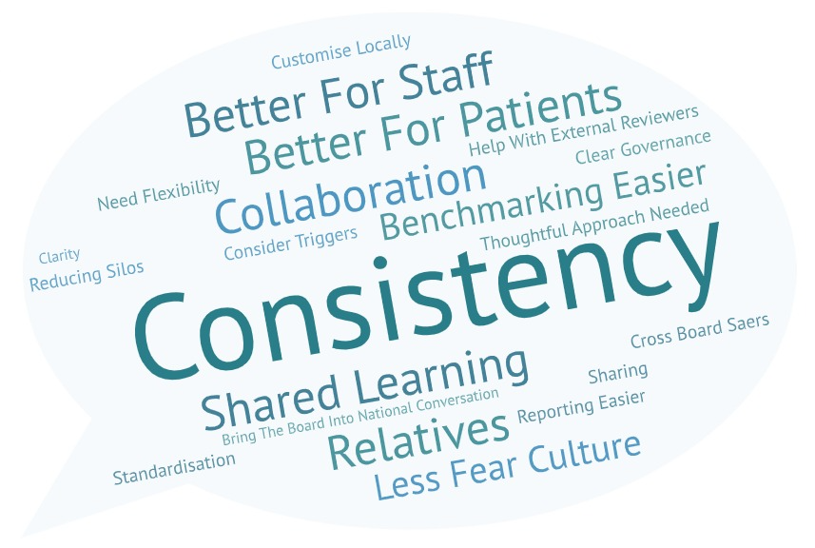
Potential benefits of a notifiable events system:
Notes:
Over the past 2 months we have met representatives from every board in Scotland and discussed the potential for this notifiable events system to gather data about significant adverse events.
From our recent discussions with boards, we were really enthused to hear a lot of positive reasons to develop this system. This slide reflects what NHS boards told us including – that it would
Develop national consistency would impact positively on both our staff, patients and families.
Promote a learning culture to drive away fear &
It would also facilitate opportunities for benchmarking and national learning.

Slide 8
Potential challenges of a notifiable events system:
Notes:
However boards also told us of their concerns about the impact and challenges of a notifiable events system.
This slide represents sone of the concerns identified.
We have assured boards that we want to work collaboratively to ensure that the notifiable events system does not become a never events list.
We have emphasised the intention is that it will be used to gather data to support patient safety and quality of care, that it will promote reviews of near misses and occasions where harm has been minimal but there is potential for organisational learning.
We recognise that local variance will support reviews being undertaken for adverse events which are not on our database and that this cannot be lost.

Slide 9
Range of Significant Adverse events
Absconsion or abduction, including unauthorised or unknown departure from ward
Deterioration
Diagnosis - delay or failure to diagnose
Unexpected death
Falls with harm
Cardiac Arrest
Patient death or serious harm as a result of failure to identify and treat metabolic disturbances
Air embolism
Maternal death;
Neonatal hypoxic-ischaemic encephalopathy (HIE) requiring therapeutic hypothermia;
Unexpected stillbirth during inpatient stay (includes intrapartum stillbirth in any setting, using Each Baby Counts definition of intrapartum stillbirth – see Appendix C)
Unexpected neonatal death (>37 weeks) within 7 days of birth.
Medication error: wrong drug including allergies
Medication error: Wrong dose, time or duration
Medication error: Wrong route of administration
Medication error: Essential medication missed medication
Suicide
Self-Harm / self-injurious behaviour
Rong patient treated??/
Wrong patient received surgical treatment
Wrong site surgery
Wrong implant/prosthesis
Retained foreign object post procedure
Patient death or serious harm arising from the use of improperly sterilized instruments or equipment provided by the health care facility
HAI/ Infection Prevention & Control
Errors in blood or blood product administration
Any stage III or IV pressure ulcer acquired after admission to hospital
Stage III and IV pressure ulcers
Treatment - delay
Treatment - Incorrect /inappropriate
Treatment - complication
Treatment - failure to carry out relevant investigations/ actions
Misplaced naso- or oro-gastric tubes
Errors in radiotherapy (wrong patient, body region, procedure or dosage)
Blood incompatibility
Manifestations of poor glycemic control
Use of physical or mechanical restraint resulting in serious harm or death
Burns
Physical or sexual abuse or assault of any patient, staff member, visitor or vendor, either on-site or while involved in care
Notes:
Don’t panic we don’t expect you to read this whole list, however it is intended to give you a snapshot of the wide range of notifiable significant adverse events covering the whole of healthcare.
This is an initial draft and we are about to commence workshops tomorrow to explore what events should go into the notification system and how we add additional detail to ensure that these are the significant adverse events that we need to monitor.
Our hope it to have a notifiable events system up and running this year

Slide 10
Questions?
Email us at his.adverseevents@nhs.scot
Notes:
Thank you, and please do email us if you would like more information

