Slide 1
Enhancing Inspections through the Use of Digital Tools: Case Studies of Data Driven Enforcement
Carola Bertone, Junior Policy Analyst
Regulatory Delivery Programme, OECD

Slide 2
Agenda
I.
Identifying non-conformity situations through the web
Webscraper instrument and TripAdvisor
Increasing equity in inspections
Noise in food safety inspectors’ decision making process
II.

Slide 3
Targeting non-compliance situations (I)
When data is scarce—revealing only the tip of the iceberg
Web-based tools can detect and address non-compliance
Notes:
IT and inspection findings enable data-driven enforcement

Slide 4
Targeting non-compliance situations (II)
Non-compliance situations:
A. Businesses are unaware of certain regulations due to the complexity of the regulatory framework
B. Businesses intentionally avoid compliance

Slide 5
 | If lacking adequate data repository, one of the biggest challenges is identifying situations of non-compliance: How to acquire unknown information?
 | How to increase availability of data through social networks?
Using data from social networks

Slide 6
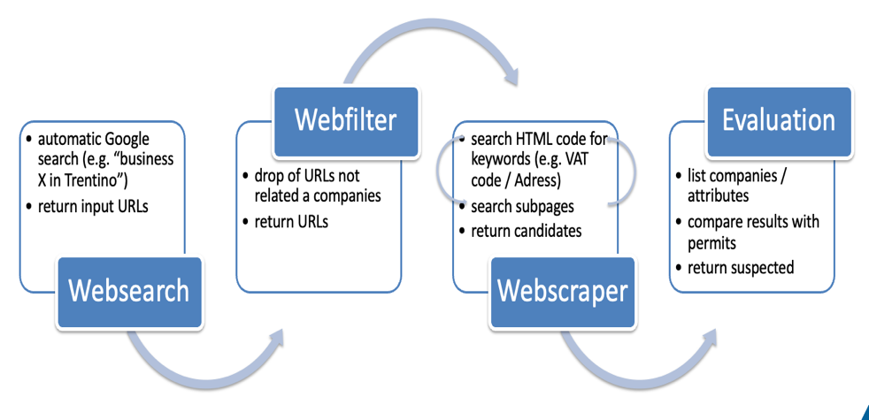
Web scraper – Provincial Agency for Environmental Protection (Trento)
Q: Are all businesses operating in the sector in possession of authorization? How to verify it?
H: Most businesses require an online presence for commercial and advertising purposes. By law, businesses in Italy must indicate their VAT number on their website, which can be compared with the registry held by the authority.

Slide 7
Social media platforms to enhance inspections effectiveness: TripAdvisor – Lazio Region
Q: Is the competent authority able to identify all risk situations? How to collect reports from citizens?
H: Based on international experiments (e.g., Las Vegas, San Francisco, New York), it has been proposed the use of restaurant reviews posted by customers on social networks

Slide 8
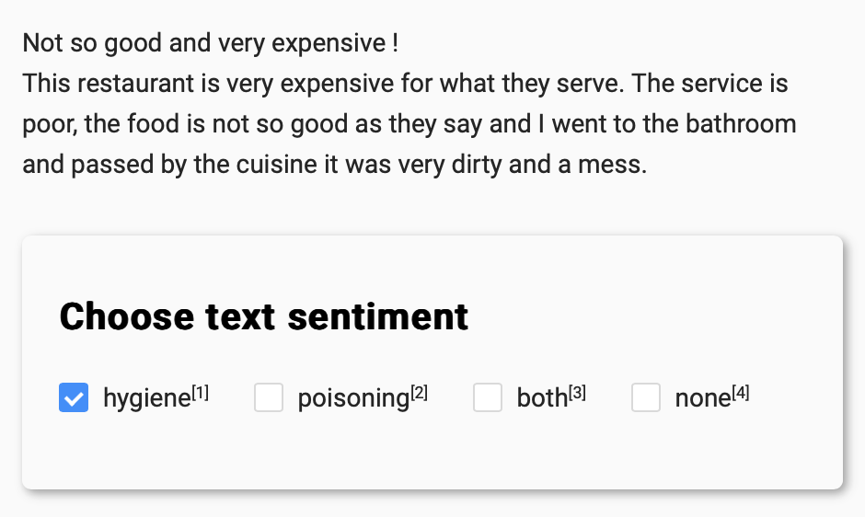
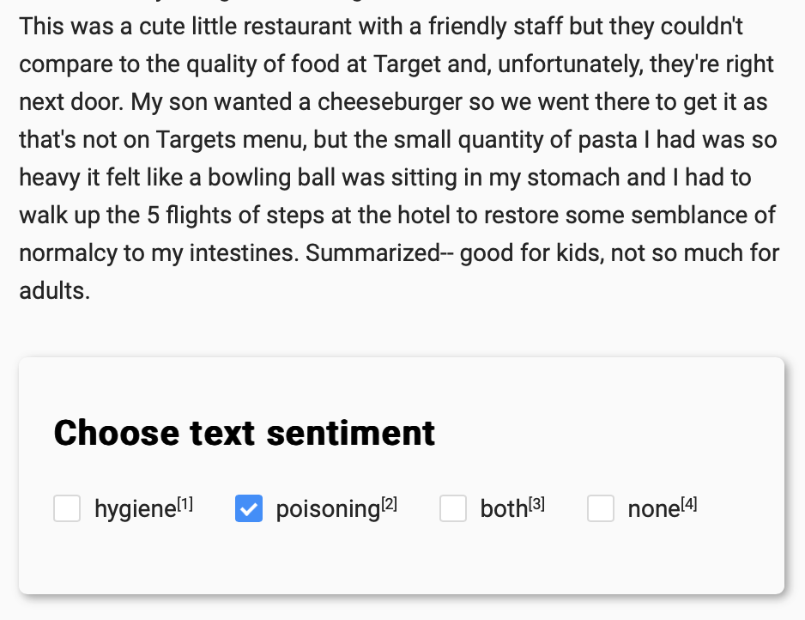
Hygiene and poisoning sentiment in reviews
random selection
dataset supervision
30% from keywords filter
24% from ★ reviews
2M reviews
19% from ★★ reviews
5k reviews
14% from ★★★ reviews
9% from ★★★★ reviews
4% from ★★★★★ reviews

Slide 9
TripAdvisor – Lazio Region (Food Safety)

Slide 10
The Lombardy Region carried out an "audit" to identify differences in the inspectors' judgement in the inspection phase, correct them and thus standardise the decision-making process
Noise

Slide 11
Improving inspections’ fairness
Errors in human judgement
Noise
Unwanted variability in professional judgments
Average error in judgements - particular error that inclines your judgement in a particular direction (-> all in the same direction)
Bias
Easier to measure and easier to control – can be reduced but not deleted
Can go unnoticed and lead to unpredictable and inconsistent outcomes
Easier to detect
Notes:
Probability of harming a public good: How likely is it that a potential harm happens to people, the environment, or another public good?
Impact of harm should it happen: How severe could be the potential consequences of a harm?
Being able to answer these questions can lead to better prioritisation of inspections. It is also important to separate both concerns correctly, as they factor differently in the calculation of the general threat to consider.

Slide 12
Improving inspections’ fairness
Starting question: How to identify inspectors' judgemental variability and avoid inefficient and unfair decision-making?
Goal
Build a noise correction model and reduce judgement variability
Experiment
Group of inspectors working together without influencing each other
Using the same scorecard and visiting the same businesses
Analysis
Areas of divergence in the overall evaluation and potential outliers
Next steps
Use of video-recording of inspections and virtual reality headsets (evaluation and training)

Slide 13
Thank you!
Carola Bertone
carola.bertone@oecd.org

