Slide 1
Long-term care policy in France: an overview of recent IGAS reports
Fabienne Bartoli, Louis-Charles Viossat
Inspector General of Social Affairs, France

Slide 2
The number of dependent elderly persons is growing fast

Slide 3
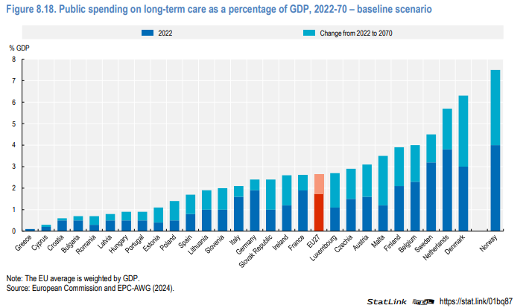
Public spending on long-term care policy is growing but remains limited and skewed towards non-home-based long term care

Slide 4
IGAS evaluated this key policy issue from three perspectives
Specialized care systems for people with neurodegenerative diseases
Report released in 2022
Interviews of 200 stakeholders
Field visits in 5 regions
1,200 persons and institutions surveyed online
« Feeling at home wherever you are » : the challenges of home care
Report released in 2024
400 stakeholders interviewed
Field visits in 12 departments
Original data analysis by data unit
Future of long-term healthcare units (USLD)
Report not yet released
Expert group

Slide 5
The French landscape of elderly care includes different segments
Home care and nursing homes
Long-term healthcare units
Specialized care services
76% of dependent elderly persons living in their homes
22% living in 7 400 nursing homes (EHPAD) with 600 000 beds
Average stay in EHPAD: 2 years
2% in alternative homes (« résidences seniors, résidences services »)
600 USLD with continuous medical supervision of patients
30 000 patients
80% of patients are very dependent (GIR1 or 2) vs. 59% in EHPAD
1,2 million people directly concerned by neurogenerative diseases
1 in 3 aged 90+ and 50% of nursing homes residents
2 500 Alzheimer Units
3 000 PASA, UHR, UCC and ESA

Slide 6
The shift towards home care is faced with several issues
A current policy orientation (le « maintien à domicile », « home care shift »)
Preconditions of success are not met yet
Fewer potential caregivers, and risks of family workers withdrawing from labor market
HR shortages
Lack of services adapted to elderly persons with neurodegenerative diseases
Increased financial costs for families
Mismatch between target audience and actuel residual needs in alternative homes

Slide 7
Nursing homes and USLD are faced with severe issues too
Insufficient nursing homes capacity
Inadequate nursing homes infrastructures (architecture, environment) for elderly patients needs, including Alzheimer
Insufficient alternative homes capacities
HR shortages, including specialized HR for Alzheimer patients in nursing homes and USLD
Imbalanced supply of services across territories

Slide 8
There are significant risks if ambitious public investments are not made towards dependent elderly persons
Risks of mistreatment at home and in institutions, risks of abuse of weakness
Overload of nursing homes
Deterioration of living conditions and support for dependent elderly persons
Strain on the healthcare system for all patients, with additional hospital costs
Development of unregulated care methods for vulnerable elderly people
Labor market impacts

Slide 9
Key recommendations are as follows
Prefer a policy orientation of “strengthening home support” over “shifting to home care”
Preserve and renovate existing “residences autonomies” and launch a plan to build 100,000 new RA by 2030
Initiate a national plan
to renovate nursing homes (Ehpad) in a way that makes residents feel like being a their private homes
to create new places in thirty departments
Conduct national health education campaigns on Alzheimer's risk factors, particularly those related to hearing and depression
Double the number of PASA and UCC (special care teams and facilities for Alzheimer patients)
Keep long-term healthcare units (USLD) and upgrade a significant number of nursing homes (EHPAD) by department

