Slide 1
Why health inequalities arise, and how to effectively combat them
EPSO conference, Utrecht, December 12 2024
Karien Stronks, dept. of Public and Occupational Health, Amsterdam UMC

Slide 2
My contribution
Health inequalities: a few examples
They arise as a consequence of societal structures
Implications for supervisory organisations in health care

Slide 3
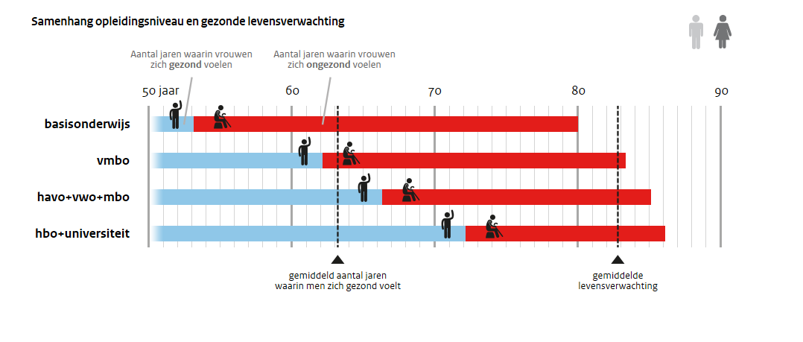
Inequalities in (healthy) life expectancy, by educational level

Slide 4
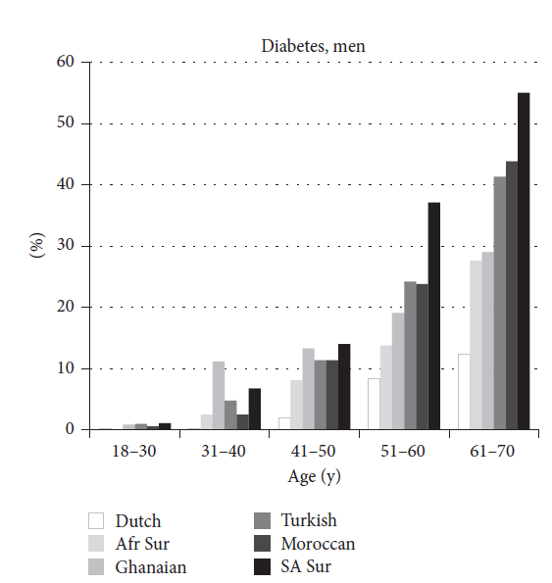
Increased prevalence of
type 2 diabetes
in 5 ethnic minority groups
(men)
Red line indicates the
prevalence in Dutch origin
people at age 61-70
Source: Snijder et al. J Diabetes Res 2017

Slide 5
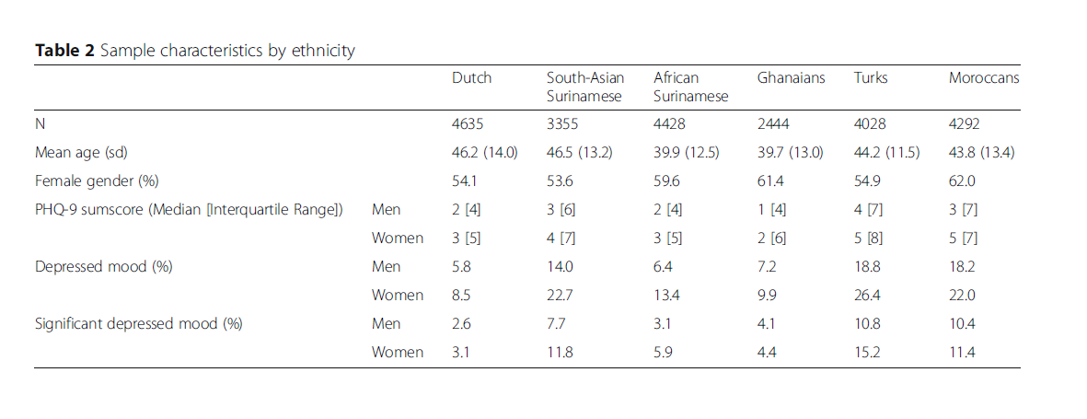
Increased prevalence of (significantly) depressed mood in 5 ethnic minority groups, based on PHQ-9 (men and women)
Source: Galenkamp et al. BMC Psychiatry 2017

Slide 6
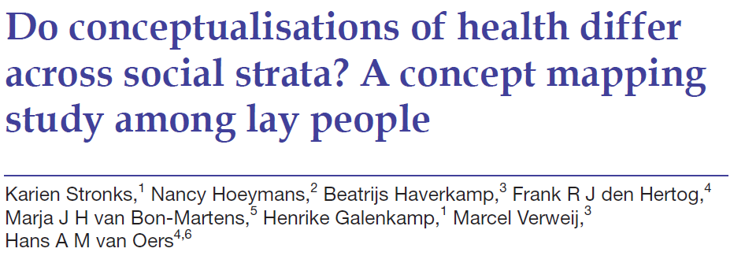
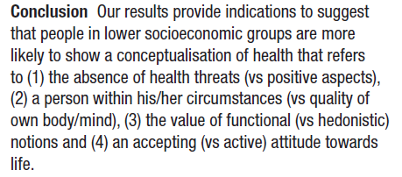

Slide 7
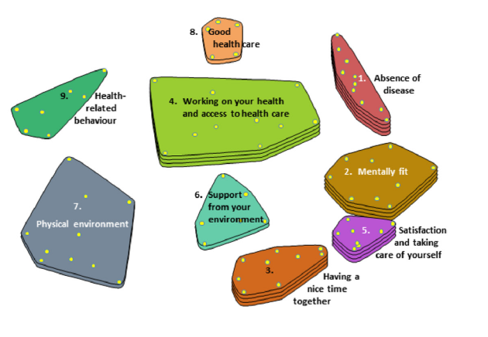
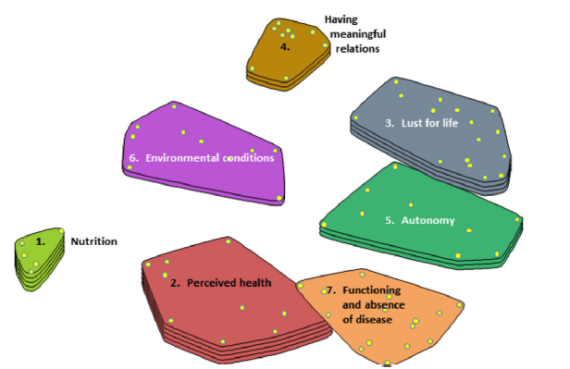

Slide 8
My contribution
Health inequalities: a few examples
They arise as a consequence of societal structures
Implications for supervisory organisations in health care

Slide 9
How could we prevent inequalities in health?
To prevent the high burden of chronic diseases in ethnic minority groups, we should address the causes of the inequalities
→ What are relevant causes?
We traditionally seek the answer in an ‘uneven distribution of known risk factors’

Slide 10
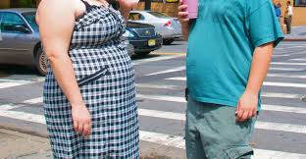
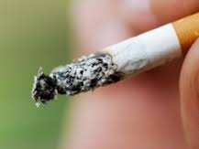
This is too simple an answer

Slide 11
Causes of the causes

Slide 12
Increasing attention for complex system approaches
Population health is an emergent outcome of complex systems that operate across spatial and temporal scales, from cells to society,
and accordingly is not reducible to the impact of single factors such as smoking or diet
Considering the whole as well as its parts

Slide 14
Similarly, in health care, health inequalities
can be seen as outcome of how care is organised
SARS-CoV-2 infection and vaccination status ª among HELIUS participants with a positive SARS-CoV-2 WANTAI ELISA
antibody test result, per ethnic group, Amsterdam, the Netherlands, May 17, 2022 - November 21, 2022 (n=1,460).
(Campman et al. 2024 under review)

Slide 15
Why are health inequalities persistent?
ChatGPT:
”Health inequalities persist for a variety of complex and interconnected reasons, and addressing them requires a comprehensive understanding of the social, economic, and environmental factors that contribute to disparities in health outcomes.”
[list of factors]
“Addressing persistent health inequalities requires a multi-faceted approach that involves changes at individual, community, and societal levels. Efforts should include policy interventions, community engagement, education, and targeted initiatives to reduce disparities and improve overall population health.”

Slide 16
My contribution
Health inequalities: a few examples
They arise as a consequence of societal structures
Implications for supervisory organisations in health care

Slide 17
Possible implications (for discussion)
Important strategies, from the perspective of supervisory organisations in health care (no silver bullet!):
A more balanced allocation of resources between prevention and treatment
A systematic evaluation of the impact of measures from an equity perspective
Unequal investments to guarantee equal outcomes

Slide 18
A more balanced allocation of resources between prevention and treatment
How do we deal with increased disease burden in some groups?
We wait ….
… until people get sick …. and then start treatment
At this time, inequalities have already arisen: i.e., they largely reflect higher incidence of health problems in certain groups

Slide 19
T2D as an example
Behavioural interventions in individuals at high risk of type 2 diabetes (T2D), as defined by weight, glucose etc.
Combined diet and physical activity programmes
Substantial reductions in T2D incidence (>50%, in trials)

Slide 20
.. also effective in South Asians, if available….
Individual meta-analysis (Jenum et al., Diabetologia 2019) indicates that intensive behavioural interventions in SA result in a 35% relative reduction in diabetes incidence …, if targeted to characteristics of SA (dietician SA background, family-based etc.)
Reality: very few people from South Asian background with a high risk of T2D get this support; if available: not targeted
If we offer this kind of preventive services to these groups, we might expect the burden of T2D to decrease substantially

Slide 21
2. A systematic evaluation of the impact of measures from an equity perspective
Given that health inequalities can be seen as (unintended) outcome of processes etc. in health care system
we could prevent health inequalities from arising by systematically assess the of impact of measures from an equity perspective
and adapt measures accordingly

Slide 23
3. Unequal investments to guarantee equal outcome = equity

Slide 24
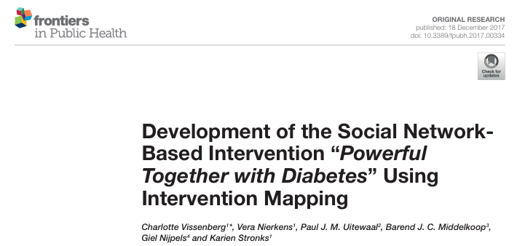
Example: Group intervention to promote better outcomes among patients with T2D with low health literacy

Slide 25
To conclude
Health inequalities are persistent
They are the (unintended) outcome of complex processes within society, including health care (no silver bullet)
Three approaches to tackling health inequalities which, in my view, are important for supervisory organisations:
A more balanced allocation between prevention and treatment
A systematic evaluation of the impact of measures from an equity perspective
Unequal investments to guarantee equal outcomes

Slide 26
Thank you for your attention
k.stronks@amsterdamumc.nl

