Slide 1
European Partnership for Supervisory Organisations in Health Services and Social Care
Mr John Farrelly, Chief Executive
Mental Health Commission, Ireland

Slide 2

Role of the Mental Health Commission in Ireland
The Mental Health Commission (MHC) is an independent State regulatory body established in accordance with the Mental Health Act 2001-2018.
It has statutory responsibility for the establishment and maintenance of high standards and good practices in Irish mental health services.

Slide 3
Leadership Verus Management
Literature is clear – different concepts
Leadership, governance and management often referred to interchangeably

Slide 4
Powers Under the Mental Health Act
The Mental Health Commission does not have any Leadership-Specific Powers. However, under the Mental Health Acts 2001-2018 the Mental Health Commission has powers to:
  Register mental health in-patient units (approved centres)
  Deregister approved centres or remove from the Register
  Apply conditions to the registration of approved centres
  Prosecute approved centres- MHC is its own prosecutor

Slide 5
Addressing Leadership Through Standards
In the absence of leadership specific powers under the Mental Health Acts 2001-2018, the Mental Health Commission is using its standards setting powers to address leadership through a lens of governance and management.
Section 33(e) of the Mental Health Act 2001 states that the Mental Health Commission shall –
  “prepare and review periodically, after consultation with such bodies as it considers appropriate, a code or codes of practice for the guidance of persons working in the mental health services.”.

Slide 6

Governance in the National Quality Framework
Dedicated Theme on Leadership and Governance
Highlighting the importance of the governance structures to adequately oversee its implementation
Recognition and championing the NQF as a driver for change and improvement

Slide 7
The regulation of restrictive practices in Ireland
The Mental Health Act obliges the MHC to make rules/codes of practice to govern the use of seclusion, mechanical restraint and physical restraint in inpatient mental health services. These practices may only be used when a person poses an immediate threat of serious harm to self or others.
The MHC measures compliance with these specific rules and codes of practice through monitoring, reporting and annual unannounced inspections of each inpatient service.

Slide 8
Ownership of the NQF at most senior level of Organisation
Governance System and Plan to ensure statutory obligations are delegated appropriately and performance is overseen. Clear lines of Reporting.
Named Individuals Accountable.
NQF
Self Appraisal – Monitoring – Reporting
Digital.

Slide 9
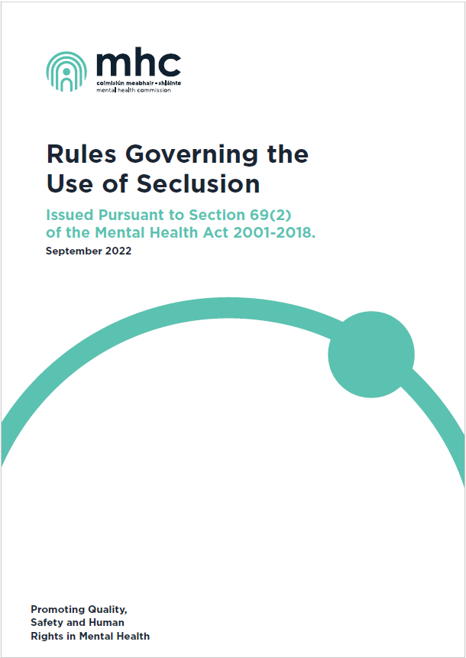
Governance in Rules and Codes of Practice
Quarterly Review and Oversight Committee
Development and Publication of a Reduction Strategy
Annual Reporting Obligations
Continuous Policy Review and Staff Training

Slide 10
Trends 2018-2022
The first prosecution under the Mental Health Act occurred in early 2019 on foot of an inspection in 2018 where a service was convicted of failing to ensure adherence to the rules governing the use of seclusion.
While the rules and code governing seclusion and physical restraint during the
five-year period remained static, the numbers of centres achieving full compliance with these standards rose substantially.
Compliance with the rules and code in centres using seclusion rose from 33% in 2018 to 83% in 2022 and in centres using restraint from 19% in 2018 to 82% in 2022.
Other possible factors include improved training on human rights and initiatives aimed at improving the quality of care in Irish inpatient services.

Slide 11
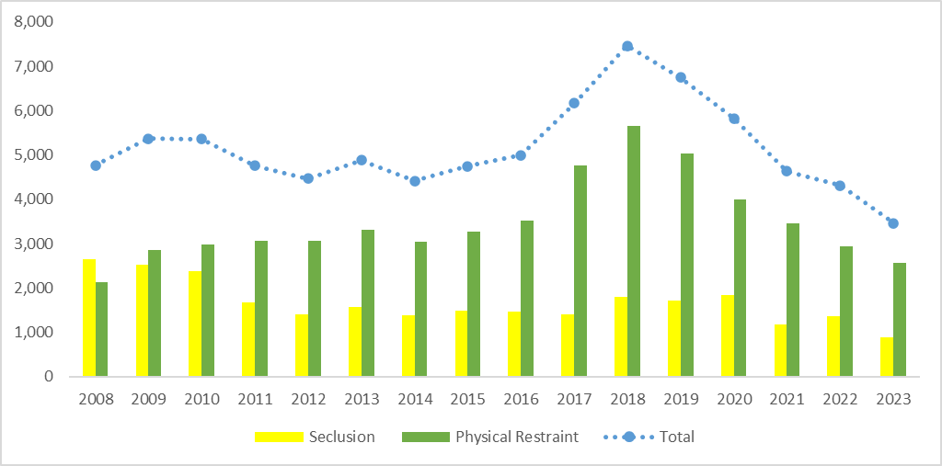
Reduction in the use of restrictive practices
Episodes of physical restraint increased year on year from 2008 (2,123) to 2018 (5,665), followed by a year-on-year decrease from 2019 (5,028), to 2023 (2,572). In relation to seclusion, there has been an overall decrease from 2008 (2,642) to 2023 (895). Total episodes of seclusions and restraints in 2023 (3,467) represent the lowest annual total episodes since reporting began in 2008.

Slide 12
Discussion
The MHC does not prescribe what good leadership looks like
The use of standards-setting provisions allows the regulator to improve relevant aspects of leadership, governance and management in a more dynamic way

