Slide 1
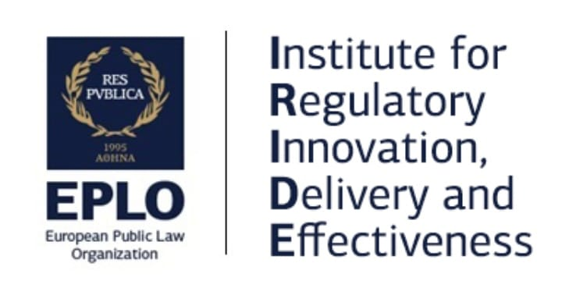


Achieving Equity in Practice
The Importance of Good Regulatory Delivery
EPSO Conference
Hosted by NZA
Florentin BLANC, Director, IRIDE
Utrecht, December 12, 2024

Slide 2
Two important barriers to greater equity:
Formalistic, Procedures-focused regulation
Ineffective to protect vulnerable
Barriers for ‘less formal’ providers
Exclusion of providers from less privileged backgrounds from access to the market
Vulnerable patients left exposed to abuse by ineffective regulation

Slide 3
We do not have a trade-off between better protection and reduced market access!
Formalistic, heavy licensing etc.
Focus on process, not outcomes!

Slide 4
Formalistic licensing gives market dominance to larger firms
Ex ante controls
Formal checks
1.Credentials
2.Processes
High barriers to entry
Minority & smaller providers excluded
Larger firms control the care market
Focus on formal checks before starting work:
Long (very long), complex set of questions and documents to fill and provide
Only larger firms with very formal processes and resources to pay specialists can enter market
Smaller providers (often minorities, people with less social capital, formerly informal providers etc.) are excluded

Slide 5
Over 400 pages of guidance for the licensing application?
Really?

Slide 6


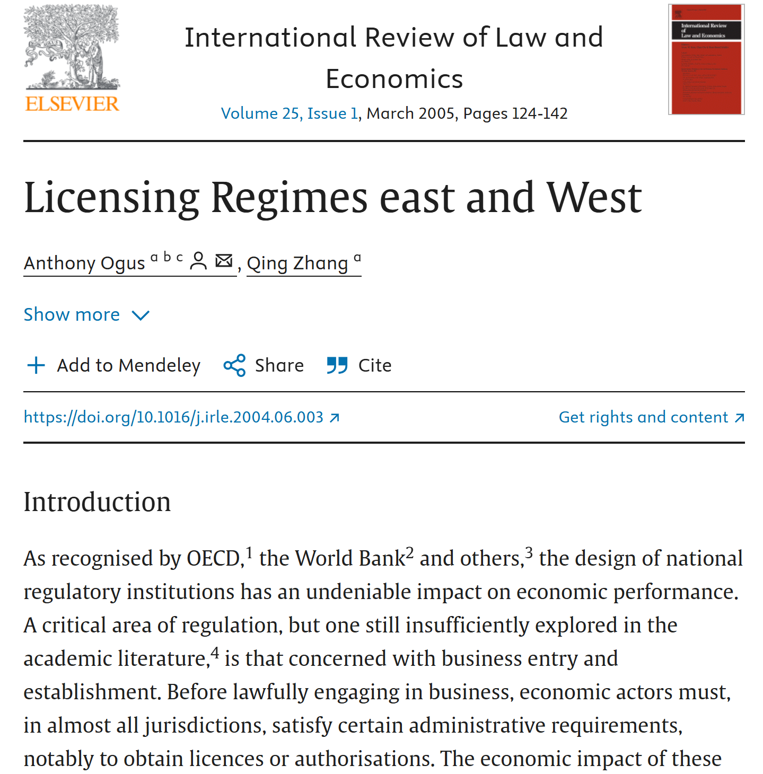

Slide 7
What do we know about licensing?
Limited effectiveness (at best) on quality and safety of service / care provided:
- Extensive comparative of US states data by Kleiner et al. shows little if any difference in quality between “licensing” and “non licensing” states for identical services
- Checking ex ante for an activity where most risks are linked to operations and not to physical conditions is mostly ineffective
- Reduced competition = reduced incentives to improve
- Mostly ex ante checks = less focus on maintaining operational quality
- Dominant position = providers know the system needs them to keep functioning
Considerable (harmful) effect on prices, employment and distribution of income:
- Kleiner et al. show “licensing” vs “non-licensing” states for same activity have (a) less jobs for these sectors and (b) higher prices (and more income for licensed profession)
- World Bank, OECD etc. find high licensing barriers prevent formalization and growth of informal activities, prevent entry into market of minorities, less-privileged-people (less formal education, connections, capital), etc.
- Harms not only (potential or informal) providers but also recipients of care (‘less able to provide formal information’ ≠ ‘not competent or able to provide quality care’)

Slide 8

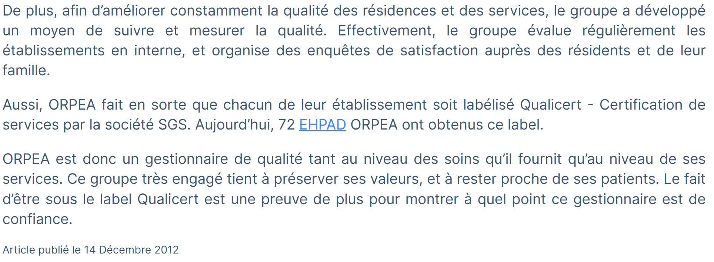
“All that shines is not gold…”
What difference a few years make!

Slide 9
What do we know about formal internal control systems?
Effectiveness to guarantee safety and quality is variable at best:
- Focus on formal documentation of processes
- Limited, if any, “reality checks” / spot-checks
- Take away valuable employee time for procedures, reports etc.
- Effectiveness of external audits of quality management system is also variable at best – focus is likewise on formal procedures and formal compliance (not always deserving of the name “audit”)
- All actors in the chain end up focusing on processes, with less time available to verify outcomes
Can actually distract attention from what really matters and end up make it easier for bad practices to remain hidden in a ‘bureaucratic fog’:
- In France, major scandal in recent years around one of the main firms managing long-term medicalized care homes – but this group had so many certifications!
- For 1.5 years am supporting total transformation of a government agency that had very ‘serious looking’ ISO certifications as inspection body, but recurring corruption scandals
- Focus on formal processes made it easier to hide corrupt/unsafe/abusive practices

Slide 10
Focus on formal aspects
Heavy ex ante checks
Supervision mostly of formal processes
No time / resources / methods for “reality checks”
Bad practices and harm can fester unchecked
All looks fine until scandals break out!
Formalistic regulatory delivery leaves major unchecked risks for patients – and for regulators!

Slide 11
All looks fine until scandals break out!
Comprehensive data on duty holders
Risk-Based Planning (activity x track record = risk level)
Risk-Based Inspection (focus on practices and critical risk points)
Updated Risk Levels
Regular Updates on Existing and New Duty Holders
Regular Inflow of Data on New/Modified Duty Holders
Effective regulatory supervision requires using multiple data sources to assess risks and detect problems
Input From Patients and Relatives

Slide 12
Documented process
Talk to patients, relatives
Consistent with “official”?
Alarm signs?
Talk with workers
Consistent w procedure, and w each other
Dissimulation / evasion?
Competence?
Effective regulatory supervision requires focusing on people and practices
All looks fine until scandals break out!

Slide 13
Getting Enforcement Right - Not Every Health Care Operator Is the Same!
Enabling conditions
Deterrence
Source: Scottish Environmental Protection Agency
Legitimacy and Interactions
Social and
Cultural
Drivers

Slide 14
Understanding Drivers of Behaviour
    Enabling
    Conditions
  Deterrence
Knowledge
Capacity
              Inspections
              Enforcement
Attempting to increase deterrence excessively can weaken other drivers and result in a net decrease in compliance
    Legitimacy & Interactions
Social & Cultural
Drivers
            Conformity
            (“everyone does it”)
            Ethics
            (“this is the right thing to do”)
Fair regulators
Legitimacy of authorities

Slide 15
Map of Regulatory Systems
Moving towards outcomes
Systematic data management
More data-driven planning
Risk-based management of complaints
Enforcement Management Mode
Hands-on guidance
Effective inspections outcomes
Map systems

Slide 16
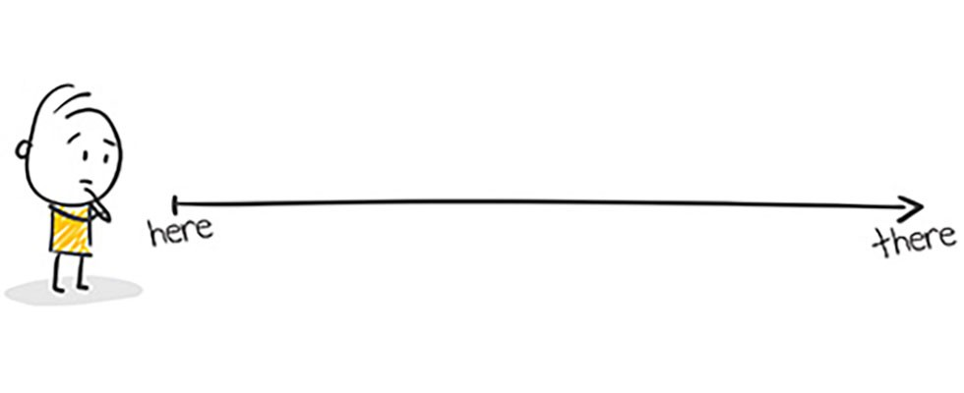
Getting There
www1.eplo.int/iride
fblanc@eplo.int

