Slide 1
The Effects Of Older Persons In Residential Care Homes Compared To The Benefits Of Older Persons Staying In The Community
Presented by:
Christine Sammut
Manager Well-Being Unit

Slide 2
AGENDA
Definition, benefits and challenges of Residential Care
Functions of the Older Persons Standards Authority
Definition, benefits and challenges of Community Care
Situation in Malta

Slide 3
Residential Care
A Residential Care Home for the Older Persons acts as:
an alternative living arrangement, for the older persons who need a safe and homely long-term residential based environment with 24-hour care available.
(Lim, Wendy & Sulaiman, Noralfishah & Baldry, David., 2013)
A research study from City St George’s, University of London (My Home Life England initiative) (2024), reveals six key ways that older persons can thrive in a care home:
Thrive Relationally Thrive Actively
Thrive Inclusively Thrive Securely
Thrive with Dignity Thrive Healthily

Slide 4
Benefits
Challenges
24/7 care and support
Social engagement
Safety and security
Nutritional support
Specialised care
End of life care
Loss of independence
Adjusting to a new environment
Isolation
Limited privacy
Quality of food

Slide 5
The Older Persons Standards Authority (OPSA) is dedicated to enhance the quality of geriatric services.
Our mission is to protect and promote the dignity, safety, and welfare of older persons by ensuring high standards of care.

Slide 6
Functions of the Authority
Establishing and maintaining regulatory standards in the geriatric sector.
Licensing of geriatric service providers to ensure high standards
Conducting inspections and providing recommendations to protect those using geriatric services, assess the quality of care, and identify areas for improvement
Ensuring and promoting the rights and well-being of older persons

Slide 7
Reason:
Loneliness
Expectations:
Meet new people, social interaction
Reality:
Built new friendships with other residents and staff
His children feel reassured knowing he is content
Forms part of the older persons committee at the care home
Suggestions:
Older persons should embrace the mindset that life goes on and doesn’t end when they move into a care home
Charles

Slide 8
Reason:
Recovery following a fall at home
Expectations:
To receive continuous care for her recovery
Reality:
Receives excellent care
Has the freedom to visit her home and spend time with her friends outside of the care home
Rose

Slide 9
Reasons:
His wife has dementia
Needs assistance with walking
Expectations:
Good quality of life for him and his wife
Reassurance that his wife is well taken care of
Reality:
Share a room in the same care home
Receive good quality care
Peace of mind to their children that they are receiving proper care
Suggestions:
Quality of food
Joe

Slide 10
Maltese Culture
Traditionally in Malta, older persons have looked for support from their relatives, mostly from the eldest daughter. This has now changed as a result of several changes in today’s world such as an increase in working women and changes in family structure. As a result, elderly are forced to seek support from other entities (Micallef, 2010).
When community care services provided are unable to satisfy to the increasing needs of older persons and their carers, institutional care is available. (Micallef, 2010).
Therefore, as societal norms shift, more families are seeking residential care options, reflecting changing lifestyles and the pressures of modern living.

Slide 11
This being said, there is also research which suggests that well-being of older persons is better when in the community.
Community Care services aim to assist older persons to live independently in their homes and maintain or enhance their quality of life for as long as possible
(Low, LF., Yap, M. & Brodaty, H., 2011).
The results of a study held by Wang, Q., Fan, K., & Li, P. (2022) on the effect of use of community care services on the multidimensional health of older persons, showed that using community care:
physical health cognitive function
active participation in life life satisfaction
depression

Slide 12
Benefits
Challenges
Social connections
Comfort and familiarity
Independence
Reduction in risk of infection
Cost-effectiveness
Suitability
Emergency response delay
Caregiver burden/turnover
Isolation risks
Safety concerns

Slide 13
A performance audit was held by the National Audit Office in Malta, in January 2020. It reviewed the Social Work, Meals on Wheels, Domiciliary Nursing and Caring as well as Home Help services.
Cost effectiveness
Lack of human resources
Service inefficiencies and quality concerns
Language barriers

Slide 14
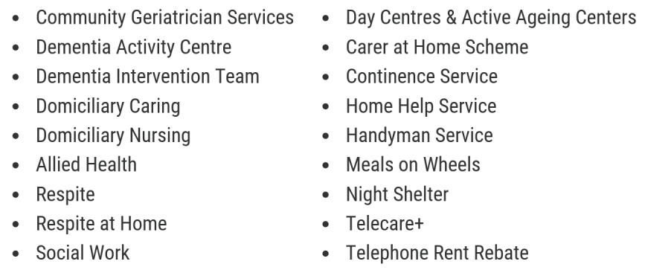
Community Care Services In Malta

Slide 15
Dependency Levels
Residential Care Homes (2024)
Low/Medium | High
2902 | 2005

Slide 16
Older Persons Standards Authority
The Plan for 2025
Publishing the updated standards following public consultation
Implementing a more person-centered approach with the setting up of the Well-Being Unit
Working towards taking the necessary action to start the process of overseeing more community care services

Slide 17
What are the methods of licensing and for monitoring the quality of community
care services?
How has technology impacted the regulation and delivery of home care services?
How to implement a home care system with limited availability of trained staff?

Slide 18
THANK YOU

