Slide 1
Health for Everyone?
Social Inequalities in Health and Health Systems
Caroline Berchet
Health Economist, Health Division, OECD
12 December 2024

Slide 2
Socioeconomic inequalities and health – What do we know?

Slide 3
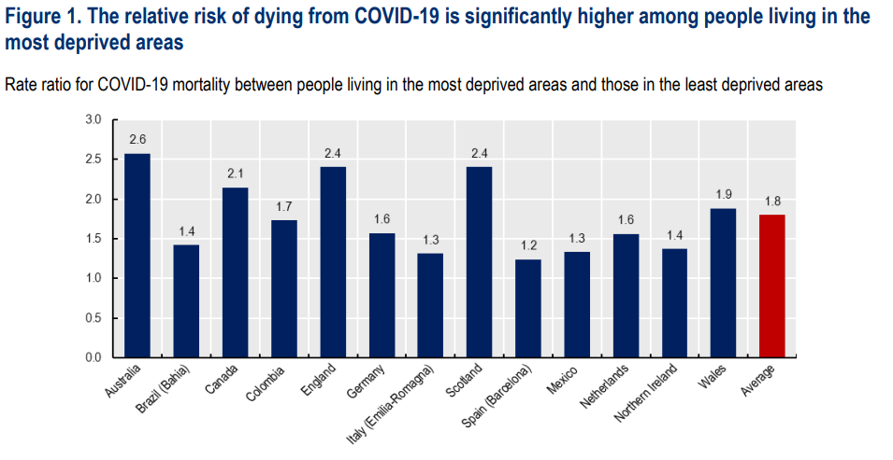

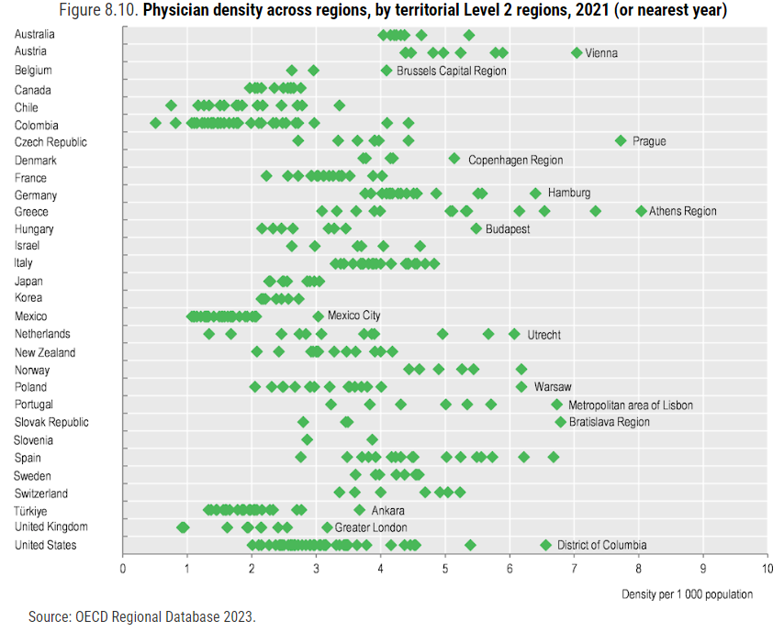

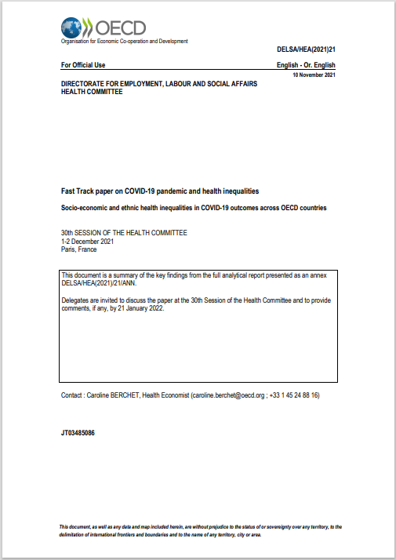

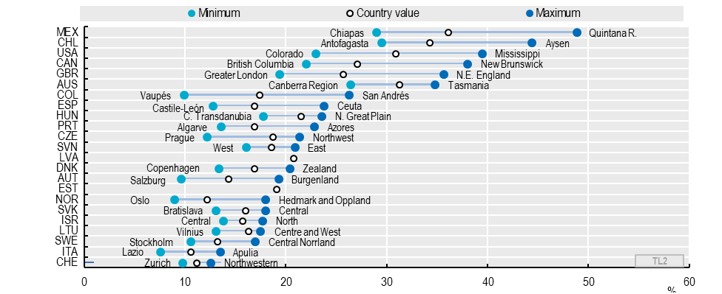
OECD already has a broad portfolio on work related to inequalities
Physician density across regions, by territorial level 2 regions, 2021 (or nearest year)
Obesity rates, 2018, Percentage of adult population, large regions

Slide 4
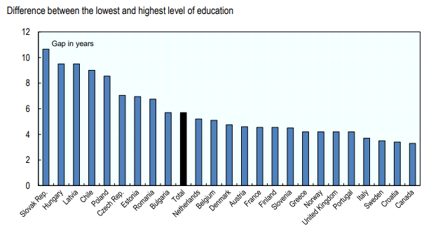
People with highest education live longer than those with lowest education
Gap in life expectancy between the lowest and highest level of education (in years)
Health for Everyone?
Social Inequalities in Health and Health Systems

Slide 5
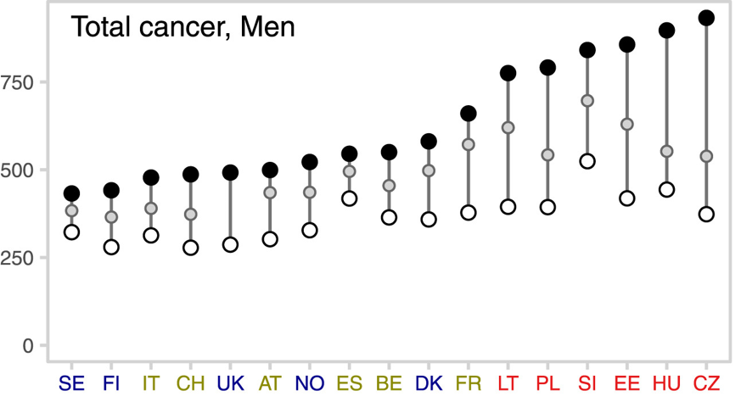
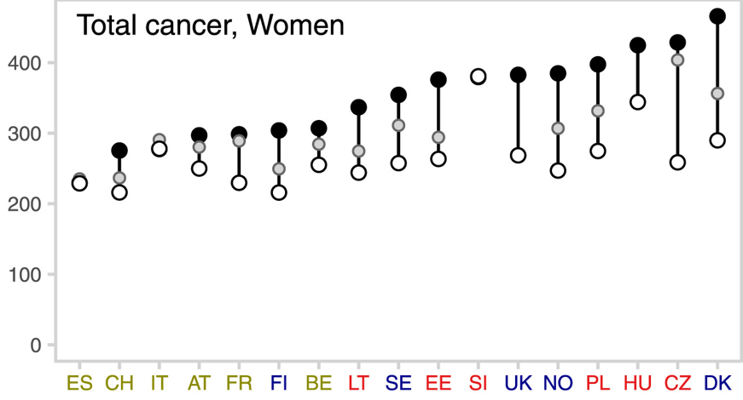
Low-educated people show higher cancer mortality rates than high-educated people
Age-standardised cancer mortality rates per 100 000 population by education
Source: Vaccarella, S. et al. (2022), “Socioeconomic inequalities in cancer mortality between and within countries in Europe: A population-based study”, The Lancet Regional Health Europe, Vol. 100551, https://doi.org/10.1016/j.lanepe.2022.100551.

Slide 6
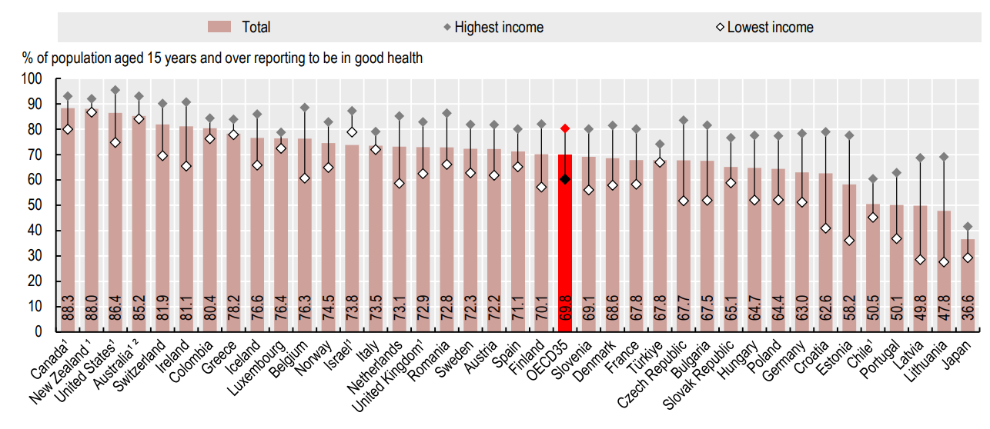
People with lowest income are more likely to report longstanding illness or health problems
Health for Everyone?
Social Inequalities in Health and Health Systems

Slide 7
A two-way link: Ill-health also worsens economic prospects throughout the lifecycle
Adults
Employment prospects
Wage prospects
Absence from work
Presenteeism
Young infants & children
Cognitive development
Educational outcomes
Birth
Adolescents and Youth
Core skills development
On-the-job-training
Death
intergenerational transmissions
Health for Everyone?
Social Inequalities in Health and Health Systems

Slide 8
Poor health damages labour market outcomes
Unemployment
People with mental distress are up to 3X as likely to be unemployed than people with no mental distress in the UK
Absence from work
Across 15 OECD countries, 11 days lost per person in 2013
Women with obesity are 68% more likely to miss work than women with a healthy weight
Presenteeism
Estimated to have cost US economy $150bn pa in early 2000s (Hemp 2004)
The productivity losses due to NCD-related presenteeism tend to be 2 to 3X higher than that of absenteeism
Lower wages
Men in good health earn 8% more than those in poor health, difference widens to 16% by age 64
For women, gaps rise from 4% to 15% respectively
Sources: OECD, 2022, Fitter minds, Fitter jobs. OECD/WHO 2016: Inclusive growth: improving the dialogue; OECD 2017 Ageing Unequally; OECD 2022, Promoting health and well-being at work.

Slide 9
Social health inequalities are rooted in factors that are amenable to policies actions

Slide 10
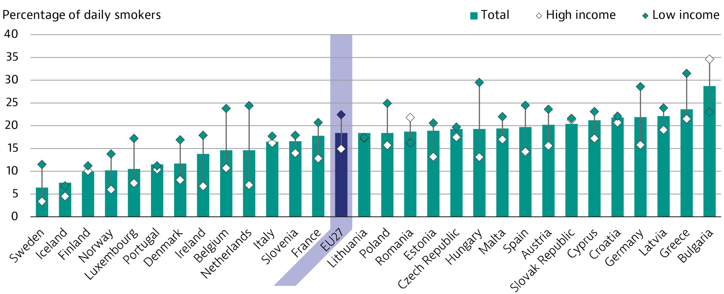
Smoking remains more common among low socio-economic status
Smoking is 50% higher among low income than high income people in EU countries
Health for Everyone?
Social Inequalities in Health and Health Systems

Slide 11
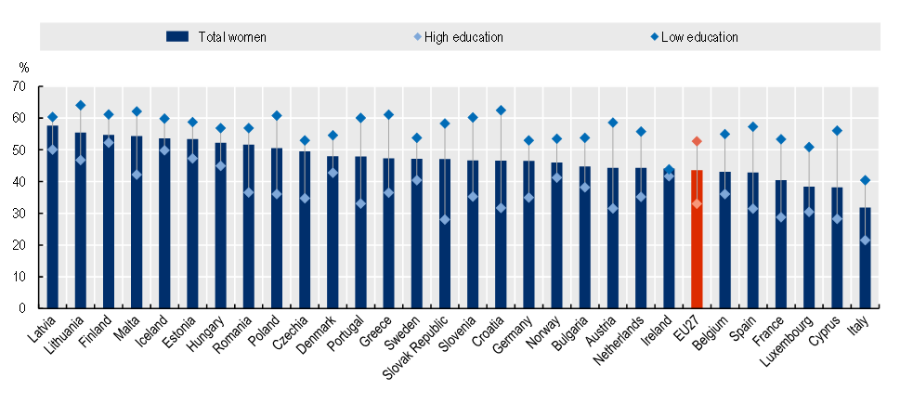
Women with low education have overweight rates that are 60% above those with higher education
% of overweight and obesity, women population, 2022
Health for Everyone?
Social Inequalities in Health and Health Systems

Slide 12
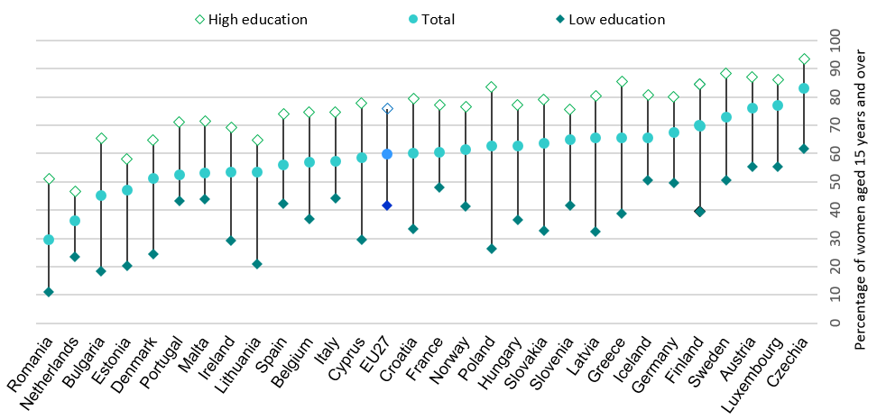
Women with lower education have lower access to early cancer diagnoses
Self-reported participation to cervical cancer screening programme varies almost 2-fold across education groups in the EU
Health for Everyone?
Social Inequalities in Health and Health Systems

Slide 13
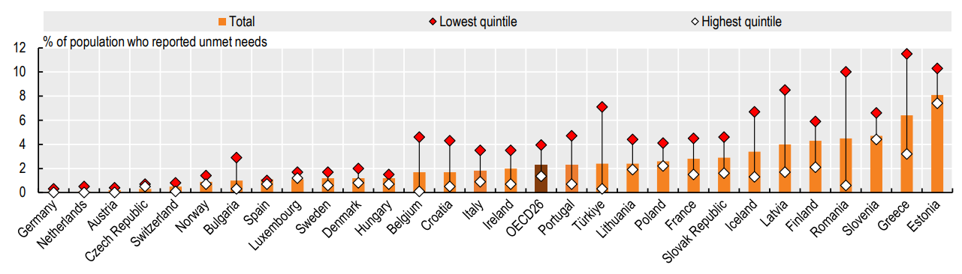
People with lowest income are 3X more likely to delay or forgo care
Health for Everyone?
Social Inequalities in Health and Health Systems

Slide 14
What can health systems do?

Slide 15
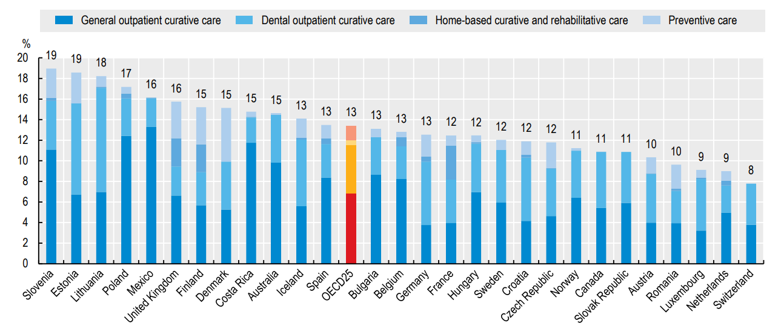
Stronger health system centered on primary health care
Expenditure on Primary Health Care, 2021
Spending on primary health care services as a share of current health expenditure
Health for Everyone?
Social Inequalities in Health and Health Systems

Slide 16
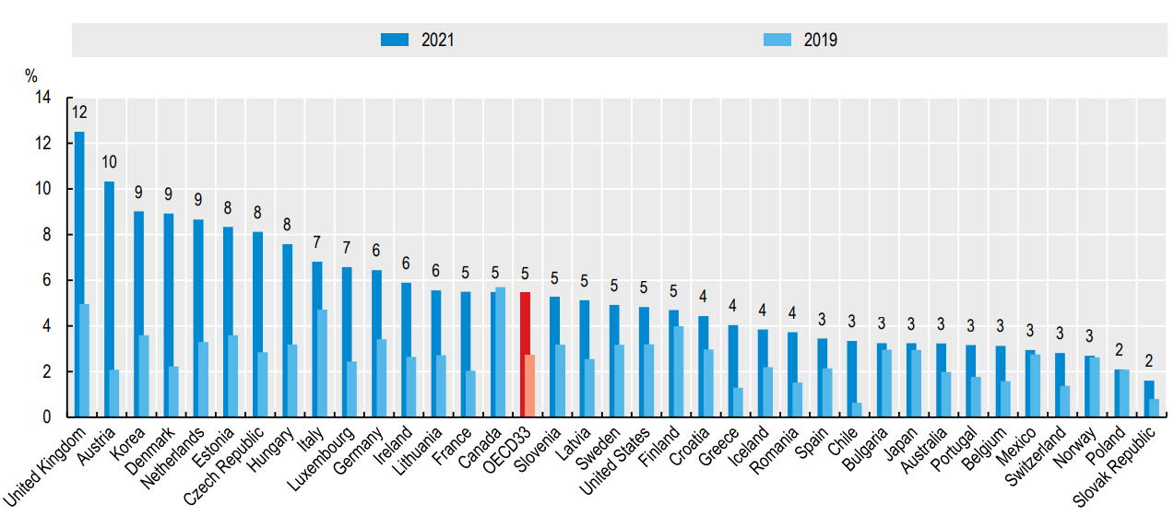
A stronger focus on prevention: costs little and delivers a lot
Expenditure on prevention, 2021
as a share of current health expenditure
Health for Everyone?
Social Inequalities in Health and Health Systems

Slide 17
…and equipped with better data on what care delivers for people
PaRIS
Patient-Reported Indicators Surveys
Health for Everyone?
Social Inequalities in Health and Health Systems

Slide 18
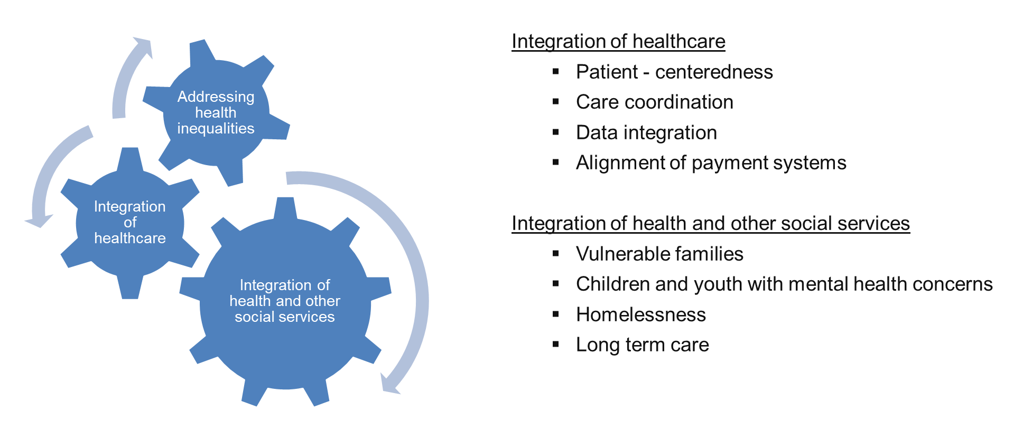
Better integration of health and social services has multiple benefits: access, cost, quality
Health for Everyone?
Social Inequalities in Health and Health Systems

Slide 19
A policy response balanced across sectors delivers improved outcomes
Health
Costs of health care
Capacity to work
Income / social factors
Living environment
Unemployment, poor working conditions
Education, health-seeking behaviour
Illness in childhood
Health for Everyone?
Social Inequalities in Health and Health Systems

Slide 20
Key policy actions to reduce health inequalities
Strengthening primary healthcare, reconfiguration of service delivery towards people-centered care
Beyond health sector: social policy, housing, education, labour and job quality
Investing in health promotion and diseases prevention
Strengthen data collection on what matters to patients.
Health for Everyone?
Social Inequalities in Health and Health Systems

Slide 21



Thank you!
Email me
Caroline.Berchet@oecd.org

