Slide 1
Organisation of home care and community care
Dutch Health Authority
Dr. Anneke van Vught
Chief Healthcare

Slide 2
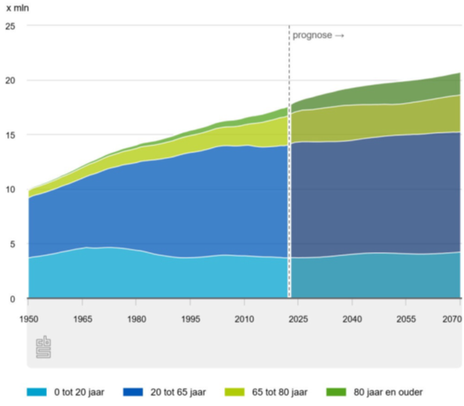
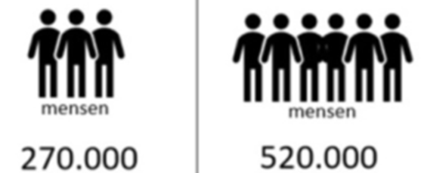
Challenges in Dutch Society
Dementia
2019 2040

Slide 3
Healthcare Costs (Health Insurance & Long-term Care) in billions euros for 2023
Long-term Care Act (WLZ) €32,04 billion €1.840,83 per insured per year | Health Insurance Act (ZVW) €54,73 billion €3.098,80 per insured per year
Mental healthcare €2.02 billion €116,15 per insured | Medical specialistic care €28,51 billion €1.614,05 per insured | Geriatric rehabilitation care €1,26 billion €71,43 per insured
Disability care €9.87 billion €567,13 per insured | Farmaceutical care €5,40 billion €305,66 per insured | Paramedical care €1,13 billion €63,82 per insured
Nursing and care €16.92 billion €972,32 per insured | Medical mental healthcare €5,02 billion €284,13 per insured | Medical transport €0,99 billion €56,15 per insured
Other healthcare costs €3.22 billion €185,23 per insured | General practitioner care €4,71 billion €269,59 per insured | Dental Care €0,93 billion €52,62 per insured
 | Nursing and care €3,21 billion €181,80 per insured | Perinatal care €0,73 billion €41,30 per insured
 | Medical aids €1,91 billion €107,98 per insured | Other healthcare costs €0,89 billion €50,27 per insured
Source: zorgcijfersdatabank.nl (Zorginstituut Nederland)

Slide 4
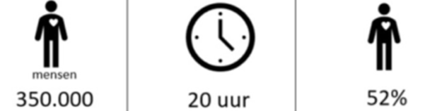
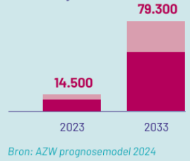
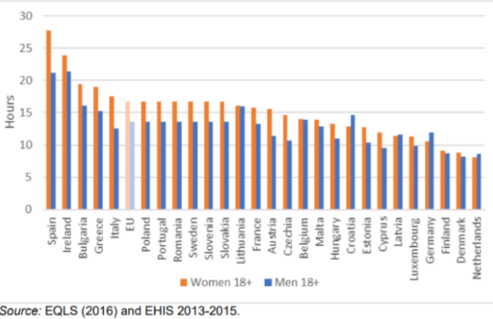
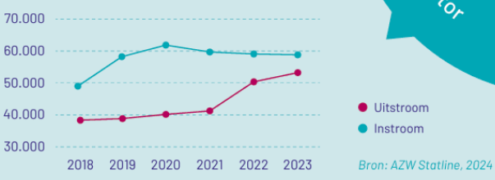
Challenges in Dutch Society
Challenges
in Dutch
Society
Informal care
Every week
Overloaded
Vacancies
Outflow
Inflow

Slide 5



Challenges in Dutch Society
Two main structure issues (transition needed)
Shift required to primary healthcare combined with social domain;
Long-Term Care Act is presently our unique insured right.
Supportive care vs. right on care
We have professionalized and centralized care (Support → Right);
Bring care back to the individual and their context (Right → Support).
Human Oriented?
Sustainable?
Environmental?
Providing care differently
More emphasis on home care, self-care, digital and hybrid care
Managing (increasing) multimorbidity
From 4.3 mln to 5.5 mln individuals by 2040
More focus on meaningful living
Not just longevity, but also quality of life matters to people
Large Health disparities
18 years difference in healthy life years
Individualization
Solidarity under pressure
Rising healthcare costs
From 14% to 20% of GDP by 2040
Labor market shortage
From 49,000 to 117,000 workers short by 2030
Double aging
From 8% to 12% aged 75+ by 2030
Growth in treatment options
More (person-centered) treatments and medications
Climate under pressure
Healthcare responsible for 7% of CO2 emissions in The Netherlands
Environment under pressure
Healthcare responsible for 13% of resource use in The Netherlands

Slide 6

Integrated care agreement
Strenghtening organisation primary care (p. 63): “Good care for (vulnerable) people requires that there are sufficient healthcare providers who have sufficient time for their patients, who know each other in the neighborhood, know what they can do and help each other.”
Challenges
Labor market
Largely small-scale and monodisciplinary organized primary care
Connection between social domain and hospital care
Data exchange
Accountability and responsibility
Frameworks, legislation and regulations
(Segmented) purchasing
Market forces

Slide 7
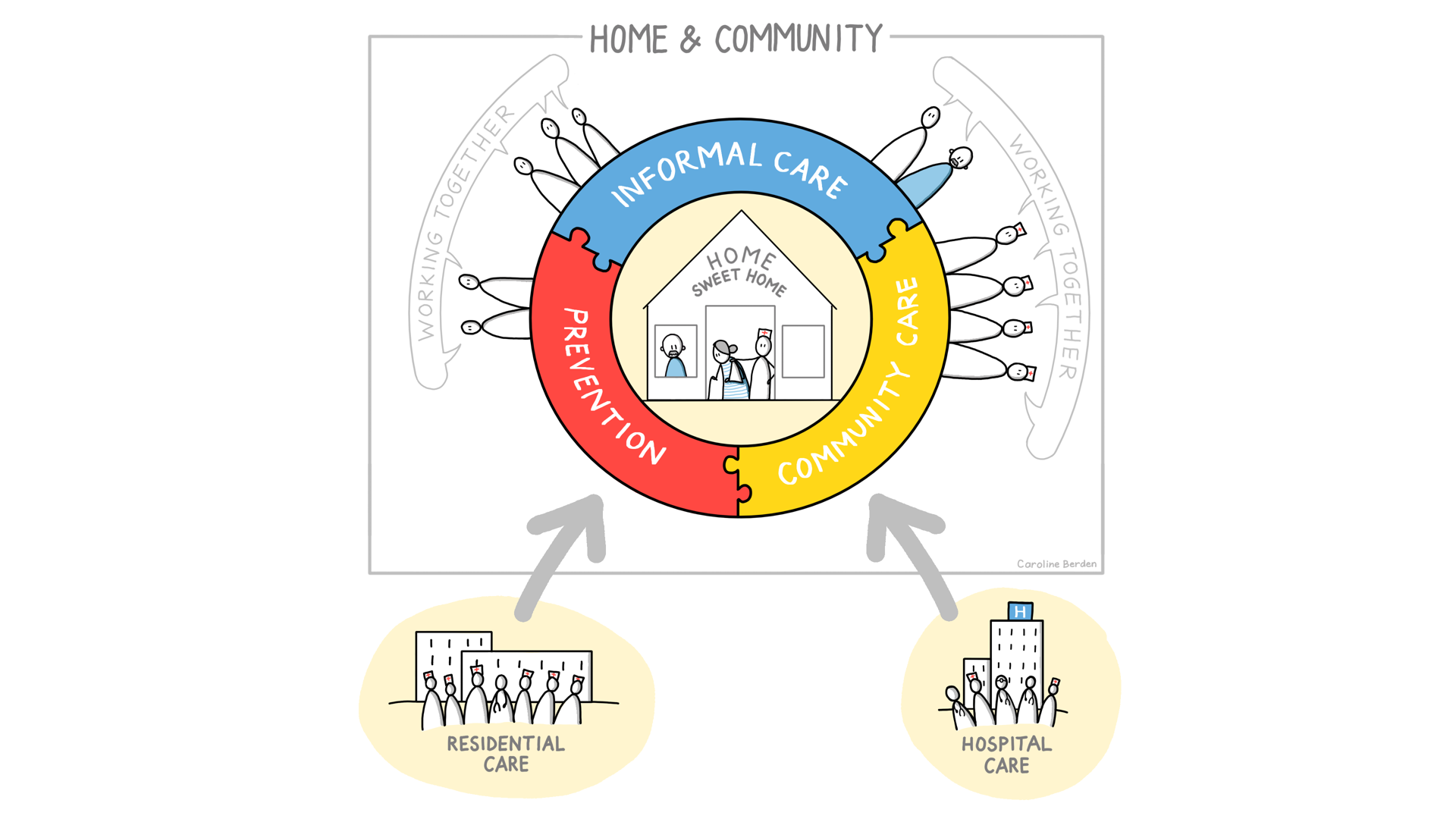
Organisation of home and community care

Slide 8
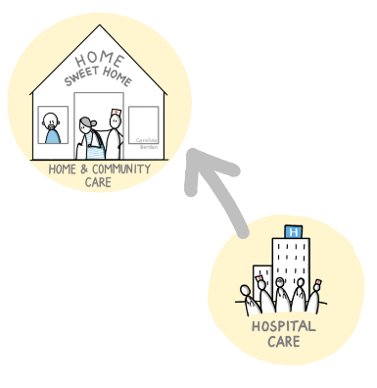
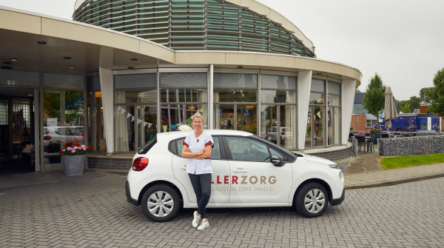

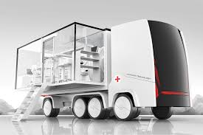
Hospital care@home
Dilemmas
What does this mean for hospitals?
What do you need in primary care?
Many collaboration issues.
Who exactly does what?
How do you ensure coordination?
Notes:
Allerzorg
IV meciatie
Acute care @home
Palliatieve zorg thuis

Slide 9
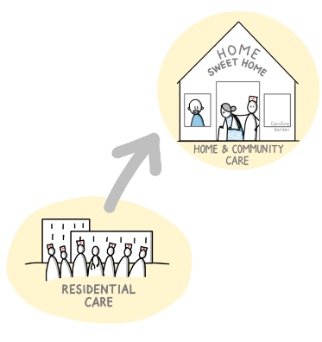
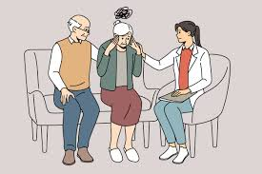

Residential care@home
Dilemmas
When community nurse and when residental care@home?
Which care is most appropriate?
How to make it appropriate, also in terms of financing?
What is the optimal skill mix for residental care@home?

Slide 10
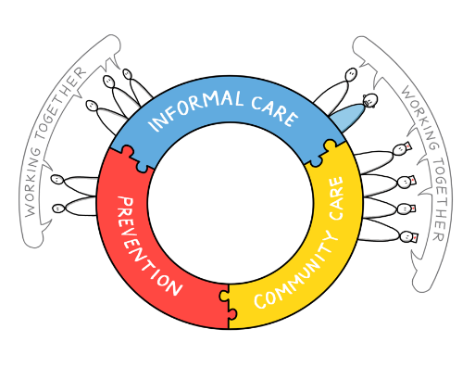
Informal & formal care
Precautionary circles
Neighborhood-oriented work
Citizen cooperatives
Dilemmas
What is care and what is not care?
Changing roles of health care professionals?
How to finance?
Requirements?

Slide 11

Investing in prevention
Advanced care planning
Neighbourhood-oriented collaboration
Community based prevention
Dilemmas
Funding?
Who is responsible for prevention?
What does it mean to professionals?
What is care, what is not care?

Slide 12
New role for supervisory organisations in health services and social care
Towards
More collaboration and coordination of tasks
Governance agreements
Learning health data system
Transparency of outcomes
Self regulation
Government responds with
Supporting collaboration
Removing bottlenecks in funding
Providing data and analyses
Stimulating transparency of outcomes
Supervision on governance and quality system in the chain of care

Slide 13
What does NZa?
Removing bottlenecks in funding. We identify these bottlenecks in collaboration with stakeholders in the sector and stakeholders can submit them to us;
Experiments for alternative forms of financing together with providers and insurers;
Experiments for financing new or differently organised healthcare;
Spreading good practices;
Monitoring of appropriate care;
Setting the agenda as a transition master in healthcare.
Notes:
EXPLANATION:
We are expressly working with the national and regional parties to provide future-proof funding. For this purpose, we compile sector analyses and develop views that are agenda-driven for the sector.
We do this by:
participating in vision projects of the ministry of health, welfare, and sport, and others (strengthening frontline organisation)
developing their own vision (acute care, palliative care, elective care, etc.)
We speak up as the market manager.

Slide 14





Our work in practice:
New funding for overweight and obese children
NZa establishes six new optional activities for the financing of telemonitoring
05DEC2023
Guide offers general practitioners and health centres guidance in the search for suitable accommodation
Skipr Editorial
24MAY2023, 2:01 p.m.
Read 387 times
The chain approach to healthcare and support for overweight and obese children is funded structurally from 2024. The Dutch Healthcare Authority (NZa) establishes performance and maximum rates for the central healthcare provider and for the combined lifestyle intervention for children.
Skipr Editorial
07OCT2021, 4:21 p.m.
Read 1,887 times
The Dutch Healthcare Authority (NZa) has established six new optional performances for the financing of telemonitoring for six common disorders. This concerns telemonitoring with cardiac arrhythmias, hypertension, heart failure, chest pain, COPD, and asthma. The initiators of these new achievements are the OLVG (Onze Lieve Vrouwe Gasthuis [Our Dear Lady Hospital]) and health insurer Zilveren Kruis. With the determination, the performance is also available to other hospitals.
The new funding is an important prerequisite for agreements in the Integral Care Agreement (IZA) and the Healthy and Active Living Agreement (GALA) on the national implementation of the
NZa gives a green light for the first IZA funding
Acute healthcare transition possible thanks to funding support
News report | 16JAN2024 | 1:45 p.m.
Samira Ahli
18JAN2024, 2:15 p.m.
Read 4,582 times
Acute healthcare is under threat. The demand for healthcare is increasing and there are too few staff. To make acute healthcare future-proof, the acute healthcare chain must change. In the Acute Healthcare Funding Advice, the Dutch Healthcare Authority (NZa) outlines how the funding and financing supports this change.
The NZa has issued the first orders for transformation plans. An order by the NZa makes it possible to pay out money for these plans.
Notes:
EXPLANATION:

Slide 15
What does the Supervision department do?
Risk-based supervision of health insurers, regional contracting agencies, healthcare providers, and the CAK
Agenda-driven by developing ambitious frameworks
Shaping surveillance of healthcare networks
Research within the sector about appropriate care

Slide 16
Conclusions from a healthcare perspective

Slide 17

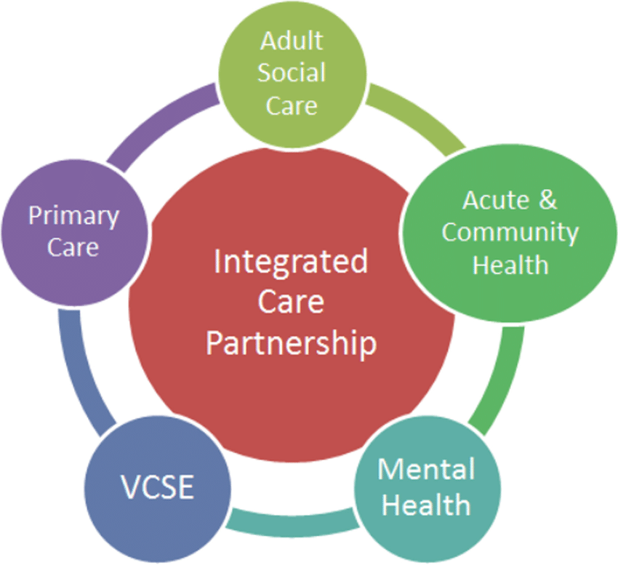
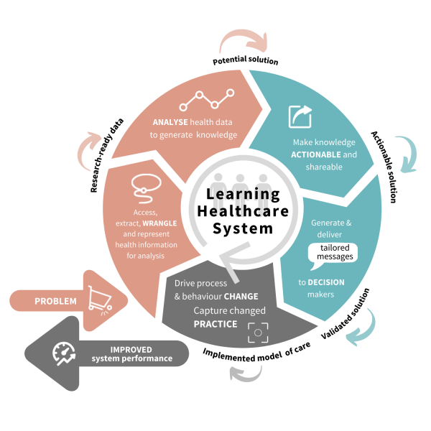
Conclusions from a healthcare perspective

