Slide 1
A RISK-BASED Regulatory Approach to the Home Care Sector in Singapore
EPSO 11 - 12 December 2024

Slide 2
Singapore Population | Home Care Landscape | Regulatory Assessment | Regulatory Approach
1
Singapore Population
2
Home Care Landscape
3
Regulatory Assessment
4
Approach to Regulating the Home Care Sector
2

Slide 3
Singapore Population | Home Care Landscape | Regulatory Assessment | Regulatory Approach
Singapore’s ageing population is a key healthcare challenge
Singaporeans are expected to become a “superaged” society by 2026, with 1 in 5 Singaporeans > 65 years. Additionally, Singaporeans are living longer.
INCREASED HEALTHCARE RESOURCE UTLISATION
Utilisation of healthcare services is expected to surge, with the expected increased prevalence of chronic diseases and age-related conditions.
Disease Policy and Strategy Division, and Health Analytics Division, Ministry of Health Policy, Research & Surveillance Group, Health Promotion Board, Singapore
EMPOWERING RESIDENTS TO AGE IN PLACE
Singapore is embarking on strategies to enhance ageing strategies and enable residents to age well in place, including expanding types and capacity of care models, especially in the community.
Fang, C. S. (2022, September 28). S’pore’s population ageing rapidly: Nearly 1 in 5 citizens is 65 years and older. The Straits Times. https://www.straitstimes.com/singapore/singapores-population-ageing-rapidly-184-of-citizens-are-65-years-and-older
3
Notes:
Lifespan estimated to be ~83 years, female ~85 years and male 80 years. With the expected gap between our estimated lifespan of ~83 years, and health span (time spent in in full health (74.5 years in 2019)), there is an expected increase in the incidence of chronic disease and age-related conditions.

Slide 4
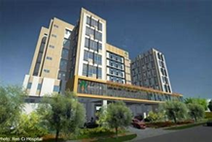
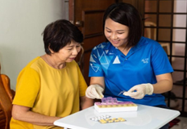
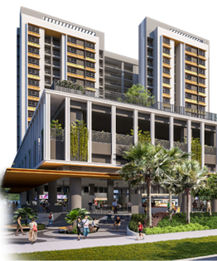
Singapore Population | Home Care Landscape | Regulatory Assessment | Regulatory Approach
Within the current community healthcare context, there are various community touchpoints for seniors serving different needs
Own network
Social support
Medical support
Place of residence
Complexity of care needs
- Home Medical
- Home Nursing
Institutional care: Nursing Homes
- Home Therapy
Own Home/ Assisted Living Facilities incl stay-in shared caregivers services
Family and Friends
Polyclinics / General Practitioner Clinics
Home Personal Care
Medical Escort
Family and Friends
Medical Escort
Polyclinics / General Practitioner Clinics
Active Ageing Centres
Home Personal Care
Own Home/ Assisted Living Facilities incl stay-in shared caregivers services
Family and Friends
Active Ageing Centres
Polyclinics / General Practitioner Clinics

Slide 5
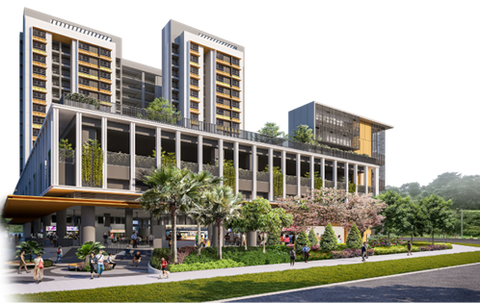
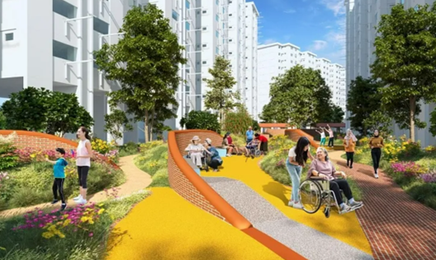
Singapore Population | Home Care Landscape | Regulatory Assessment | Regulatory Approach
There are ongoing national efforts (i.e. AgeWell SG) to strengthen community support for seniors from revamping living spaces to enhancing support networks
Encourage Active Ageing
Enhancement of the Active Ageing Centres (AACs) by boosting both their numbers and scope
Encourage more active seniors to join the centres as a) participants and b) volunteers and work with other seniors
Boosting Community Support
Plans to establish service points to assist seniors and their families in coordinating and streamlining care across service providers including:
Healthcare services:
Home Medical
Home Nursing
Home Therapy
Hospice Home Care
Home Personal Care
Other services including:
Meals on wheels
Medical escort
Stay-in Shared Caregiving (SCS) sandbox
Physical Infrastructure Upgrading
Increased housing options with senior-friendly facilities. For those preferring to stay in their original place of residence, the Enhancement for Active Seniors (EASE) programme is available.
Upgrades planned within housing estates to improve and encourage activities, as well as ensure better commuters’ experience
5
Notes:
wider range of senior-friendly fittings under the Enhancement for Active Seniors (EASE) programme. These include bidet sprays, foldable U-profile grab bars and lowered toilet entrance kerbs. other enhancements are planned, including enhancements include therapeutic gardens, fitness trails, barrier-free access ramps and rest points, and dementia-friendly features to improve way-finding. In support of Age Well SG, we will enhance our commuter infrastructure, to make walking to key public transport nodes more convenient, comfortable and accessible, especially for seniors. Residents will benefit from more covered linkways, upgraded bus stops with senior-friendly features, and more pedestrian overhead bridges with lifts. Besides helping seniors stay socially connected and active, these will create more comfortable and safer commutes for all. Friendly Streets initiative, we are doing more to further enhance safety and convenience for residents, especially seniors, to move around their neighbourhoods, and encourage more active lifestyles. There will be features like longer and more frequent green man signs, raised zebra crossings and barrier-free pedestrian crossings such as kerbless crossings, so our seniors and families with young children have more time to cross the road. It will also include traffic calming measures such as road humps to slow vehicles down.
We are scaling up the number of AACs from 157 today to 220 by 2025, so that 8 in 10 seniors will have an AAC near their homes. strengthen the programmes offered by AACs through standardised evidence-informed initiatives across five key domains of social, physical health, cognitive, learning and volunteerism.
These include befriending services, group physical activities and other active ageing programmes, and social support for vulnerable seniors. These evidence-informed programmes cater to all seniors, with different programmes designed for different needs.

Slide 6
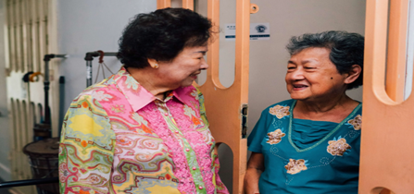
Singapore Population | Home Care Landscape | Regulatory Assessment | Regulatory Approach
During our regulatory review of community-based healthcare models, two major care models of concern emerged: SCS and HN
Stay-in Shared Caregiving (SCS)
Home Nursing (HN)
Assisted living variant which provides appropriate and high quality of care for senior clients by laypersons
A sandbox was created for participating providers to experiment with different care permutations
Current residential options include public housing estates as well as private residential areas, with great demand seen within the sandbox
Mobile nurses who provide nursing care at homes of frail and home-bound elderly who find it difficult to access services in the community
Steady increase in service utilisation, with expected demand to surge with the ageing population
6
Notes:
Other aims of the sandbox include:
address a gap in the senior caregiving landscape;
reduce reliance on foreign manpower while ensuring well-being of care staff; and
demonstrate stay-in shared caregiving as a viable and scalable business model
HN involves such as wound dressing, injections, stoma care and insertion of nasogastric tubes to play a key role in managing and reviewing the care plan of the patient, in consultation with doctors, as well as providing caregiver training. support families in the care of their seniors with the aim to help seniors age in place

Slide 7
During our assessment, HN services was deemed to be at higher risk compared to the SCS services
Singapore Population | Home Care Landscape | Regulatory Assessment | Regulatory Approach
SCS (Laypersons)
HN (Healthcare Professionals)
Service scope
Additional community living option where basic care is provided
Assistance with Activities of Daily Living (ADLs)
Episodic healthcare service to home-bound patients
Clinical assessment and judgement to manage patient, including education of caregivers
Clinical procedures
Medication management
Competencies required
No different from another layperson caregiver (e.g. family)
Up-to-date and relevant professional expertise required
Provider’s control over environment
High, with caregivers living and maintaining care in the same area as residents in an ongoing basis
Low, with nurses providing episodic care as required. Thus, they have less control over the different residential environments visited.
Risk of harm if unregulated
Low, if other mitigation measures implemented
High, service needs to be regulated
7
Notes:
(1) the risk of harm to clients for SCS (including the expanded service scope) is low and can be mitigated with providing service providers and clients/NOK access to a good practice guide*; (2) presence of governance levers such as manpower concessions; and (3) no known adverse/safety signals from existing providers in the sandbox, we propose to take an initial light touch governance approach.
This would balance our intent to allow such a nascent sector to grow/scale without imposing unnecessary regulatory burden at the onset.
Regulatory approach/tools to be applied (e.g. accreditation) could be re-assessed in the future if the risk assessment for SCS changes.
Concerns over outcome. Nurses are delivering care independently in clients’ homes. Visits to selected HN care providers (Annex B) revealed large variation in service standards and governance, which might lead to adverse care outcomes and potentially unsafe patient care. Furthermore, current nurse training is geared towards institutional practice, and not the community setting, which constitutes independent practice. Discussions with CNOO also demonstrated similar concerns within the Home Nursing (HN) and Centre-based Nursing (CBN) services.
Absence of other governance levers to assure care standards are adhered to. Landscape currently consists of subvented and non-subvented providers, and informal engagement of the nursing workforce. Contractual levers only applies to subvented providers.
Limitations of Nurses and Midwives Act (NMA). NMA governs individual nurses’ professional practice, and its reach may not be sufficient to ensure safe and consistent service standards beyond the individual’s competencies. Guidelines are in place on good practices for HN service providers to adhere to but there are no legislative mandate for compliance.
To ensure service providers are able to meet proposed minimum safety standards. A structured governance framework is required to ensure standards in addition to an individual’s professional expertise. Thus, it is desirable to make clear the requirements to be met to assure basic safety standards for the nurses and clients (e.g. no hiring of inappropriate personnel including layperson for nursing tasks).

Slide 8
Thus, our eventual regulation approach was devised accordingly
Singapore Population | Home Care Landscape | Regulatory Assessment | Regulatory Approach
SCS
HN
Licensing not required
Allocate responsibility to the public/consumer in choosing an appropriate service provider and nudge providers to adhere to the good practice guide
As an additional safeguard against the identified risk of certain tasks being performed by untrained individuals, a list of prohibited tasks is being prepared for enforcement via legislation regulating health professionals and / or health services
Licensing required under HCSA
Regulatory Tools
Regulatory Tools
Consumer Education
Stakeholder Education
Guidelines / Standards
Guidelines / Standards
Regulations/ Legislation
Eventual aim of regulating the sector, however, given the high compliance burden, the requirements will be circulated as guidelines at the start for service providers’ feedback and provide sufficient time to gear up
To further inform the team on the sector’s readiness for enforcement, we intend to audit service providers who volunteer first, with the view of fixing the enforcement timeline after assessing information collected from the overall landscape
8

Slide 9
Proposed Principles in Determining Prohibited Tasks
Singapore Population | Home Care Landscape | Regulatory Assessment | Regulatory Approach
Principles for allowable activities for 3rd party lay caregivers
Principles for prohibited activities for 3rd party lay caregivers
(a) Invasive procedures*:
Insertion of tubing (e.g. NGT, IDC)
Phlebotomy
Administration of IV therapy
Complex wound management
(b) Clinical assessment and judgement in relation to the management of a medical condition requiring professional expertise*
Revision or deviation from the client’s existing care plan
Medication dosage adjustment
Education on individualised medical management (except for lifestyle advice e.g. smoking cessation, healthy diet)
(c) Acts which could infringe on the clients’ rights
Application of restraints
(a) Integral part of clients’ ADLs (as prescribed by Healthcare professionals or as an assistive care need by resident/family) and (b) not a prohibited activity
Record and report vital signs
Packing of medications
Assist in medication administration of prescribed medicines. These may include pre-packed oral meds, creams, ear/eye/nose drop, nebuliser and suppositories in accordance to prescribed details or as instructed by family and/or client​
Assist in insulin injection (vial or pen-filled)
Blood glucose checks as requested by family/client
Care of superficial wounds (e.g. skin tear, abrasions)
*Good practice for SCS providers include:
Provider to ensure SCS care staff is trained; ​
Care tasks to be done in accordance with client or family’s instructions;​
Clear documentation including any instructions received from the family; ​
Care tasks to be done only for 1 client at any one time;​
Established SOPs for escalating potential complications and/or deviations which should include informing the family; and ​
Setting out expectations, liabilities and risks from the start with the client and family.​
* This does not preclude the SCS provider or the family from engaging a licensed healthcare provider (e.g. home nursing or home medical) to perform said activity, whether within or outside of the SCS premises.
* The performance of any non-allowable activities may result in the SCS provider / caregiver being taken to task under Professional Acts and/or HCSA.

Slide 10
For Discussion
Singapore Population | Home Care Landscape | Regulatory Assessment | Regulatory Approach
What would the regulatory approach be for the shared stay-in caregivers / ALF care models in your country? What are your views on the risks associated with the described care models without healthcare regulation?
What are the regulations that apply to Home Nursing services in your country, other than professional licenses?
Would you agree with the principles proposed for the prohibited tasks, and are there other principles / activities that should be incorporated within the list?

Slide 11
Thank you.
Singapore Population | Home Care Landscape | Regulatory Assessment | Regulatory Approach

