Slide 1
EPSO conference
Compliance and Just Culture
Leonie Boskeljon-Horst

Slide 2
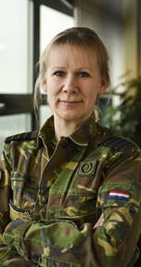
Who am I?
RNLAF officer (Colonel)
Sr aviation psychologist & Human factor specialist
Associate Professor in Human Factors, Just Culture and Psychological Safety / Program Leader Academic Collaborative Centre Just Culture and Social Safety

Slide 3
Next 30 minutes…
Rules, compliance and local ingenuity
Openness and just culture
A pattern found

Slide 4
Dealing with risks: Rules and procedures
Advantages: Memorisation, collaboration, organisational memory, standardisation, easier learning and improved performance
Disadvantages: do not include everything, distance from shop floor, self-thinking discouraged, reduced expertise

Slide 5
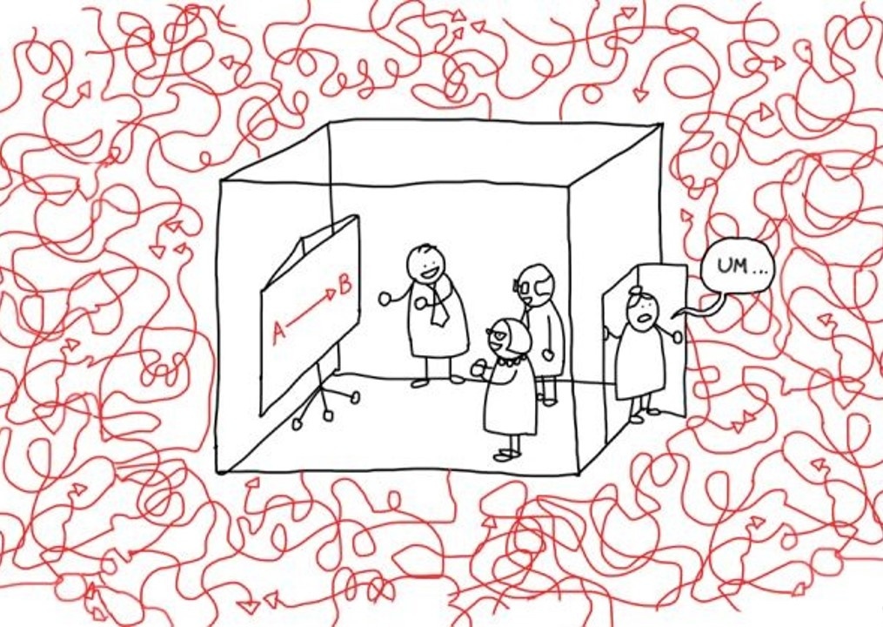
What we actually do…
Rules/procedures regularly an ill-fit
Goal conflicts arise
Solutions:
Perform work less effectively (or not at all)
Come up with creative solutions
Work arounds, violations, short cuts
Local ingenuity!

Slide 6
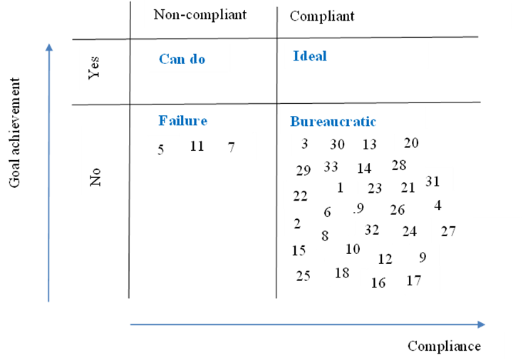
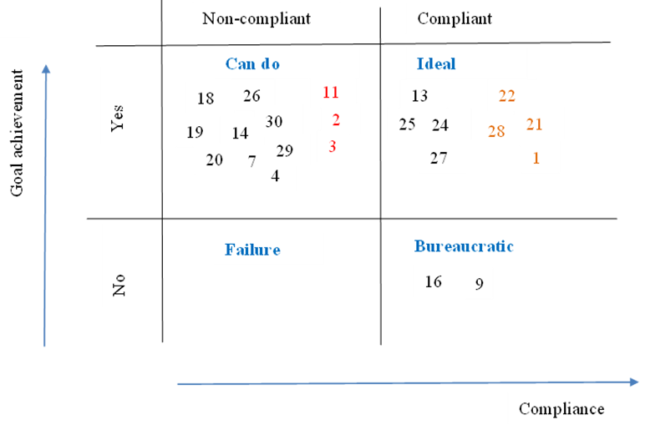
Local ingenuity
Rules don’t fit
Goal conflicts
Local ingenuity
Improved job execution
External pressure
Reduced compliancy
Promise to be compliant
Increased pressure, more compliance activities
Job execution hampered
Local ingenuity

Slide 7
Ingenuity being local
Local ingenuity is hidden out of fear
Local ingenuity not shared or distributed; hence learning hampered and additional risks unseen.
Challenges in high risk organizations are openness and just culture

Slide 8
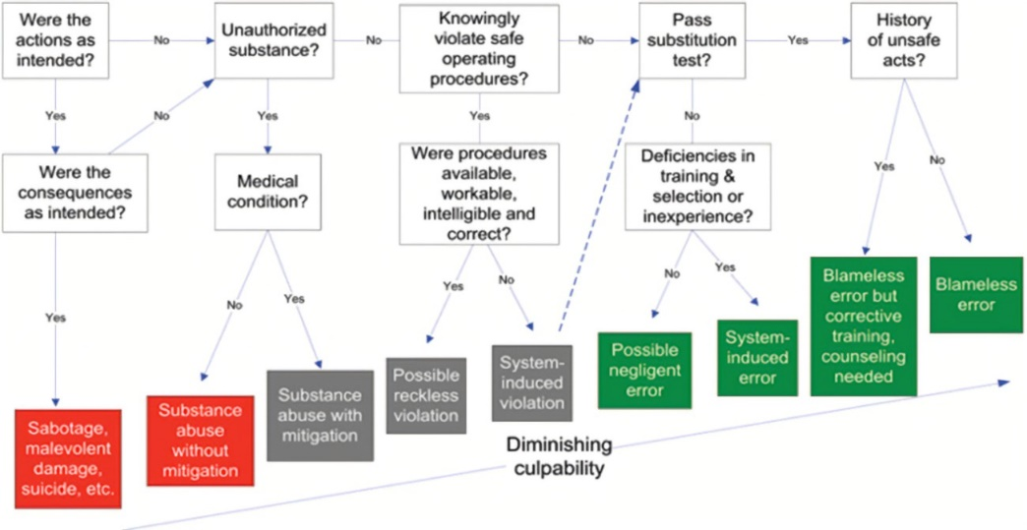
What is ‘just culture’?
Openness and reporting important;
Accountability also important;
Classical Punishment and learning mutually exclusive
Sollution: determine what is and isn’t acceptable, be transparent about consequences = just culture
Compromise between openness and accountability
Primary human response to bad news and the way we deal with involved colleagues.

Slide 9
First generation just culture
Response
Retributive (focus on reclaiming balance)
Questions
What rule has been broken?
Who did that?
How bad is this and what are the consequences?

Slide 10
Claim: neither openness nor accountability achieved
Although transparent and fair (proportional), a judgement will be made.
Accountability done to you is fundamentally different from accountability embraced.
Result?

Slide 11
Alternative: restorative just culture
Response:
Restorative (focus on restoration and learning)
Questions:
Who is hurt?
What do they need?
Who can provide this?
Result?

Slide 12
To summarize
Retributive
Quick
Decisive
Confirming standards
Feels less just
Learning hampered
Looking back
Restorative
Feels more just
Economic/recurrences
Preserving openness
Takes time
Political pressure
Moral courage

Slide 13
Pattern found
Rules don’t fit
Goal conflicts
Retributieve just culture
Local ingenuity
Improved job execution
External pressure
Reduced compliancy
Local ingenuity hidden
Promise to be compliant
Paper ≠ practice
Increased pressure, more compliance activities
Management no idea
Increased complexity
Job execution hampered
Local ingenuity
Goal conflicts

Slide 14
To sum up…
Rules & procedures can widen the gap between paper and practice;
Local ingenuity as solution to goal conflicts and hampering R&P;
What is needed: paper (R&P) and practice (expertise, local ingenuity) in balance: freedom-in-frame;
Precondition: a restorative just culture;
Management needs to know how success is achieved.

Slide 15
So…
Openness and trust crucial;
Multiple realities as opposed to one perspective;
A different response is required, a restorative just culture with a focus on understanding, respect, learning, restoring and accountability:
Be patient.
Sit back. Relax. And enjoy the failure.
Wisdom comes with time.

Slide 16
Questions or comments?

