Slide 1
EPSO conference NZA – NVTZ - Vilans
New leadership models in
health and social care
Prof .dr. Mirella Minkman & Aad Koster
CEO Vilans, National Center of Chair of the board NVTZ
Excellence for care and support, EAHSA
Tilburg University - TIAS
vilans.nl
December 2024

Slide 2
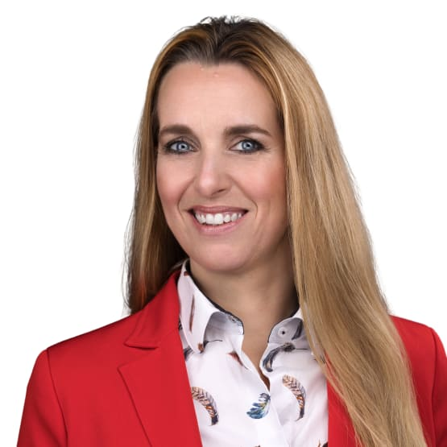
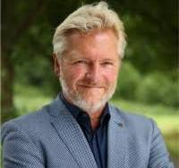
Short introduction
Aad Koster
Chair of the board NVTZ,
National Association for Supervisory
Board members in Healthcare
European Association of Homes and Services for the Ageing (EAHSA)
Experienced CEO and
supervisor
Former chair of Actiz
Mirella Minkman
CEO of Vilans
Professor TiU – TIAS, Innovation of the organisation and governance of integrated care
Supervisory board member Hospital Rivierenland, RIBW Brabant
Chair Scientific Advisory Board
NVTZ and Chair IAC committee for
the innovation of governance

Slide 3
Governance challenges in health & social care in the Netherlands

Slide 4
Roles of the Supervisory Board
Discuss and approve budget, annual accounts, strategic plans and major real estate decisions
Exercise the employer function with respect to the Executive Board
Thinking about strategic issues and giving feedback
Keeper of the dialogue

Slide 5
Dutch Healthcare Authority (NZa) & Health care Inspectorate (IGJ): Good governance framework
1. The supervisory board invests in its own supervisory vision and formulates objectives and actions
2. The supervisory board monitors risk management with attention to behaviour and culture
3. The supervisory board also serves the public interest beyond the boundaries of its own organisation
4. The supervisory board ensures its own diversity and professionalism
5. The supervisory board ensures independence and avoids mixing interests
6. The supervisory board ensures transparent and balanced decision-making and provides public accountability

Slide 6
“Society is changing, so healthcare
should change and adapt also”

Slide 7
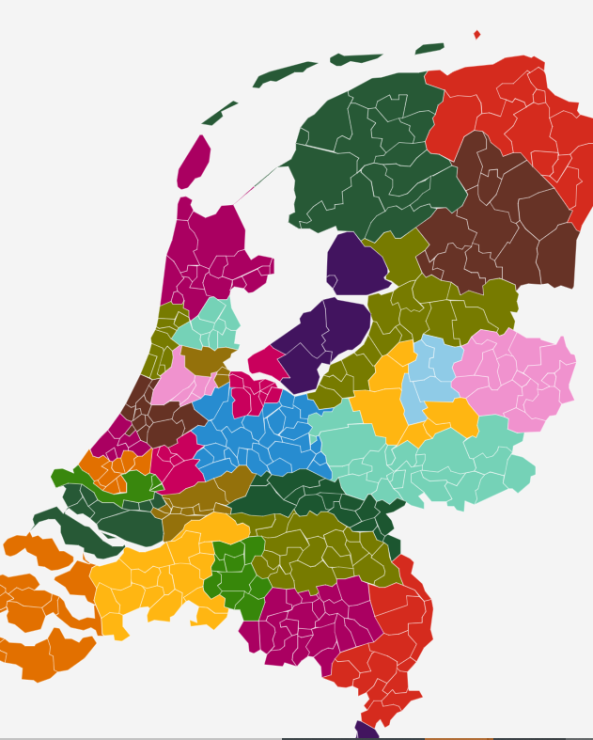
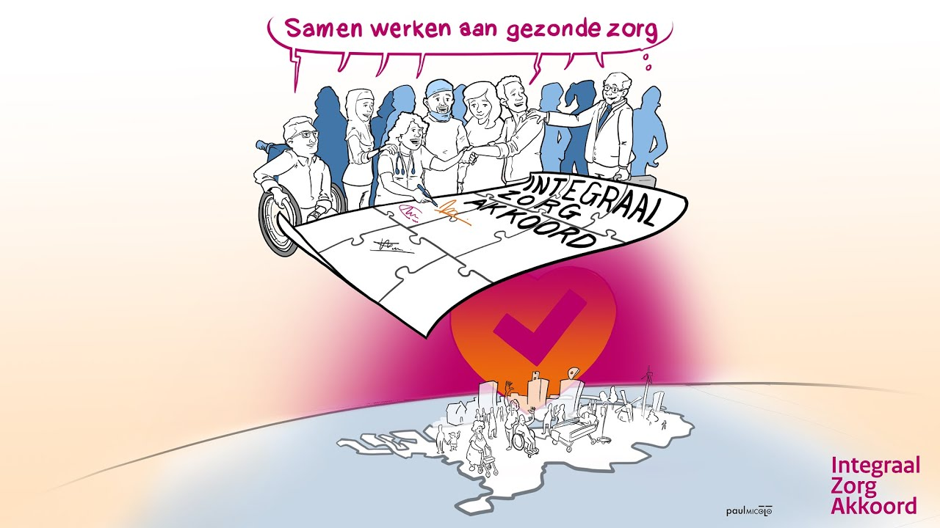
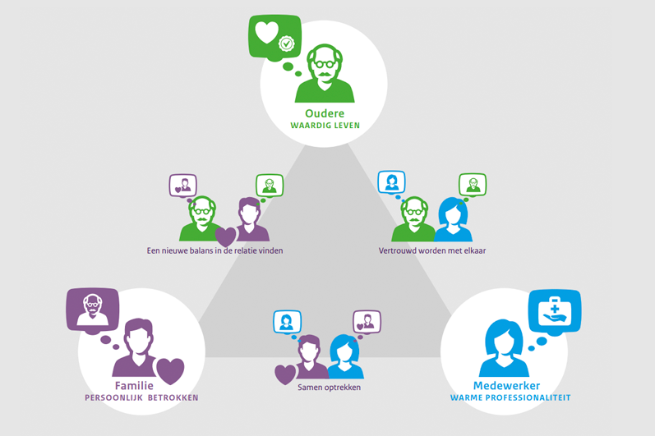
The Netherlands: transformation time
Innovation at 4 levels
National. A history of integrated care initiatives….
2022: Integrated Care Agreement
Right care, right spot. At home as long as possible
Regional collaboration of
welfare & care providers
Regio characteristics
Suitable scale?
Transformation plans
Social & tech
innovation
We need: caring communities
>2000 initiatives, but huge need
From institutionalisation towards
an inclusive society
Challenge:
Real cooperation
between profes-
sional, carer and
person, new
balance.
Impopular
message: supporting
elderly is an issue
of society, not of
healthcare

Slide 8
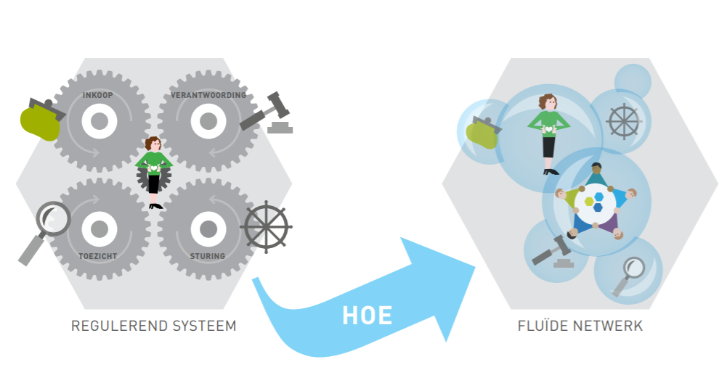
Towards other organisational modes

Slide 9
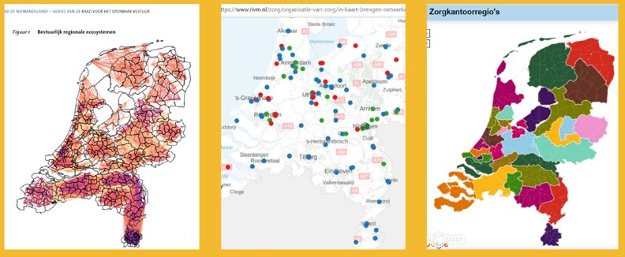
A pluriformity of networks....

Slide 10
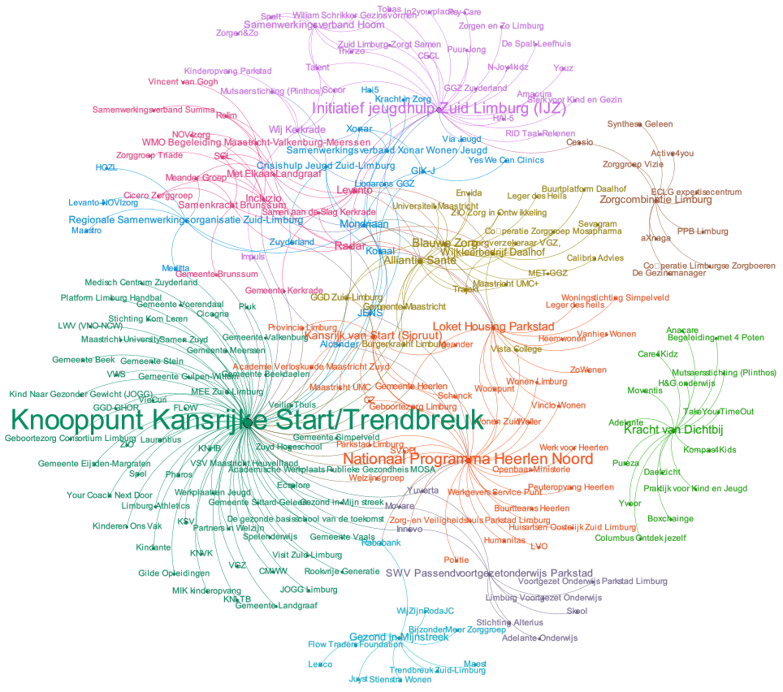
Youth care in the south
of the Netherlands
Multiple networks in a relatively small area. All on youth care; not even complete. Start is ‘the Jens network”.
Some are not connected with the rest (Zorgcombinatie Limburg, Kracht van Dichtbij, Gezond in Mijnstreek).
JENS is interwoven wit other networks. This raises the question: who is accountable for the quality of care and the outcomes delivered? What is the entity for supervision and accountability?

Slide 11
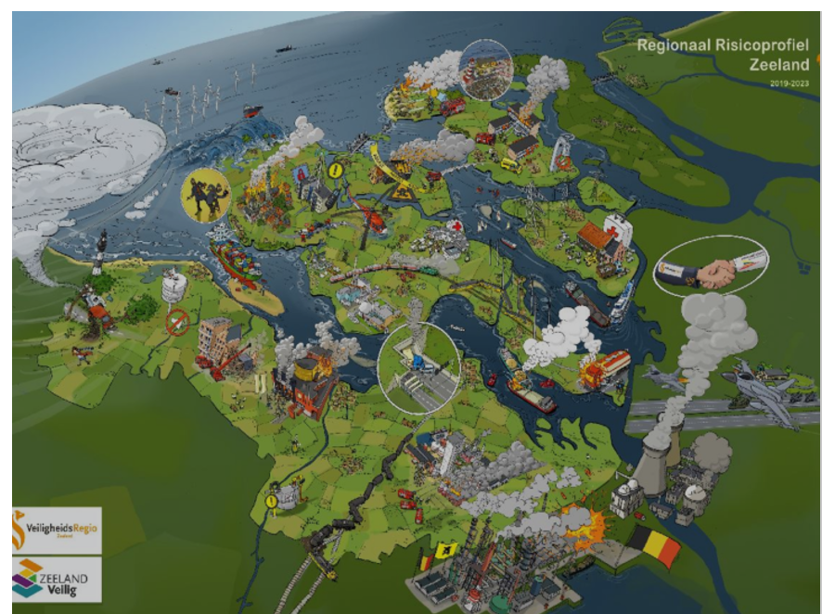
Interorganisational networks and
eco-perspectives

Slide 12
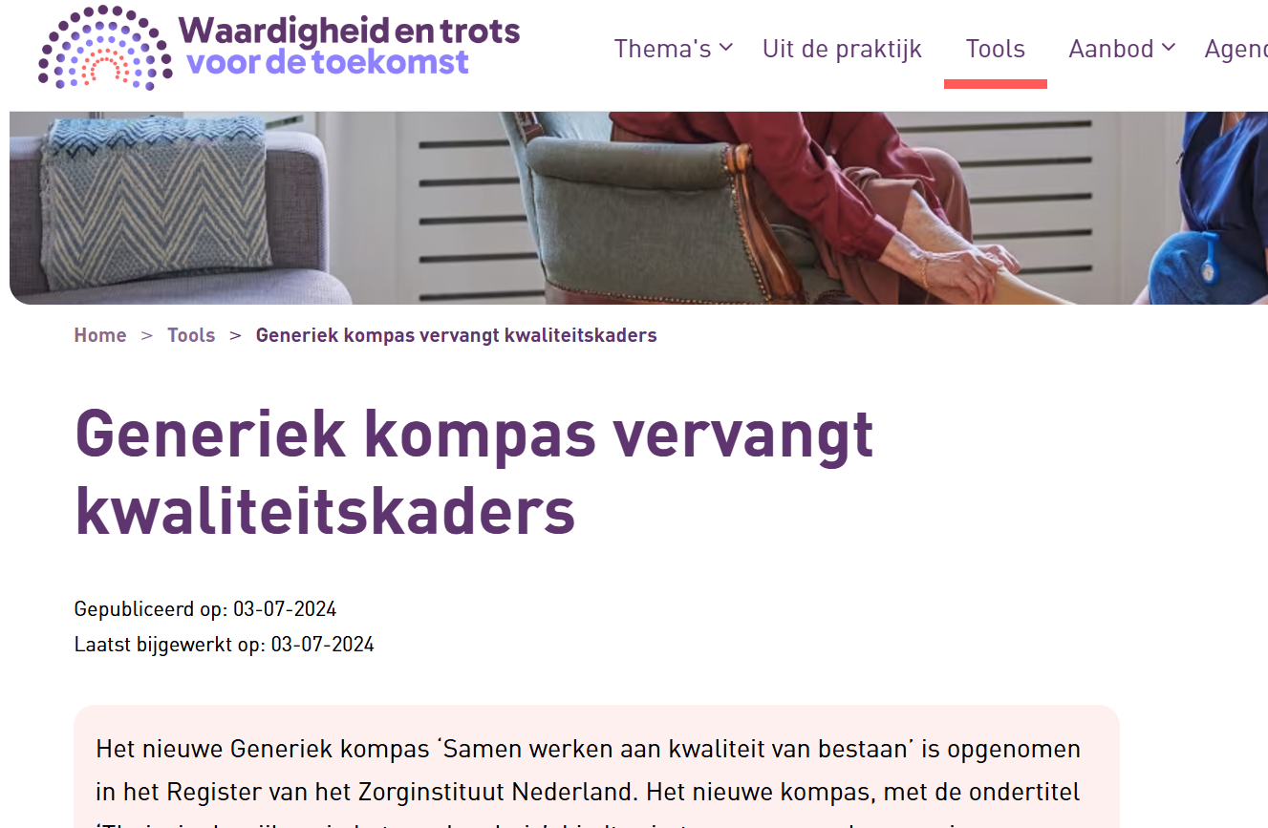
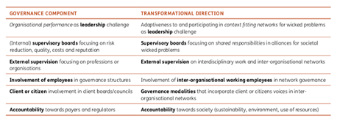
Developments in governance and leadership
From governance towards governing, leadership in partnerschip
Supervisory boards; from a focus on finances, towards quality, towards society
Quality frameworks as a guide, not as ‘a protocol’
Changing accountability: from initial control-distrust, a call for reducing administrative restraint, trust Shared collaborative models: involving professionals, families/clients, innovation of mede)zeggenschap
Governance and interorganisational networks, purpose oriented networks in the region – ecosystem thinking
Role of the citizen– the community- participation
Minkman, M (2022). Slowing down to accelerate:the innovation of the fundamentals of integrated care governance.

Slide 13
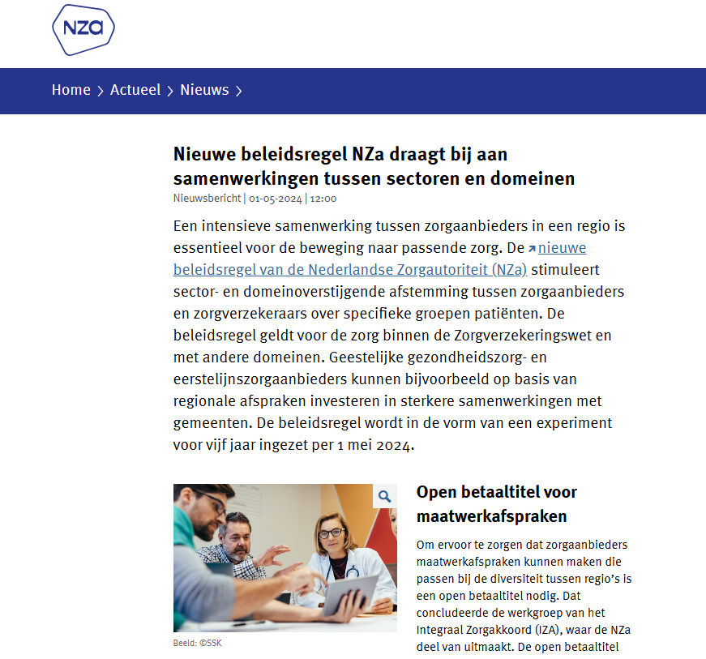
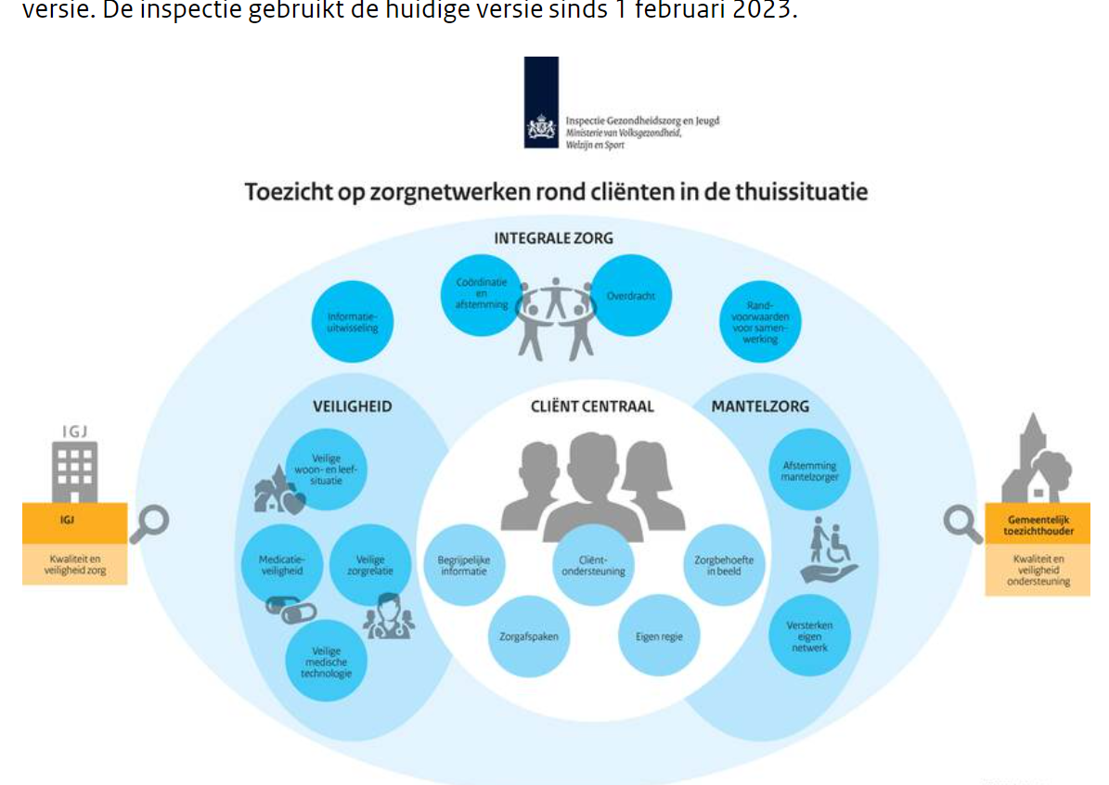
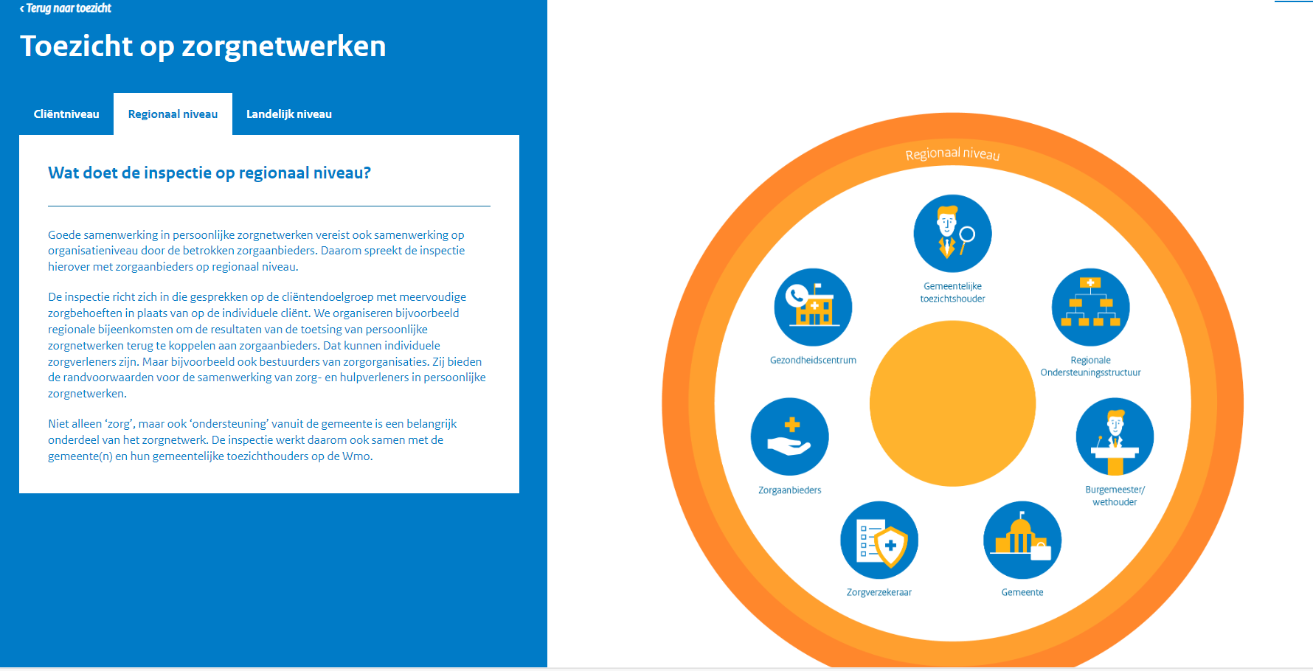
Toezicht op zorg in zorgnetwerken | Zorgnetwerken | Inspectie Gezondheidszorg en Jeugd (igj.nl)
Zorgnetwerken | Inspectie Gezondheidszorg en Jeugd in oprichting (igj.nl)

Slide 14
Towards shared and collaborative governance

Slide 15
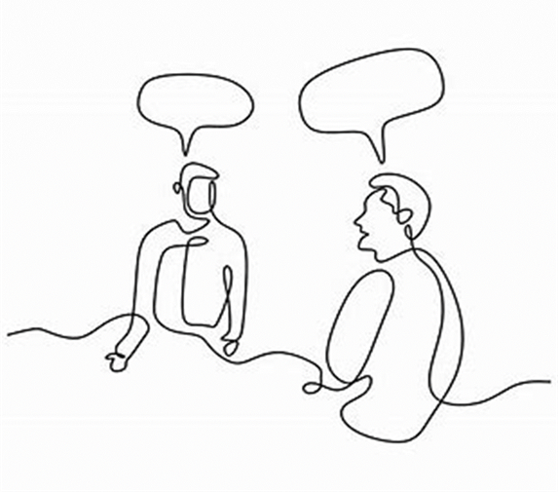
Network confusion: different organisational modes
New challenges:
What modes, what organisational structure
Decision making in networks
Effectiveness of networks
Measuring impact of networks
…..
What network are we talking about….
Learning networks
Shared services -purchase
Eco-system, platform collaboration
Purpose-oriented networks

Slide 16
Options for organisational (network) modes
(Bron: Provan en Kenis 2008)

Slide 17
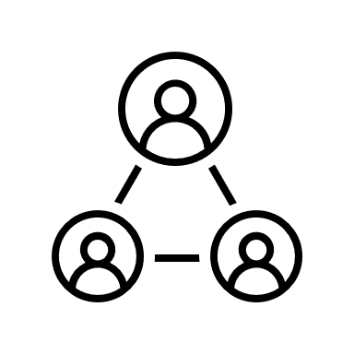
Decision making dilemma’s in networks
Underlying dilemma
Decision-making
Dilemma 1
Autonomy
Interdependence
Efficiency
Dilemma 2
Coherence
Diversity
Dilemma 3
Self-interest
Common goals
Inclusiveness
Bron: J Michgelsen et al. (2022). Decision-making dilemmas within integrated care service networks: A systematic literature review. IJIC

Slide 18
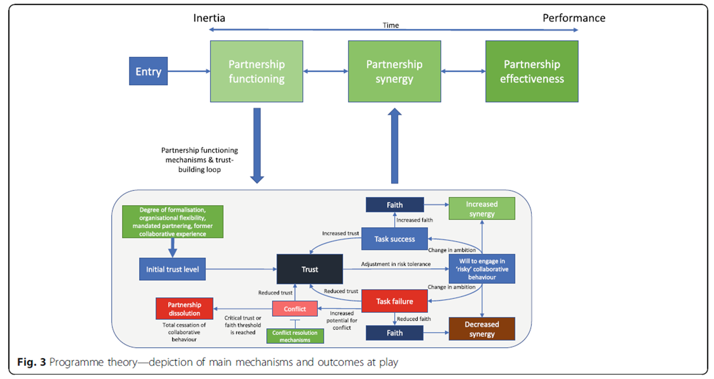
Bron: Aunger et al. (2021). Why do some inter-organisational collaborations in healthcare work when others do not? A realist review

Slide 19
old power
new power
Currency
Held by a few
Pushed down
Commanded
Closed
Transaction
Current
Made by many
Pulled in
Shared
Open
Relationship
Jeremy Heimens, Henry Timms New Power (2018)

Slide 20
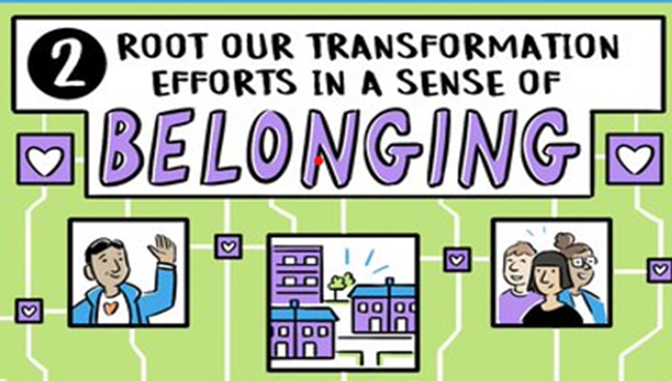
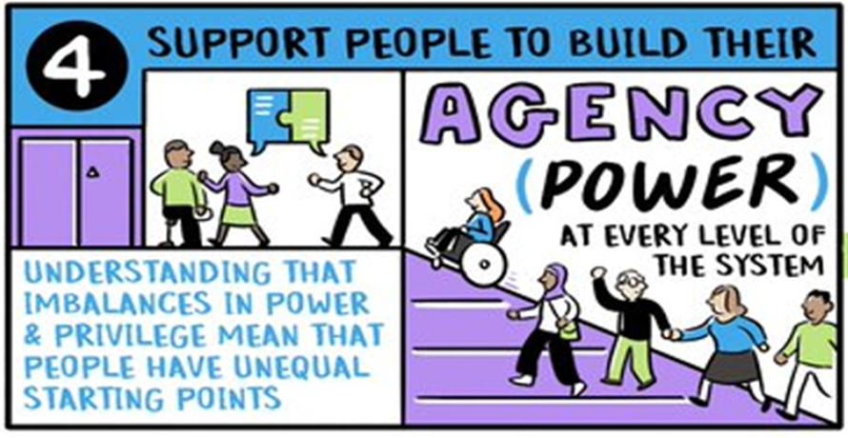
Human synergy

Slide 21
Supervisory arrangements &
the role of inspectorates

Slide 22
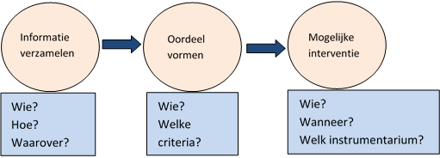
EISON: External & Internal Supervision on Organisational Networks
Complex wicked problems
Organisational networks
Intern
Arrangements
for supervision
Extern
What’s the question?
In what way are external and internal supervisory arrangements suitable for organisational networks and do they add value towards solving complex problems in society?

Slide 23
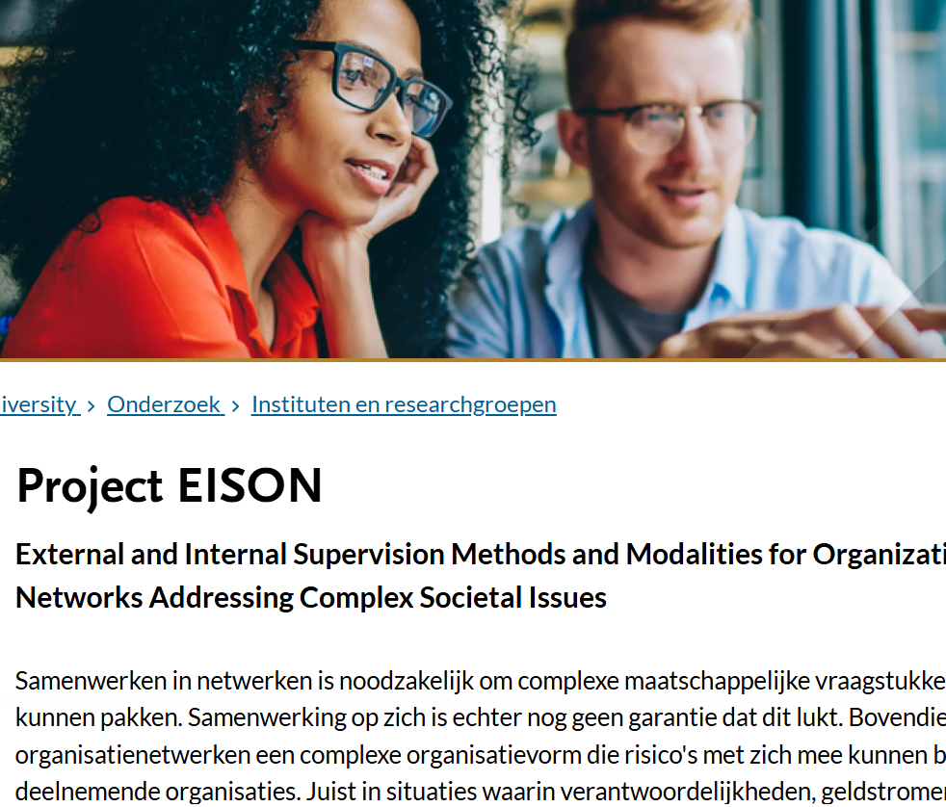
Arrangements for leaders and supervisors?
On which networks to focus? Having an overview, prioritize.
Getting to know other supervisors in the region. Is there a shared purpose and commitment?
What is the subject of supervision/inspection?
The organisation within a network?
An inter-organisational network?
The region/community…
Arrangements for new/leaders stepping in?
Clarity about what supervisors are for/what not? What topics, agreements..
Shared information from the network for all supervisors?
Shared decision making agreements in the network
……
Notes:
Vanuit welke perspectief en waarop willen wij als RvT toezien?
• Hoe, wanneer en waarover neemt de bestuurder de RvT mee bij (nieuwe) samenwerkingen?
• Welke ruimte heeft de bestuurder nodig om samenwerkingen te realiseren én wat kan de RvT dan wel doen en wat juist niet?
• Wat geeft de RvT genoeg comfort om vertrouwen en ruimte te geven?
• Heeft de RvT ook een rol in de samenwerkingsverbanden en netwerken waar de organisatie actief in is? En zo ja, wat is dan die rol?
• Hoe voorkomen we een stapeling van toezicht en blijft het werkbaar?

Slide 24
Discussion points
Similar challenges?
Scale and focus for supervision?
How do fitting and suitable arrangements look like….

Slide 25
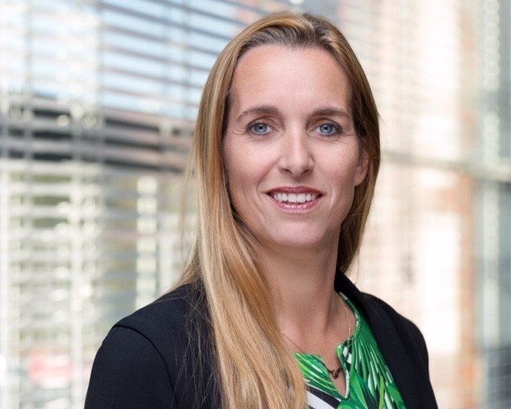
Thank you for your attention
Prof. dr. Mirella M.N. Minkman
Voorzitter Raad van Bestuur
Vilans, Kennisorganisatie voor zorg en ondersteuning
Bijzonder Hoogleraar
Innovatie van organisatie en besturing van integrale zorg. University of Tilburg/ TIAS School for Business and Society
www.vilans.nl en www.tias.edu
m.minkman@vilans.nl en m.minkman@tias.edu
Assistente: Simone van Emmerloot s.vanemmerloot@vilans.nl

Slide 26
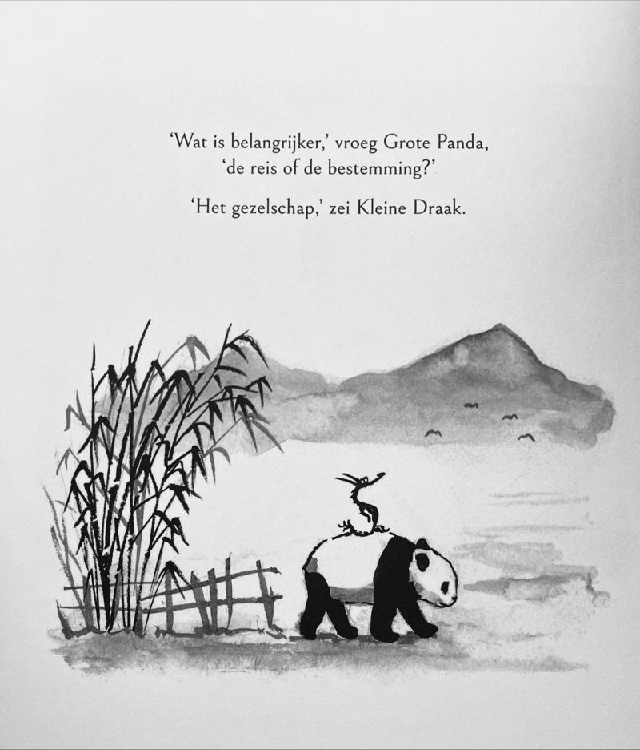

Slide 27
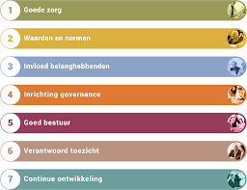
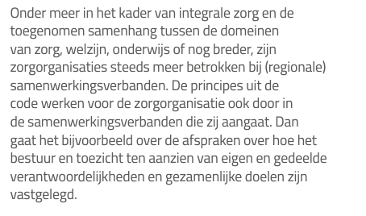
Governancecode Zorg (2022)
De verantwoordelijkheid eindigt niet bij de deur van
de organisatie
Het aangaan of verbreken van duurzame samenwerking met andere
rechtspersonen of vennootschappen die van ingrijpende betekenis zijn
behoeft goedkeuring van de RvT
Vanuit advies IAC Governance:

Slide 28
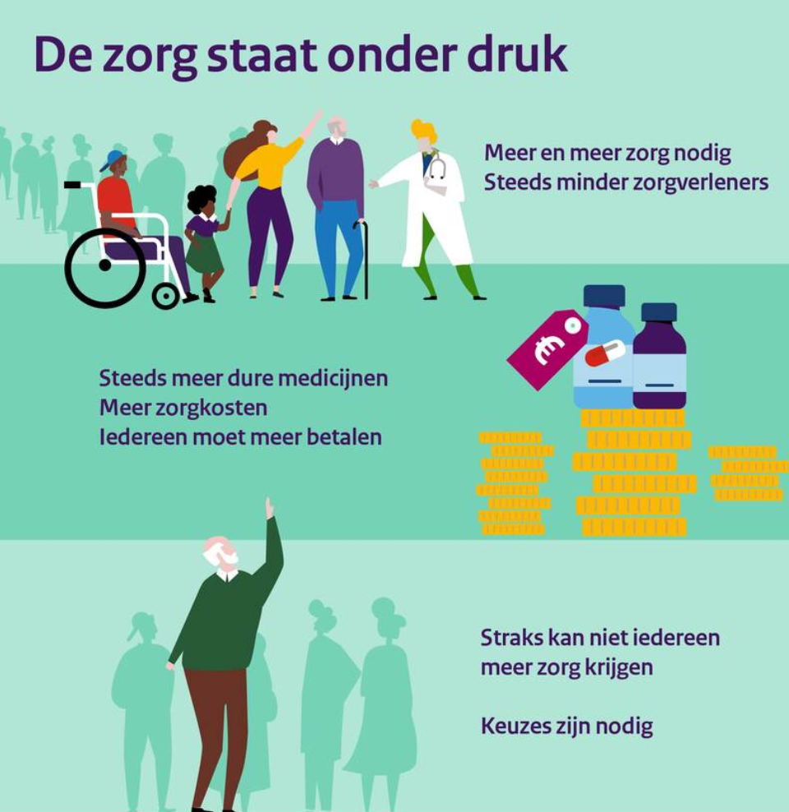
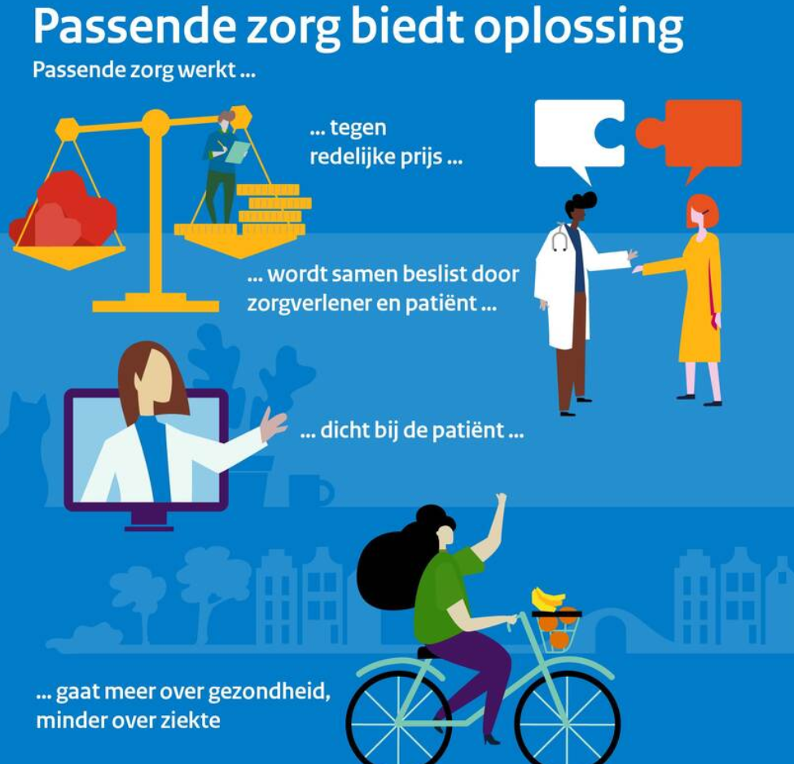
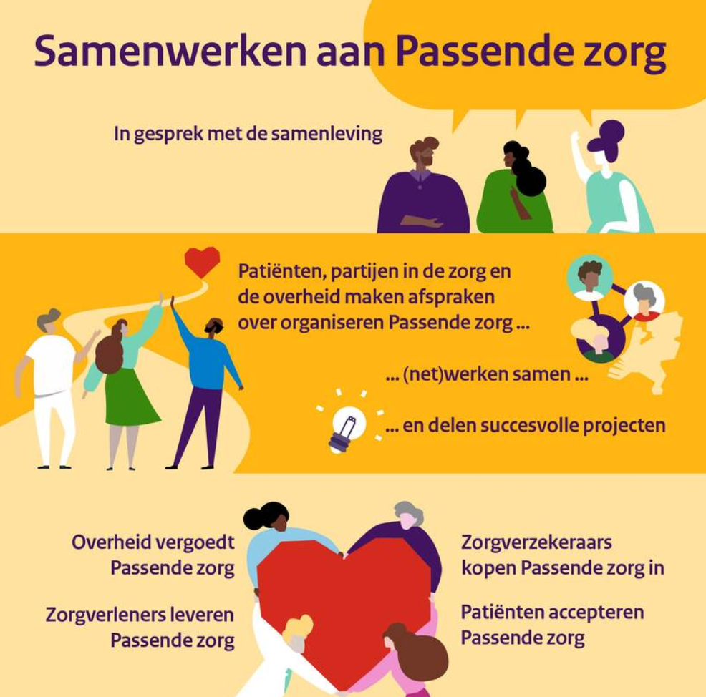
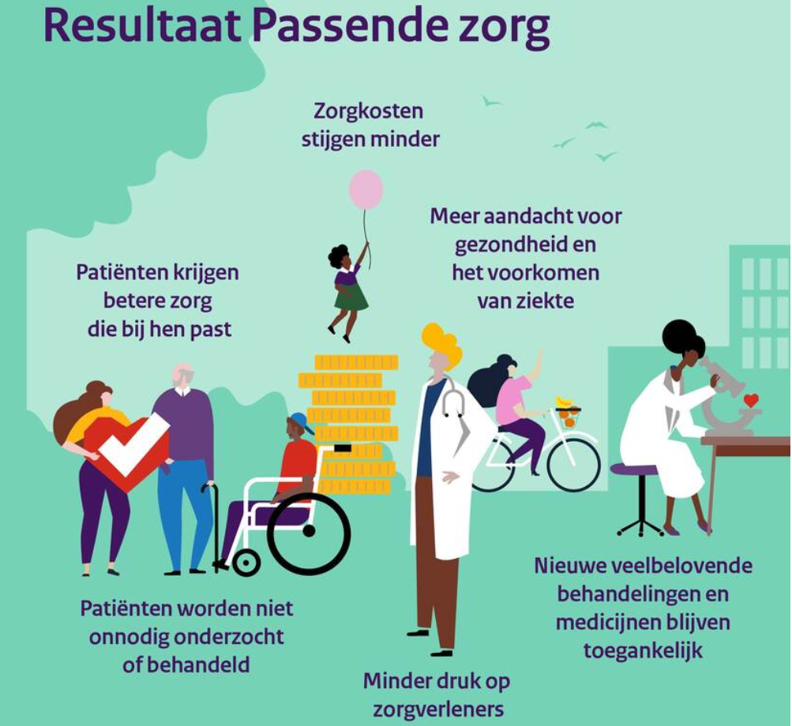
Samenwerking, ja … maar waarvoor, welke en hoe?
De zorg van de toekomst … een zorg
Samenw* = 206x op 117p.

Slide 29
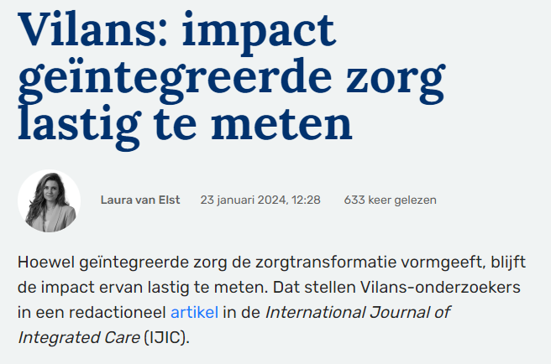
https://ijic.org/articles/10.5334/ijic.7783
https://www.skipr.nl/nieuws/vilans-impact-geintegreerde-zorg-lastig-te-meten/

Slide 30
