Slide 1

Regulation of home care and the role of knowledge and large-scale improvement programs
door
  Anneke Augustinus, director of Knowledge Application and Aging Society
12 december 2024

Slide 2
Program
Transformation agenda as a start for legislation /regulation
Role of Vilans
Transformation supported by knowledge and implementation programs

Slide 3
Transformation agenda elderly care and support

Slide 4



General assignment
Public values
Quality
Accessibility
Affordability
Staffability
Preconditions
Personal responsibility
Solidarity

Slide 5
Future agenda for the elderly care and support
Prevention
Prevention
Quality of life
Reallocation
Close to/in home
Networks
Replacement
Technology
Informal care

Slide 6
Focus on:
Vital and independent ageing
Good general care in the neighborhood
Reducing staff shortages
Reduction of administration
Accessibility of care through appropriate care and sufficient accommodation
Specific attention to:
last stage of life through palliative and terminal care
dementia

Slide 7
How to realise?
Policy
Legislation and regulations
Financial insentives
Knowledge
Support programs

Slide 8
Role of Vilans

Slide 9
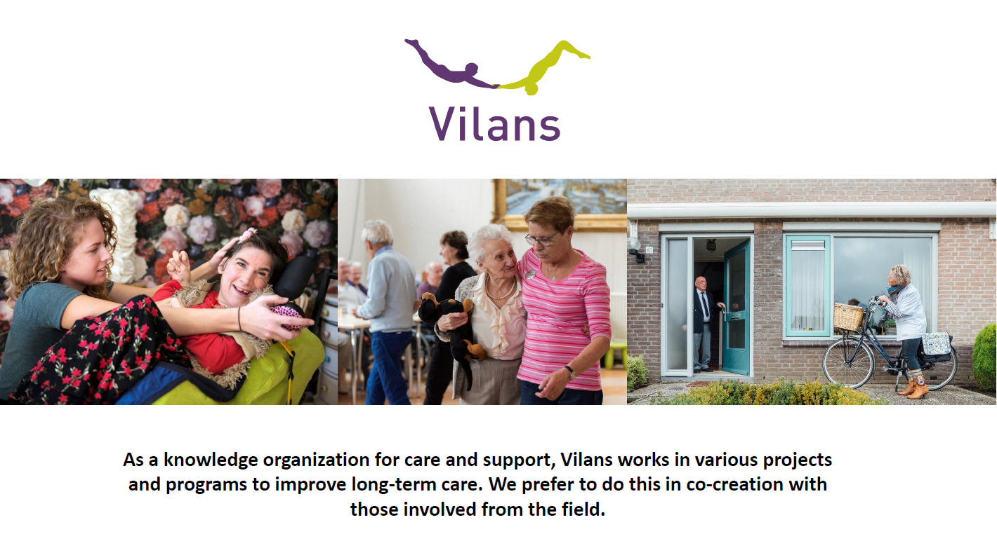

Slide 10

Facts & Figures
Founded in:
Employees:
Online visitors per year:
Organizations provided with knowledge:

Slide 11


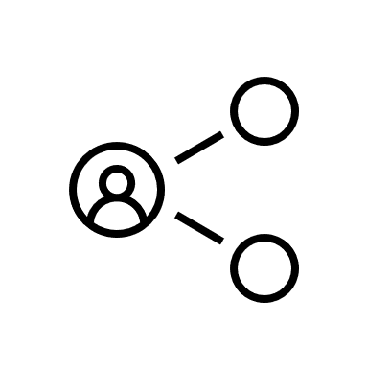
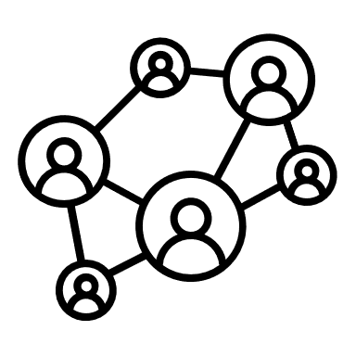
How do we do that?
Enriching & Validating
Collecting
Connecting & applying
Sharing
Notes:
Verzamelen
Identify and match knowledge questions with existing knowledge and/or convert them into research questions!
Verrijken en valideren
Develop knowledge and make it usable
Verspreiden en toepassen
Making knowledge easily accesible for healthcare professionals (online and offline)
Give advice and support in the implementation so that the knowledge is used properly
Broadly speaking this is the trajectory we follow

Slide 12
Knowledge and for whom?
Knowledge for the basic skills
Knowledge: inspiration, information, instructions, toolbox, protocols
Why: easy access to knowledge, support needed, on demand, strongly adviced by the health and youth care inspectorate or care office
Individuals
Networks
How: websites, webinars, learning communites, courses, individual support
Knowledge as an accelerator
Notes:
Verzamelen
Identify and match knowledge questions with existing knowledge and/or convert them into research questions!
Verrijken en valideren
Develop knowledge and make it usable
Verspreiden en toepassen
Making knowledge easily accesible for healthcare professionals (online and offline)
Give advice and support in the implementation so that the knowledge is used properly
Broadly speaking this is the trajectory we follow

Slide 13
Challenges home care?
Knowledge for the basic skills
Less performance indicators
Appropriate care
To colleborate with (in) formal care / a caring society / technology
Integrated care/community teams (social work, home care, medical care ets.)
Individuals
From home care to community care to a caring society =
New quality framework
Networks
Learning organisation
Knowledge as an accelerator
Notes:
Verzamelen
Identify and match knowledge questions with existing knowledge and/or convert them into research questions!
Verrijken en valideren
Develop knowledge and make it usable
Verspreiden en toepassen
Making knowledge easily accesible for healthcare professionals (online and offline)
Give advice and support in the implementation so that the knowledge is used properly
Broadly speaking this is the trajectory we follow

Slide 14
Challenges board members home care
Knowledge for the basic skills
How do you finance the deployment of a specialist elderly care in primary care for clients who live independently together
What is future proof quality of care and how to monitor within the new quality framework?
Binding and captivating employees
Individuals
Regional innovation vs intern implementation
Networks
Supervisory board and Regional Cooperation
How can we create awareness among employees for the necessary changes?
As a small-scale home care organization, how do you work together with various GP practices in the region?
Collaboration with minicipalities, housing cooperatives, citizens and the neighbourhood
Knowledge as an accelerator
Notes:
Verzamelen
Identify and match knowledge questions with existing knowledge and/or convert them into research questions!
Verrijken en valideren
Develop knowledge and make it usable
Verspreiden en toepassen
Making knowledge easily accesible for healthcare professionals (online and offline)
Give advice and support in the implementation so that the knowledge is used properly
Broadly speaking this is the trajectory we follow

Slide 15
Challenges professionals home care
Knowledge for the basic skills
What are the legal aspects of the involvement of informal caregivers and volunteers in the care?
How to colleborate with (in) formal care / a caring society
Individuals
Team of the future
Networks
How do you shape the collaboration with informal care if someone has no network?
How can the vision of future-proof care be translated into concrete processes and behavior?
Knowledge as an accelerator
Notes:
Verzamelen
Identify and match knowledge questions with existing knowledge and/or convert them into research questions!
Verrijken en valideren
Develop knowledge and make it usable
Verspreiden en toepassen
Making knowledge easily accesible for healthcare professionals (online and offline)
Give advice and support in the implementation so that the knowledge is used properly
Broadly speaking this is the trajectory we follow

Slide 16
Role of Vilans
We help/support with knowledge as a catalyst for change. Knowledge of:
The fundamentals of care and support
Good practices and innovations
Organizational principles and structure
Transformation, learning organization

Slide 17
Collaboration with minicipalities, housing cooperatives, citizens and the neighbourhood
Knowledge
How do you finance the deployment of a specialist elderly care in primary care for clients who live independently together
Knowledge for the basic skills
cross-domain financing, more than a conversation about euros
cross-domain financing, contro, over shifting costs and benefits
values ​​map for integrated care
Supervisory board and Regional Cooperation
Individuals
Regional innovation vs intern implementation
Networks
As a small-scale home care organization, how do you work together with various GP practices in the region?
A good conversation about supervision of netwerks co-creation with Common Eye and Levinas institute
The governance of network care unraveled. Why “joint management” is important and complicated.
guidance on collaboration and task reorganization in elderly care
Knowledge as an accelerator
Notes:
Verzamelen
Identify and match knowledge questions with existing knowledge and/or convert them into research questions!
Verrijken en valideren
Develop knowledge and make it usable
Verspreiden en toepassen
Making knowledge easily accesible for healthcare professionals (online and offline)
Give advice and support in the implementation so that the knowledge is used properly
Broadly speaking this is the trajectory we follow

Slide 18
Large scale improvement programs
Programs support:
Regional networks, cooperations (power of the region)
Illness or theme related networks (dementia network, informal care network)
Care providers (special attention to small scale providers)
Professionals
How:
Knowledge
Learning
Coaching

Slide 19
Large scale improvement programs
Large scale improvement programs, focus on:
Technical, social and organisational innovations
Implementation of legislation and regulation (care and forcement law, quality of care)
To improve a specific element of care (infection prevention / medical generalist care)
Speed up the tranformation by scale up and implement innovations (Dignity and pride for the future)

Slide 20
Programs
Knowledge for the basic skills
How do you finance the deployment of a specialist elderly care in primary care for clients who live independently together
Medical generalist care
What is future proof quality of care and how to monitor within the new quality framework?
Dignity and pride for the future
Binding and captivating employees
Individuals
Regional innovation vs intern implementation
Networks
Supervisory board and Regional Cooperation
The power of the region
As a small-scale home care organization, how do you work together with various GP practices in the region?
How can we create awareness among employees for the necessary changes?
Collaboration with minicipalities, housing cooperatives, citizens and the neighbourhood
Knowledge as an accelerator
Notes:
Verzamelen
Identify and match knowledge questions with existing knowledge and/or convert them into research questions!
Verrijken en valideren
Develop knowledge and make it usable
Verspreiden en toepassen
Making knowledge easily accesible for healthcare professionals (online and offline)
Give advice and support in the implementation so that the knowledge is used properly
Broadly speaking this is the trajectory we follow

Slide 21
Lessons learned

Slide 22
Lessons learned
Awareness and active outreach to those directly involved is crucial, big gap between policy and daily practice.
Critical success factor: management (leading coalition) and personnel changes
Transformation needs the involvement and commitment of the entire organization, from the supervisory board to support staff.
Focus is often on the objectively verifiable criteria, the real change is in the more subjective criteria, the soft skills.
There is a positive correlation between improvement and work pleasure.
The willingness to change is high but there is unconsciously incompetence.
Use a mix of learning interventions: passive, active, training on-the-job.
Tranformations involves a behavioral change, from those directly involved and from society and takes time.
Not invented here syndrome.

Slide 23
Strengthen the capacity for change:
needed, for the challenges of today and those of the future

