Slide 1
Financing the quality of care in French hospitals
EPSO meeting Tallinn 30 mai 2024
Mikael HAUTCHAMP

Slide 2
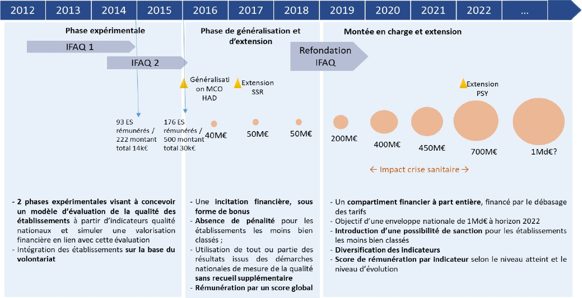

Quality financing has been available in France since 2012
Introduced in 2012 : Financial Incentive for Quality of Care (Ifaq).
Generalized in 2016
budget for the Ifaq has been gradually increased from €50m to €700m by 2022, with a target of €1bn.
The scheme, financed by a deduction from the activity-based funding allocation, was then transformed to benefit almost all hospitals
Other financial incentives based on quality funding for emergencies and local hospitals, a fixed fee for the treatment of chronic kidney disease), and several experiments have been carried out
Notes:
"medicine, surgery, obstetrics" (MCO) field, including hospital at home (HAD), this financial incentive was subsequently extended to medical and rehabilitation care establishments (SMR) and recently to psychiatric centres

Slide 3
Despite few evaluation, positive results
The results of international studies of pay-for-performance experiments are generally mixed (Mendelson, Kondo, Damberg et al (2017), The Effects of Pay-for-Performance Programs on Health, Health Care Use, and Processes of Care: A Systematic Review. Ann Intern Med) ;
According to a Cochrane literature review in 2019, schemes that would tend to produce positive effects on process indicators and much less clear-cut effects on intermediate or outcome indicators
In France, the evaluation of the Ifaq system in its experimental form does not differ in its conclusions from the international literature but quality funding schemes are viewed positively by stakeholders
The signal sent out by politicians is seen as important for raising awareness among the various players and changing practices

Slide 4
A system too complex to be used as a quality management tool
Share of the Ifaq grant in the resources of health care institutions
The Ifaq system, as it is currently implemented, suffers from several limitations :
  lack of predictability of the parameters used in the model, prior to data collection
  the methods used to calculate the allocation appear to be particularly opaque to those involved
  it is so difficult for the players involved to make the link between the grant paid and the results observed on the indicators
  Too many process indicators, lack of outcome indicators
An endowment that is still a very small part of the Hospital’s resources and therefore not very discriminating. With an amount set at €700m, the Ifaq allocation represents only 1.1 % of the total economic valuation of healthcare establishments.
Notes:
The Ifaq system, as it is currently implemented, suffers from a number of limitations that make it unsuitable for the financial management of quality improvement levers or for a managerial approach to promoting quality
[107] In addition to the lack of visibility for hospitals regarding the indicators against which they are assessed, the methods used to calculate the allocation appear to be particularly opaque to those involved.

Slide 5
A new financing scheme proposed
Objective : provide meaningful incentives for healthcare professionals, within a quality policy whose overall coherence would be clear to them.
  requires measurable indicators at department level, as well as indicators by specialty or pathology, which focus on the well-being of patients throughout their care pathway, which is the main motivation for healthcare teams.
The main level is to unify, renovate and extend the current system by restoring its original objective of providing financial incentives to improve quality.
The current quality-based financing schemes (Ifaq, contracts to improve the quality and efficiency of care, and the quality components of funding for emergency facilities and local hospitals) would be integrated into a unified and simplified Ifaq system.

Slide 6
Incentives for hospitals based on a portfolio of indicators
Pillar 1: A set of indicators would focus on cross-functional quality measurement indicators calculated, as far as possible, at the level of care departments, thanks to automated data collection. Two blocks could be distinguished:
The first block would constitute a base of permanent indicators common to all. The aim is to evaluate health establishments based on their level of performance (certification, pain management, patient satisfaction, but also quality of life at work for carers);
The second block would be made up of temporary indicators, included in the model for a limited period. for example: the reporting of undesirable events, the development of eco-responsible care, increased use of home hospitalization or outpatient surgery.. reflecting the current priorities.
Establishments would be assessed on the basis of changes in their performance on these indicators and would be supported in this by national and regional health agencies, health insurance, regional support structures and, where appropriate, networks (perinatal, cancer).

Slide 7
Incentives for hospitals based on a portfolio of indicators
Pillar 2 would focus on the measurement and analysis of results of care, by specialty or pathology. Its implementation requires in-depth work with the professions, by mobilizing their learned societies, to identify the relevant indicators and the methodology for calculating and adjusting them within a framework set at national level.
The financial incentives for quality is based on two principles:
Establishments would be remunerated on the basis of indicators that measure how well teams engage in measuring and comparing results among peers, rather than on the results themselves.
The financial incentive would also be increased in the event of integration of a measure of patient care results (Patient Reported Outcome Measurement – PROM), essential for measuring the relevance of care

Slide 8
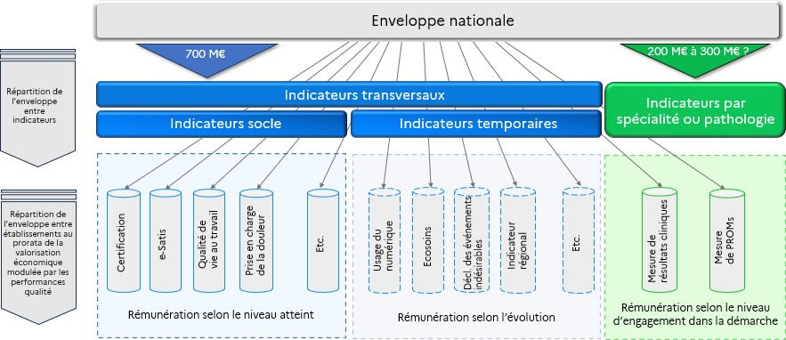
Schematic presentation of the new quality-based funding model for hospitals
Notes:
National envelop, 2/3 for transverse indicators, 1/3 for outcome indicators by speciality ou pathology. Would cost a total of 1bn€

Slide 9
Conditions for success
The Inspection recommends overhauling the governance of quality in healthcare:
To this end, it proposes setting up a national governance body, with responsibility for the entire healthcare system and led by a small multidisciplinary team.
As a complement to this new quality-based funding model, the mission proposes to promote multi-disciplinary group time for feedback on professional experience, which both the literature and carers' own experience show to be central to uniting teams around the quality approach. A lump-sum payment for collective time spent on quality improvement would replace overall funding through tariffs.

