Slide 1
Estonian Health System Performance Assessment (HSPA) framework
Eleri Lapp
Advisor | Health System Development Department | Ministry of Social Affairs
Tallinn, 31st May 2024

Slide 2
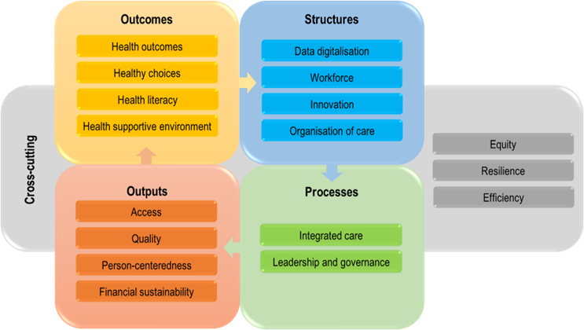
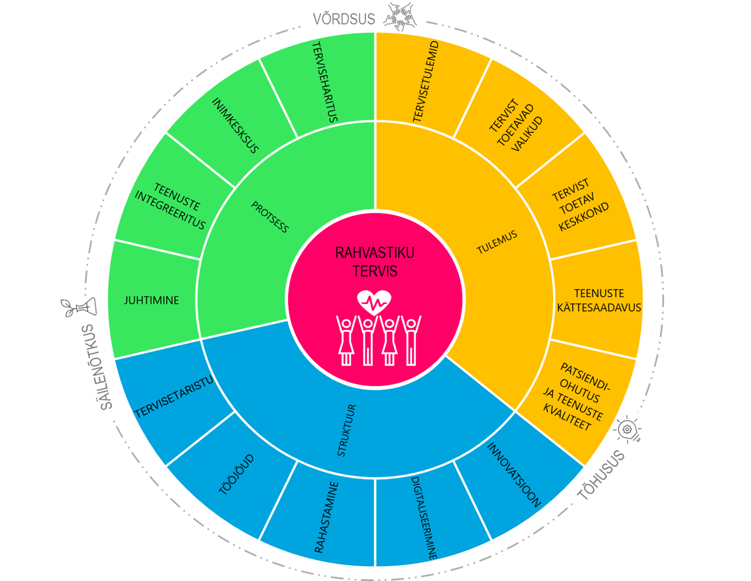
The journey to the Estonian HSPA framework
Autumn 2020
Autumn 2021
April 2022
May 2022
January 2023
January – March 2023
January – April 2023
June 2023
November – December 2022
Project application to the European Commission to support the development of the HSPA for Estonia framework
7 technical focus groups
HSPA-related Capacity Building Workshop
Describing and agreeing the HSPA Governance model
Indicators selection
2023–2024
Implementation of the HSPA framework
February 2025
The first HSPA report is ready for publication
Future and regular HSPAs

Slide 3
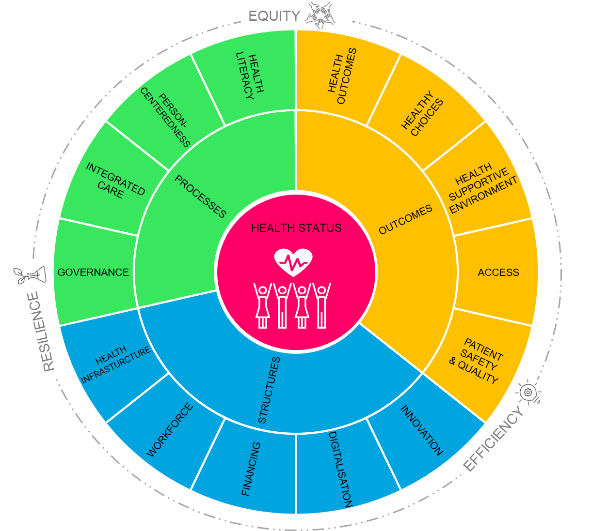
Estonian HSPA framework I

Slide 4
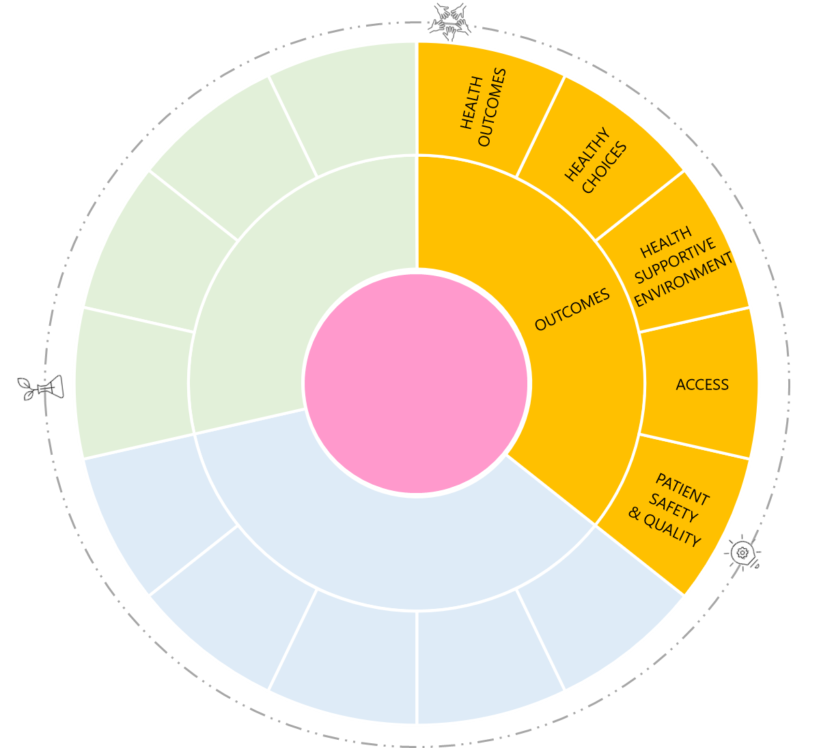
Estonian HSPA framework II
Health outcomes
Healthy Choices
Health Supportive Environment
Access
Patient safety
and Quality
Self-reported health status
Burden of disease, potential YLL
Morbidity
Multi-morbidity*
Avoidable mortality
Causes of mortality
Nutrition and Physical activity
Overweight and obesity
Drug use – Smoking, Alcohol, Illicit drugs
Sexual and reproductive health
Air quality
Water quality
Climate changes
Noise
Radiation
Medicines and AMR
Occupational health
Other
Waiting times
Timeliness – PHC, Cancer, Stroke, AMI, etc.
Affordability – General, Dental care, Medicines
Patient safety – Self reported, Acute care, Healthcare Associated infections
Clinical effectiveness – Primary Healthcare, Acute Care, Mental Health, Diabetes, Cancer care, Medicines
Examples of indicators
Avoidable specialist visits and hospital admissions – Asthma, Diabetes, Hypertension
30-day mortality – AMI, Ischaemic and Haemorrhagic Stroke
Cancer survival rates –
Post-operative pulmonary embolism after hip or knee replacement
Incidence of hospital acquired (MRSA, ESPL) infections
Prevalence of falls in hospital
Proportion of patients who are free of pressure ulcers within 72 hours of admission
Use of antibiotics and anti-depressants

Slide 5
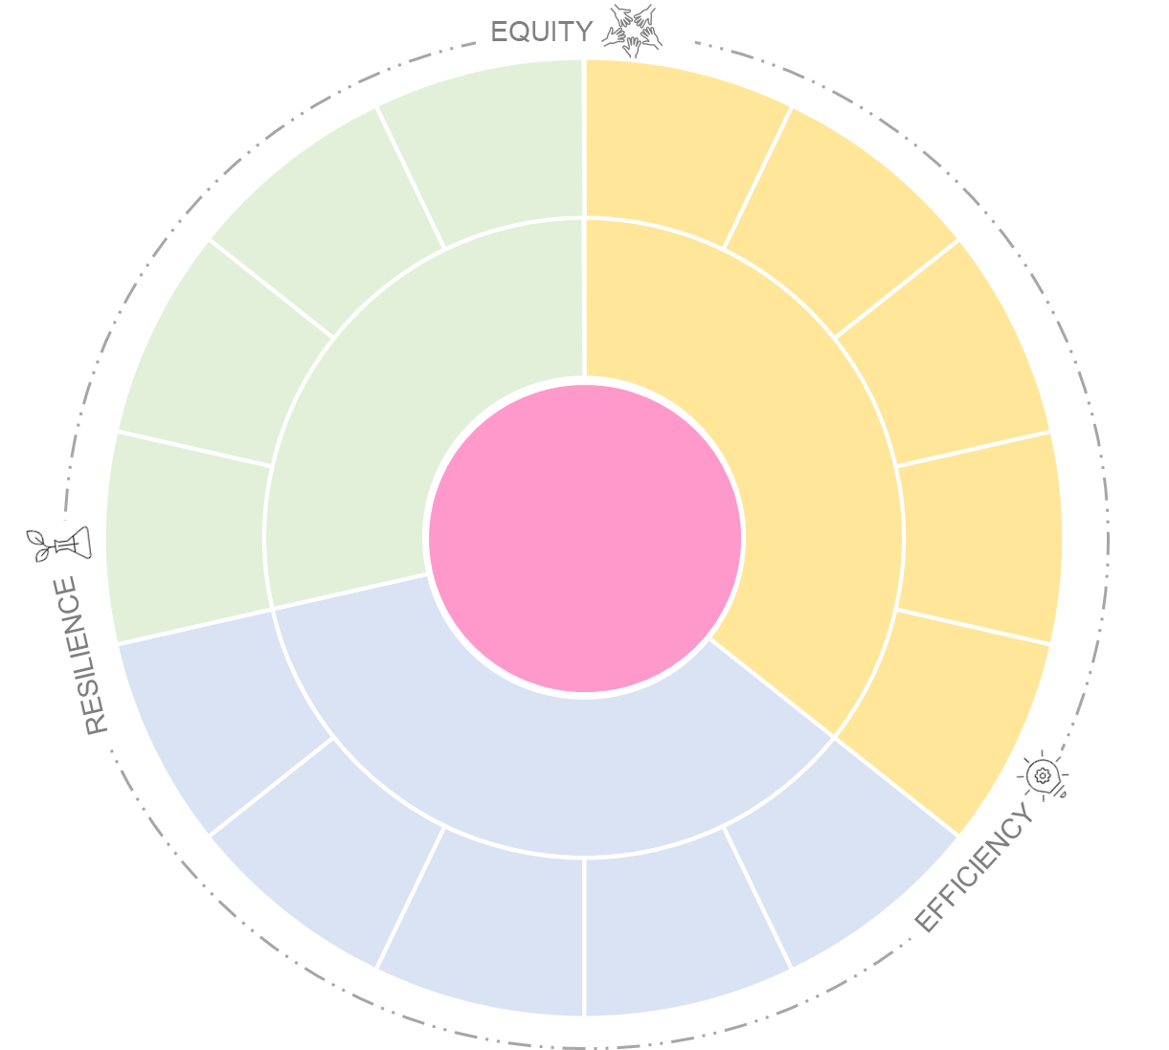
Estonian HSPA framework III
Equity
Efficiency
Resilience
Geographic
Income
Education
Medicines
Use of health care services – PHC, Ambulance and emergency, Specialist care, Equipment
Medicines
Financial efficiency
Preparedness
Vaccination
Examples of indicators
Ratio of nurses to doctors
Share of practising nurses aged 55 and older
Share of practising doctors and family physicians aged 55 and older
Diphtheria, Tetanus, Pertussis, Polio, Haemophilus influenzae type b (Hib) and Hepatitis B virus, MMR1, MMR2 vaccination coverage among children
Seasonal influenza vaccination coverage
COVID-19 vaccination coverage

Slide 6
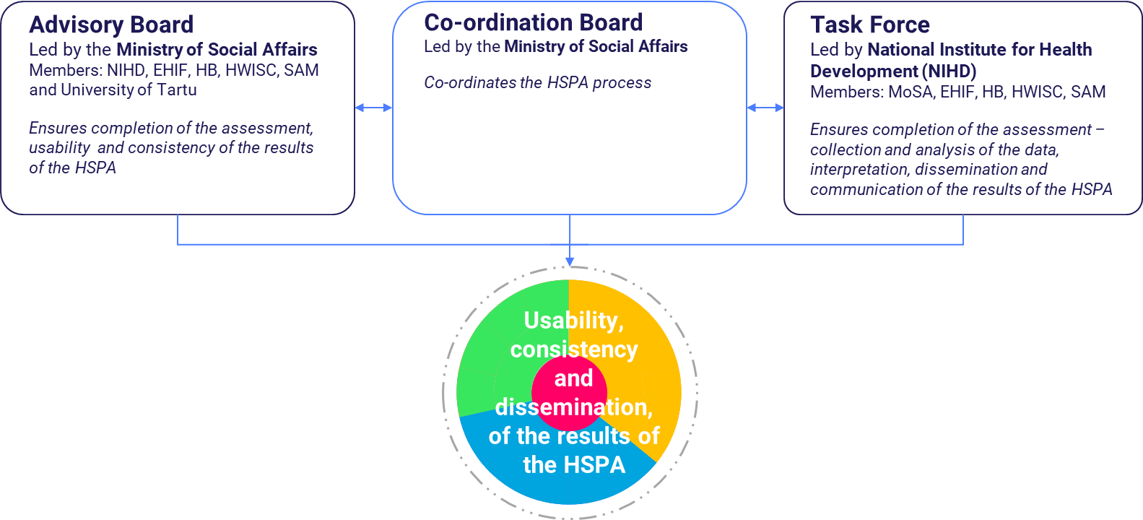
Implementation of the HSPA framework
Governance structure
HSPA cycles

Slide 7
Purpose of the Estonian HSPA
to set more common objectives and priorities for stakeholders to improve the health of the Estonian population
Common objectives
to manage changes in the health system in a targeted manner, including monitoring and evaluating the impact of actions
Change management
to increase the transparency of the health system and accountability of the stakeholders
Transparency
and accountability
A systematised, comprehensive and sustainable HSPA for Estonia enables:
to collect and use health data in a targeted manner
Targeted data use
to increase public awareness of the population's health status and of the performance of the health system
Public
awareness

Slide 8
Available:
https://sm.ee/tervisesusteemi-toimivuse-hindamise-raamistik
https://www.oecd.org/health/health-system-performance-assessment-framework-for-estonia-e67df802-en.htm

Slide 9
Thank you!
Tõnu Tunnel

