Slide 1
Internal audit approach in
Pauls Stradins Clinical University Hospital
Laura Indrikova
30.05.2024

Slide 2
About us
Founded in 1910, Hospital carries historical components and prides itself in its traditions that have and still continue for more than 110 years
Hospital is a multi-profile hospital that:
Provides full-scale emergency and planned medical assistance
Provides pre- and post-diploma education
Conducts scientific research
Ensures testing and implementation of new treatment methods and technologies in Latvia
Hospital is a state limited liability company in which all capital shares belong to the state
The holder of state capital shares is the Ministry of Health

Slide 3
Hospital Statistics
30 different clinics and centers
138 Total hospital specialists
3500 Total hospital employees
95 Doctors of Science
18 Professors
25 Associate Professors
900 Physicians
1080 Nursing staff
265 Care support staff
100 Administrative staff
1155 Technical staff
248 094 Outpatient
48 480 Inpatient
59 626 Emergency Medical Center visits
24 463 Day inpatient
*25.04.2024.

Slide 4
Internal audit
Who we are and what we do?

Slide 5
v
Structure and purpose
IA operates using Internal audit professional practice standards
Not an instrument of punishment, but support
Provides assurance on the effectiveness of the internal control system

Slide 6
v
Internal controls system- purpose
Effective, sustainable, successful operations
Compliance with normatives
Truthfulness of provided information
Compliance with operating principles

Slide 7
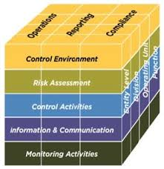
v
Internal control system –COSO model
Control environment
Risk assessment
Control activities
Information and communication
Monitoring activities

Slide 8
Effectiveness of internal control system
How do we check and what do we conclude?

Slide 9
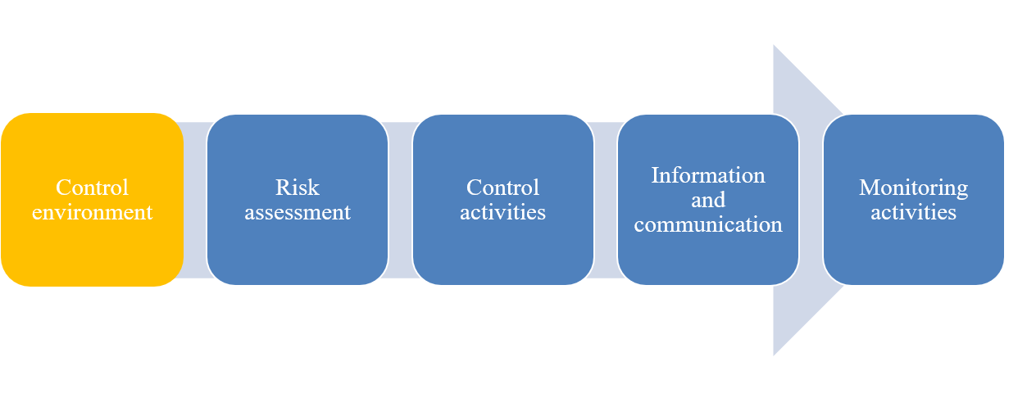
Control environment
Framework
Clear roles
Procedures
Centralised/ decentralised function
Exceptions
No one owns the process
Duplication of functions
Clear understanding of individual and team work
Effective use of premises
Quality of equipment
Ensuring succession
Responsibilities
Administration
Premises and equipment

Slide 10
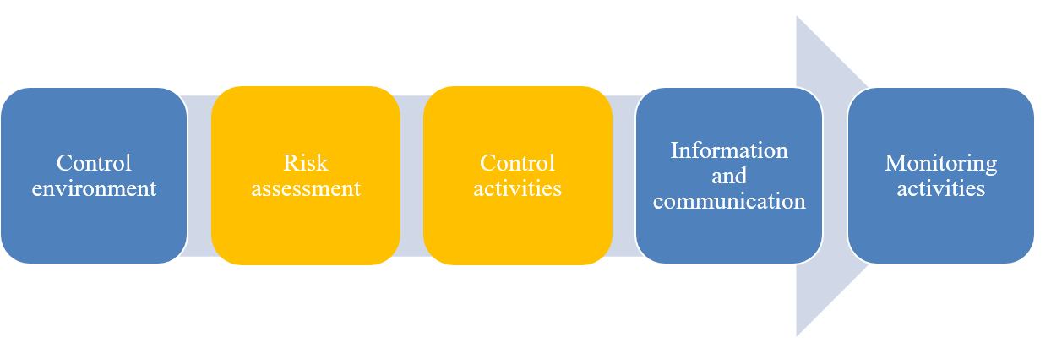
Risk assesment and control activities
Strategy
Purpose for system
Assessment process
Risk management function overall and for individual processes
Strategy for measurement of KPI
Clear understanding of work cascade
Controls for minimizing the risks
Control design and control operations
Controls
Compliance

Slide 11
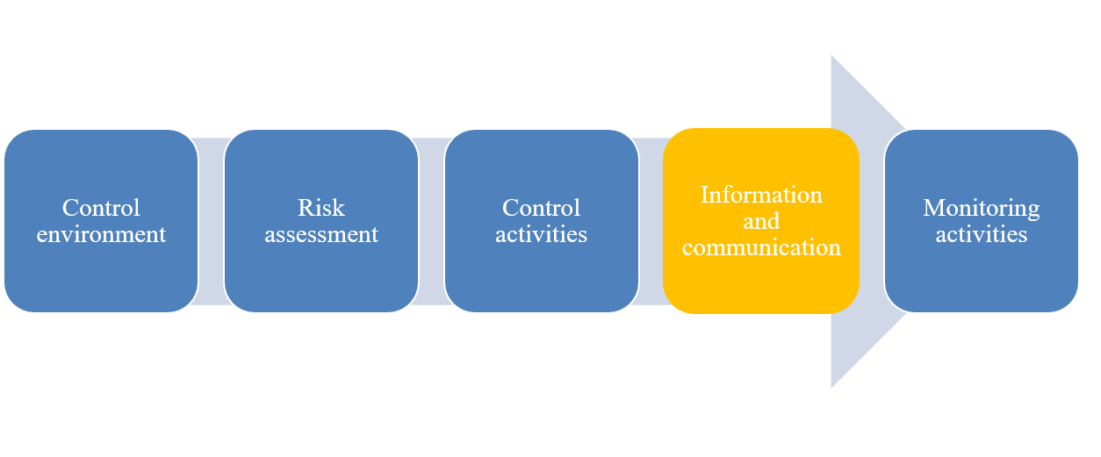
Information and communication
Communication with patients
Communication with collages
Communication with other involved parties
Effective communication with all parties is challenge
We have the information, but are not able to share it effectively
Correct information
Clear communication channels
Right information on the right time

Slide 12
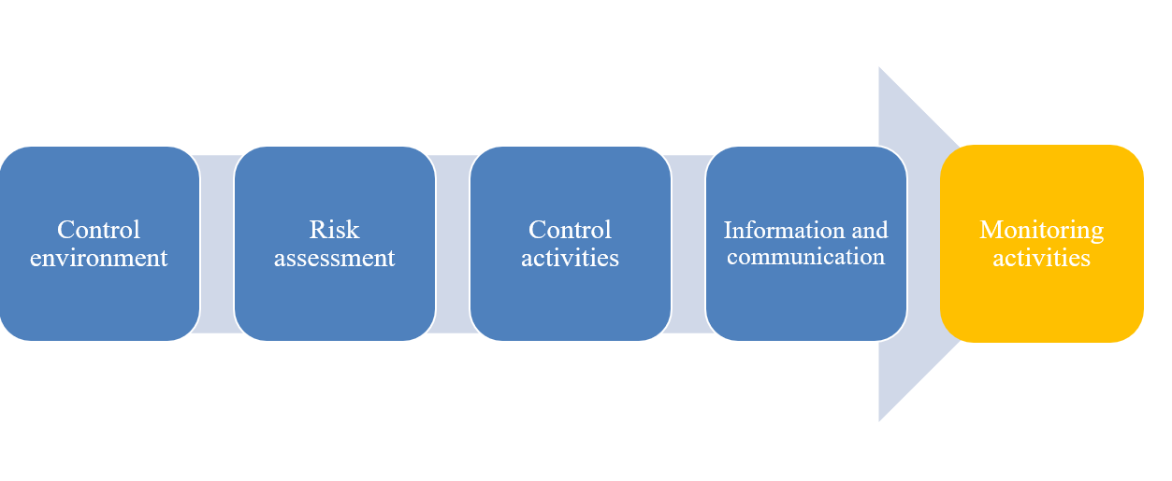
Monitoring activities
Supervision during process
Supervision provided by 2nd line
External supervision

Slide 13
Effectiveness of internal control system
What’s next?

Slide 14
v
Internal audit process
Plan
Provide
Recommend
Follow up

Slide 15
v
Internal audit results
Plan
Provide
Recommend
Follow up
Follow up

Slide 16
Effective internal control system helps us to be better for our patients, colleagues and others
Improve it together

Slide 17
Thank You!

