Slide 1
Patient safety culture and patient-based safety initiatives; Measurement of patient safety culture under stress
36th EPSO Conference, Tallinn
Katherine de Bienassis
30 May 2024

Slide 2
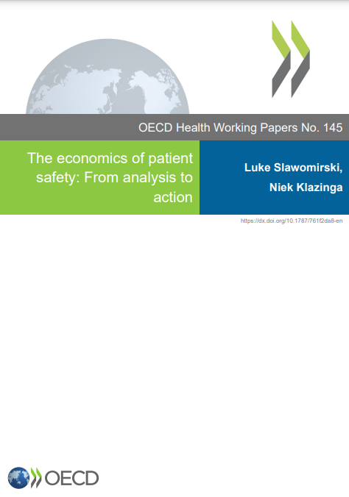
The direct cost of unsafe care in health systems is estimated at 12.6% of health expenditure
…and these costs are largely preventable. This is a huge waste of resources
The Economics of Patient Safety: From analysis to action, August 2022
Notes:
Taken together the costs of unsafe care represent a sizable portion of health spending.
Findings from the OECD’s Economics of Patient Safety: Analysis to Action report show that the direct cost of unsafe care in health systems of developed countries is estimated at 12.6% of health expenditure
By setting, 5.4% is attributable to safety events that occur in acute care, 3.3% in primary care and 3.9% in LTC.
This amounts to approximately almost 900 Billion across OECD member countries each year, or about 1.4% of their combined GDP.
Various research studies suggest that at least 50% of safety lapses that cause harm (and contribute to associated costs) could have been prevented.
Prevention is possible through changes in practice and behaviour and better policy, investment and use of existing knowledge and technology.
And so, the provision of unsafe care comes a significant opportunity cost, as scarce resources are diverted from other important areas of health and social spending to manage a preventable problem.
Safety is a basis for value-based health care: lowers the costs of care and improves outcomes.
Data notes:
This analysis is based on three previous Economics of Patient Safety OECD papers, which used various denominators in estimating the direct costs of harm. Here, results have been re-calculated using a common denominator of all annual spending on health as reported to the OECD statistics database.

Slide 3
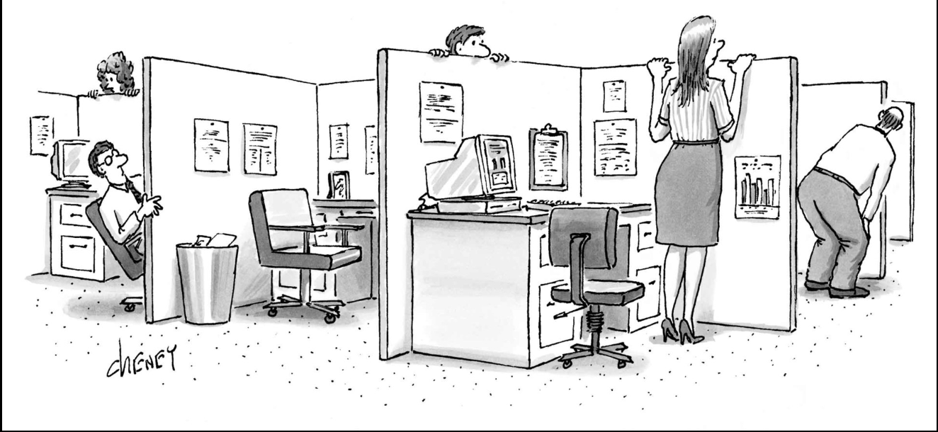
If you worked in a workplace—you know that workplace culture is important…
Source: https://www.newyorker.com/culture/culture-desk/cartoons-for-the-working-stiff
Notes:
If you have worked in a work place, you know that workplace culture has a big impact on productivity, job satisfaction, and even organisational outcomes.

Slide 4




But, however, safety culture in certain sectors can have life and death consequences.
Energy
Extraction
Construction
Health

Slide 5
Patient Safety Culture: What is it?
Patient safety culture as defined by the European Society for Quality in Healthcare, is a pattern of individual and organizational behaviour, based upon shared beliefs and values that continuously seeks to minimise patient harm, which may result from the process of care delivery
(Kristensen and Bartels, 2010_{[6]}).

Slide 6
Common Dimensions of Patient Safety Culture
The idea of ‘culture’ is perhaps similar to that of ‘intelligence’—everyone thinks they know what it is, but conceptual clarity is more elusive.
--Ken Catchpole
Common Dimensions across Safety Culture Tools
Major Dimensions | Examples of Topic Areas: Worker Safety Culture Tools | Examples of Topic Areas: Patient Safety Culture Tools
Leadership and management | Leadership and management support for staff safety; degree of supervision, leadership hierarchy, policies and procedures | Perceptions of management; leadership and management support for patient safety; non-punitive response to errors, policies, and procedures; adequacy of training
Group behaviors and relationships | Workgroup relations, conflict vs. cooperation, social relations, coworker trust, supportiveness | Teamwork within and across units; quality of handoffs and transitions
Communications | Openness of communication, formal and informal methods, conflict resolution approaches | Feedback and communication about error; reporting mechanisms
Quality of work life: structural attributes; working conditions | Staffing adequacy, job satisfaction, team satisfaction, security; work pressure, rewards, job security, forced overtime, benefits | Staffing adequacy, job satisfaction, team satisfaction; resource availability; stress recognition
Source: (The Joint Commission, 2012_{[12]}).

Slide 7
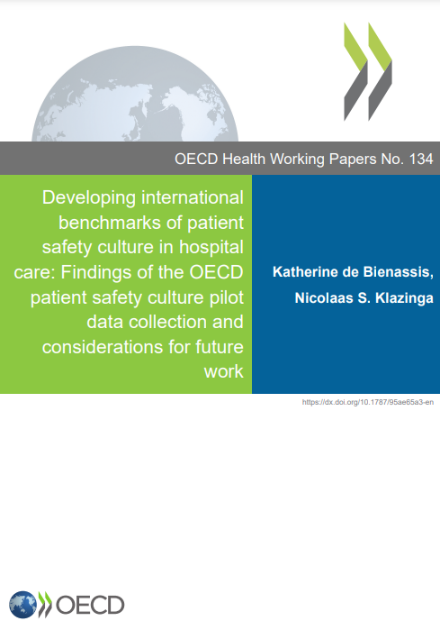
Tools used by countries
HSPSC.v1
Brazil (Accession)
Netherlands
Mexico
Switzerland
Data included from 2020-2021 PSC pilot data collection
Belgium
France
Spain
Japan
HSPSC.v2
Chile
Colombia
Israel
Korea
Peru (Accession)
Poland
Portugal
Saudi Arabia (non-OECD member)
Türkiye
United States
This is in addition to the data from 2,148,956 across participating countries published in the previous report (encompassing 2004-2011).
In total, data from 541,402 health care providers has been added in this round of data collection.
Notes:
You can easily change the colour of the panels.
If you choose a very light colour you will need to change the colour of the titles from white to something dark
Similarly, if you choose a very dark colour your may need to change the colour of the bullet points

Slide 8
About the survey data…

Slide 9
Distribution of staff types across respondents

Slide 10
Where countries stand.
HSPSC v2 Domain (v1 Domain) | Description | HSPSC v2 | HSPSC v1
Teamwork (v1 Teamwork Within Units) | Staff work together as an effective team, help each other during busy times, and are respectful. | 76% (8 OECD countries) | 69% (6 OECD countries)
Staffing and Work Pace (v1 Staffing) | There are enough staff to handle the workload, staff work appropriate hours and do not feel rushed, and there is appropriate reliance on temporary, float, or PRN staff | 48% (8 OECD countries) | 37% (7 OECD countries)
Organizational Learning—Continuous Improvement | Work processes are regularly reviewed, changes are made to keep mistakes from happening again, and changes are evaluated. | 64% (8 OECD countries) | 60% (6 OECD countries)
Response to Error (v1 Nonpunitive Response to Errors) | Staff are treated fairly when they make mistakes and there is a focus on learning from mistakes and supporting staff involved in errors. | 54% (8 OECD countries) | 47% (7 OECD countries)
Supervisor, Manager, or Clinical Leader Support for Patient Safety (v1 Supervisor/Manager Expectations & Actions Promoting Patient Safety) | Supervisors, managers, or clinical leaders consider staff suggestions for improving patient safety, do not encourage taking shortcuts, and take action to address patient safety concerns | 73% (8 OECD countries) | 63% (6 OECD countries)
Communication About Error (v1 Feedback & Communication About Error ) | Staff are informed when errors occur, discuss ways to prevent errors, and are informed when changes are made. | 65% (8 OECD countries) | 54% (6 OECD countries)
Communication Openness | Staff speak up if they see something unsafe and feel comfortable asking questions. | 67% (8 OECD countries) | 54% (7 OECD countries)
Reporting Patient Safety Events (v1 Frequency of Events Reported ) | Mistakes of the following types are reported: (1) mistakes caught and corrected before reaching the patient and (2) mistakes that could have harmed the patient but did not. | 60% (8 OECD countries) | 51% (6 OECD countries)
Hospital Management Support for Patient Safety (v1 Management Support for Patient Safety) | Hospital management shows that patient safety is a top priority and provides adequate resources for patient safety. | 59% (8 OECD countries) | 48% (6 OECD countries)
Handoffs and Information Exchange (v1 Handoffs & Transitions) | Important patient care information is transferred across hospital units and during shift changes. | 64% (8 OECD countries) | 44% (6 OECD countries)

Slide 11
Response to error
Note: 1. HSPSC v1 2 Data from previous PSC pilot data collection. All data from 2020-2023 3. The Canadian Patient Safety Culture Survey Tool. (Can-PSCS)
Source: OECD Pilot Data Collections on Patient Safety Culture

Slide 12
Staffing and workpace
Note: 1. HSPSC v1 2 Data from previous PSC pilot data collection. All data from 2020-2023 3. The Canadian Patient Safety Culture Survey Tool. (Can-PSCS)
Source: OECD Pilot Data Collections on Patient Safety Culture

Slide 13
Teamwork (Teamwork within units)
Note: 1. HSPSC v1 2 Data from previous PSC pilot data collection. All data from 2020-2023 3. The Canadian Patient Safety Culture Survey Tool. (Can-PSCS)
Source: OECD Pilot Data Collections on Patient Safety Culture

Slide 14
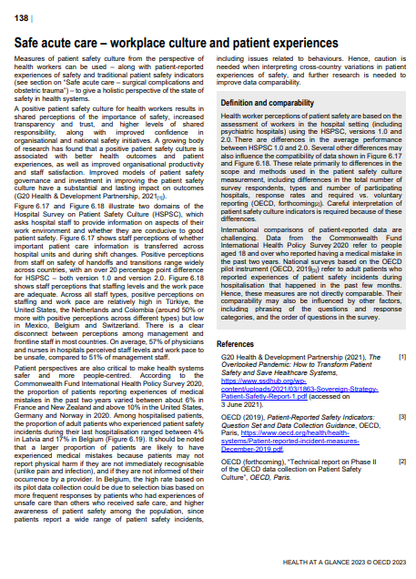
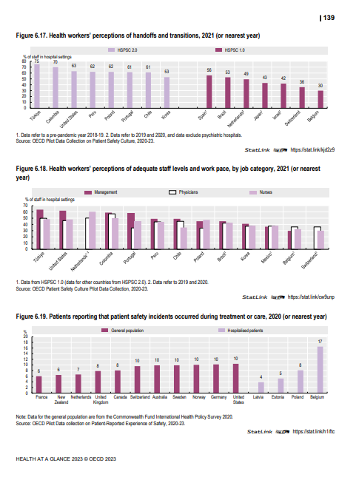
Findings in Health at a Glance 2023
Health workers perceptions of safety of handoffs and transitions
Health worker’s perceptions of adequate staffing levels and work pace
+ Technical report forthcoming
https://www.oecd-ilibrary.org/sites/7a7afb35-en/1/3/6/7/index.html?itemId=/content/publication/7a7afb35-en&_csp_=6cf33e24b6584414b81774026d82a571&itemIGO=oecd&itemContentType=book

Slide 15
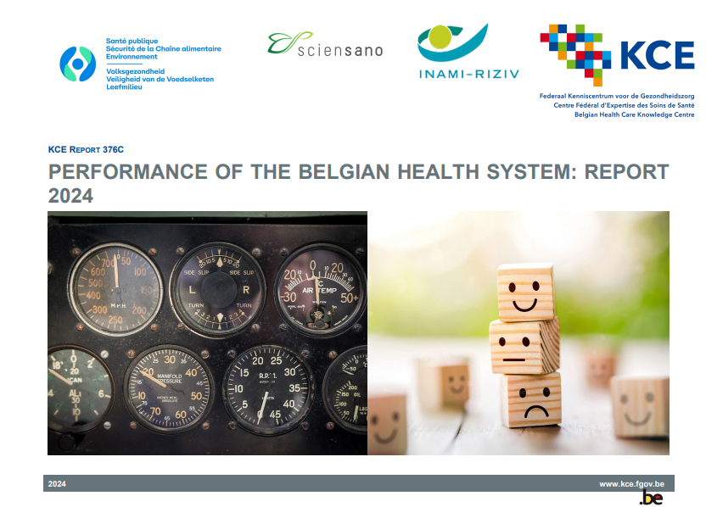
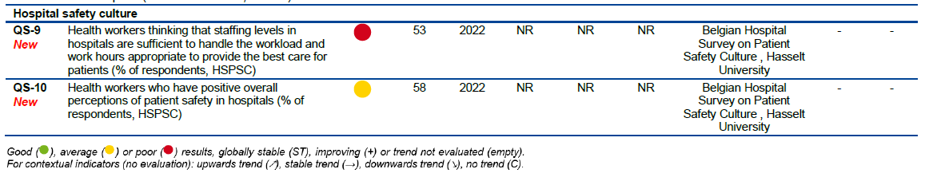
Findings of the outputs of the Patient Safety Culture Expert Group in practice
Benchmarking work and safety culture in national health systems performance assessments→ recent example from Belgium.
  Performance of the Belgian health system: Report 2024 | KCE (fgov.be)
Other examples?

Slide 16
Patient safety measurement components
Hospital Care Patient Safety Indicators | Primary Care Safe Prescribing Indicators | Long-Term Care Safety Indicators
-Retained surgical item or unretrieved device fragment -Postoperative pulmonary embolism – hip and knee replacement discharges - Postoperative DVT – hip and knee replacement discharges -Postoperative sepsis - abdominal discharges -Obstetric trauma vaginal delivery with instrument -Obstetric trauma vaginal delivery without instrument - Healthcare associated infections | - Adequate use of cholesterol lowering treatment in people with diabetes - First choice antihypertensives for people with diabetes - Long-term use of benzodiazepines and benzodiazepine related drugs by the elderly - Use of long-acting benzodiazepines in older people - Overall volume of antibiotics for systemic use prescribed - Volume of cephalosporines and quinolones as a proportion of all systemic antibiotics prescribed - Use of anticoagulating drug in combination with an oral NSAID - Polypharmacy rates amongst the older people - Overall volume of opioids prescribed - Proportion of the population who are chronic opioid users - Proportion of older population prescribed with antipsychotics | - Pressure ulcer prevalence - Healthcare associated infections

Slide 17
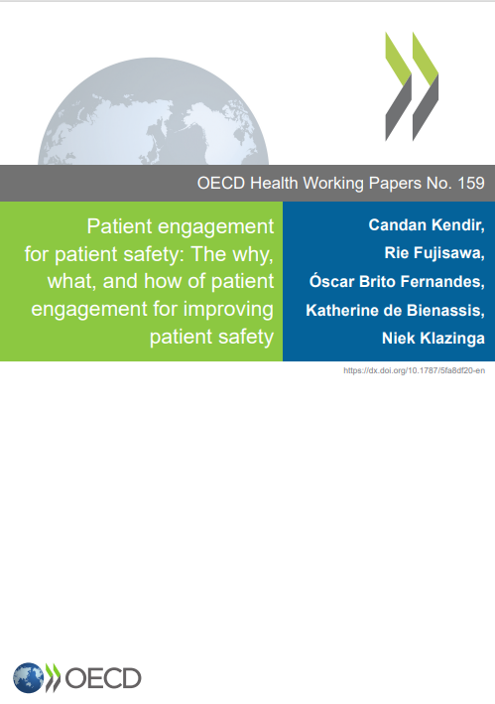
New Publication of Interest
Patient engagement for patient safety
Patient engagement for patient safety : The why, what, and how of patient engagement for improving patient safety | OECD Health Working Papers | OECD iLibrary (oecd-ilibrary.org)

Slide 18

What’s next?
Staff surveys to provide more insights on working conditions→ impacts on staff retention
  Working hours
  Intention to leave
  Satisfaction
PSC in other settings (Primary care/LTC)
Linking PSC and patient-reported experiences of safety
https://bmchealthservres.biomedcentral.com/articles/10.1186/s12913-024-11097-7

Slide 19
Thank You
Contact: Katherine de Bienassis
Katherine.debienassis@oecd.org

