Slide 1




Foundations of safety - Realistic Medicine, trust, and respect between professionals and patients
NAME, title
SIRI WIIG
Center director, Professor of Quality and Safety in Healthcare Systems, University of Stavanger, Norway
Honorary Professor, Australian Institute of Health Innovation, Macquarie University, Australia
Honorary Professor, University of Wollongong, Australia
Adjunct Professor, Western Norway University of Applied Sciences, Norway
Notes:
Thank you so much for the opportunity to talk at this important conference.
Delighted to meet others as intersted as in regulation, risk and healthcare

Slide 2

Professor Catherine Calderwood
Professor of Health Futures, University of Strathclyde, Glasgow
Consultant Obstetrician NHS Lothian, Edinburgh
Former Chief Medical Officer for Scotland
Incoming Chair RCOG patient safety committee
X THE PLACE OF USEFUL LEARNING

Slide 3

Rules, standards and regulations don’t always work
Notes:
The linear logic of regulation is good in theory but not always in practice
This presumes there is a linear wau of working. But the healthcare system is much more complex and dynamic. It inlcudes humans, technology, and organisational dimensions and operates in an ever changing context
So rules standards and regulation dont always work.

Slide 4
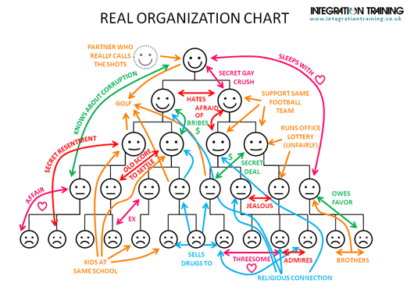
Reality

Slide 5

People make systems work and their soft skills are foundations for safety
Notes:
But people makes systems work and sometimes because of workaround high quality care is provided and we often see that their soft skills are crucial for quality delicery in complex adaptive system where patients are highly different and in very different needs and contexts

Slide 6
Example:
Patients in homecare are allocated with a certain amount of services.
The patient deteriorates/needs more help - Professionals understand and adapt service provision beyond the allocated
Professionals and leaders negotiate, work around, help, listen, contextualize
Notes:
If we take one example from a study on risk perception, adaptive capacity in homecare we see this
This happens all the time. Professionals adapt, make changes, cover up the system failures of limited resources and competence allocation
And being able to do these adaptations are such an important part of being professional and thei conceptualisation of what quality in healthcare is. This is often forgotten as quality if tought of in quantiatieve terms – which is important too but not all

Slide 7

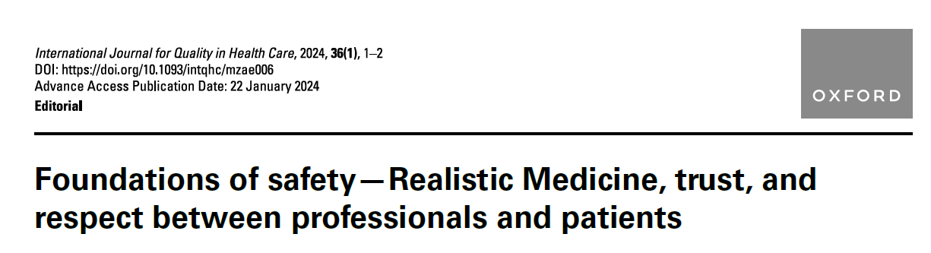
Soft skills and dimensions of safety what are they?
Notes:
This then relates to soft skills and dimensions of saferty and qualitly that we focus on today in our talk. We have written a paper about it and you can all access it in IJQHC

Slide 8

Soft dimensions of safety are not necessarily measurable, do not manifest in linear ways to produce definable outcomes, but are vital to safer care (Wiig et al 2024)
Notes:
There are, of course, multiple soft dimensions: for example, those that professionals use when they assess the quality of their own work. Professional pride and the dignity clinicians provide to care encounters are two of these.
Soft skills are developed through building trustful connec-tions with patients and walking the extra mile for them [4]. The trust and relational dimensions between professionals

Slide 9

Walking the extra mile
Professional pride
Assess quality of own work
Trust
Being transparent
Relational skills
Enable to speak up
Notes:
To examplify sof skill and fimensions we see…
These are examples we see in our research when we ask what qualiyt means – these come up

Slide 10

Contextual realities for regulation – call for combined skills “soft and hard”
Complexity and spesialization
Contextual knowledge
Competent and involved patients
New risks
Labour shortages
Relations, leadership and teams
Legislation lagging behind
Cultural diversity
Data drive
Stakeholder engagement
Notes:
If we look into the reality you do regulatory work within we see some challenging elements which implies a need for having focus on soft skills and dimesnions.

Slide 11

The regulatory logic problem?
Notes:
Regulation logic versus soft skills
If we consider soft skills as important – so what is the implications for regulatory practice and what do we mean?
This is going into the need for evidence and objective data to assess legal perspecticve and performance, while much safety infomartion is soft, hard to get and consequenses show at a later stage

Slide 12

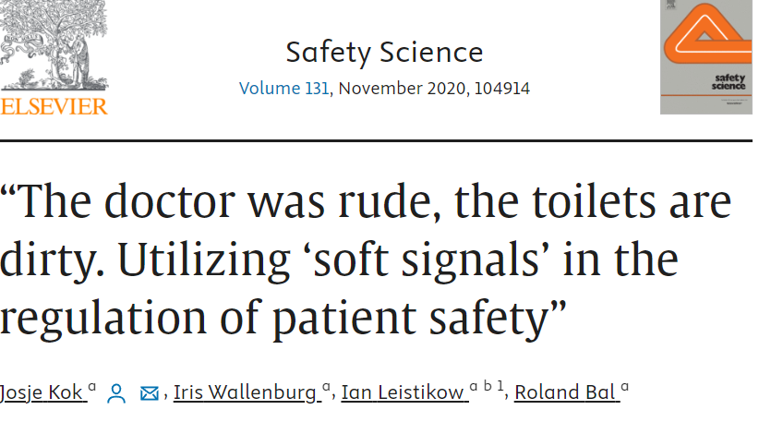
Using hard evidence vs soft signals
Notes:
Here we see researchers going into this field. From the Dutch context we see how soft signals may be used by regulators but it is challenging because it challenges the regulatory logic
The same goes for resilience perspecitives and adaptive capacity – should reulators look for what goes well and acknowledge the need for adaptations to standards?

Slide 13
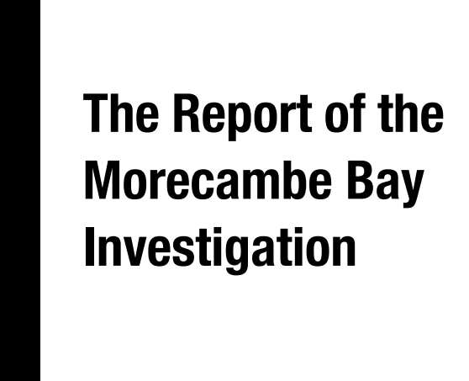

Problems often relate to soft dimensions
Notes:
This is also important to og into from reglators point of view earrly because problems often relate to soft dimenstions.
Here we can og into the cases also and show more of the soft elements leading to disasters –
add slides after this slide about it or you can have your stuff after

Slide 14


Slide 15


Slide 16


Slide 17
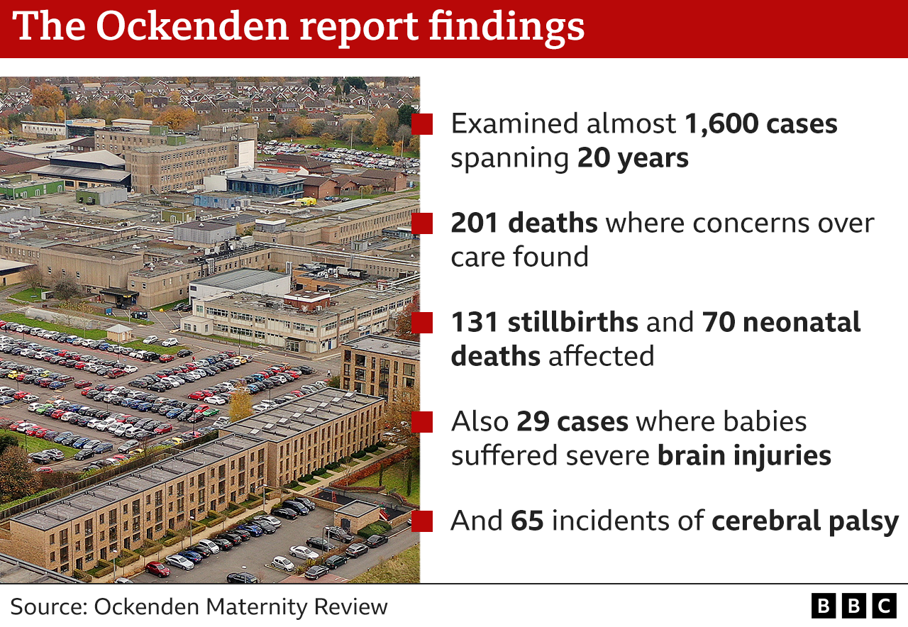

Slide 18
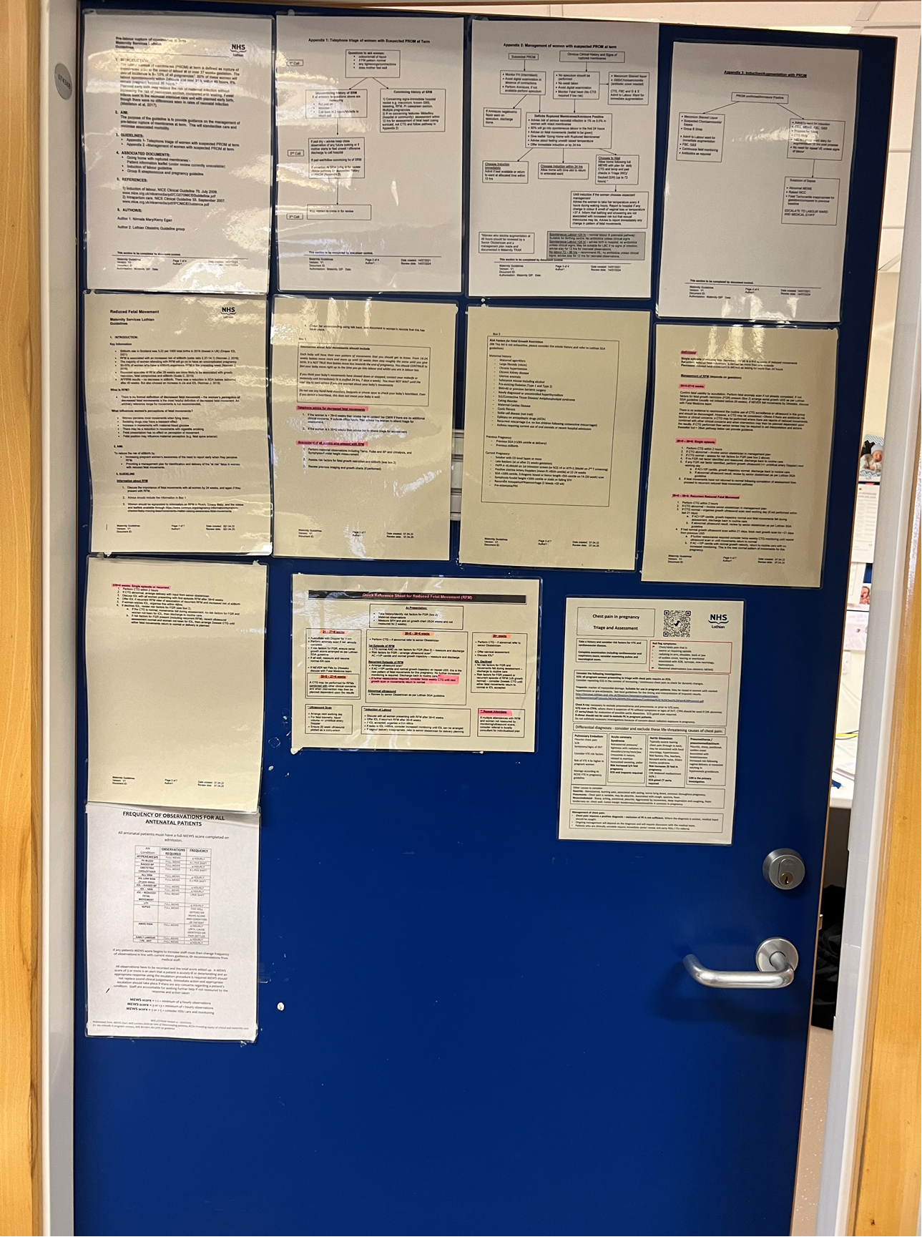
Guideline door

Slide 19
Issues identified in numerous reports
Standards and guidelines
Communication
Extension of roles beyond training
Tolerance of exception
Unacceptable becomes acceptable
Lack of care and compassion

Slide 20

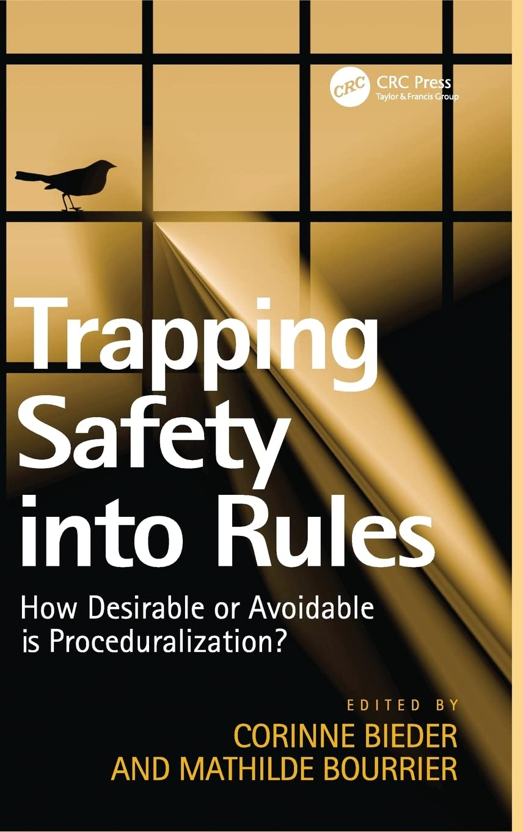

Regulating safety culture, communi-cation, relations?
Notes:
But if we think about regulating these dimensions we also enter a challengin gfeild.
Regulation of soft skills and dimensions – hard problem in practice.
Petroleum Safety Authority tried this. I worked there from 2007-2020. In 2004 they incorporated «Sound HSE culture» demands in the regulatory framework,. They were never able to enforce it, but it generated a reflexive space, discussions and creativity and a respect for soft dimenstions’ place in regulation and practice
Acknowledging soft dimesions is key, regulation is something else with

Slide 21

Conflicting regulatory frameworks – how do people handle it?
Notes:
Healthcare regulators are not the only regulatory bodies organisations meet and need to comply to.
Dimensions related to soft skille are also relevant for tradeoffs, contexting, negotiations. This is highly relevant regarding conflicting regulatory frameworks.
Here we see e.g a norwegioan study results.:
Leaders are responsible for qualtity and safety for patients and quality and safety and working environment for staff –there regulatory framworks differ and sometimes are conflicting.
QPS and HSE – tradeoffs
Battling with ethical dilemmas, and regulatory demands that cannot be met. Both relates to quality and safety
Training is mandatory for HSE, but not for QPS in Norway! This relates to regulation and understanding of importance

Slide 22

What’s needed from regulators?
Notes:
Well then what is needed for regulators in this field. What are the options, challenges and possible solutions

Slide 23

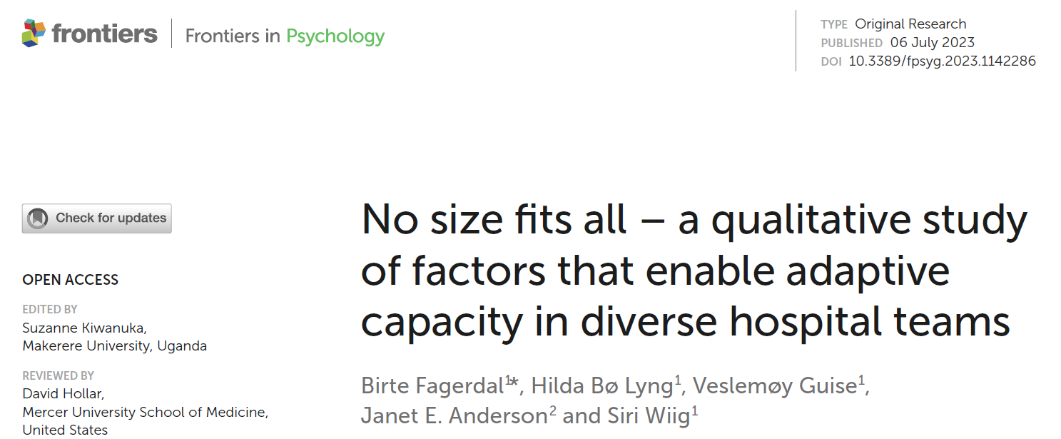
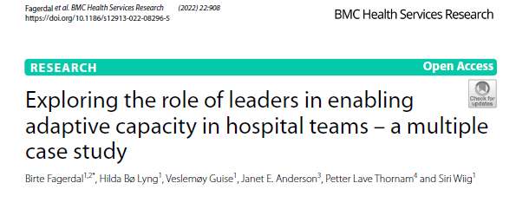
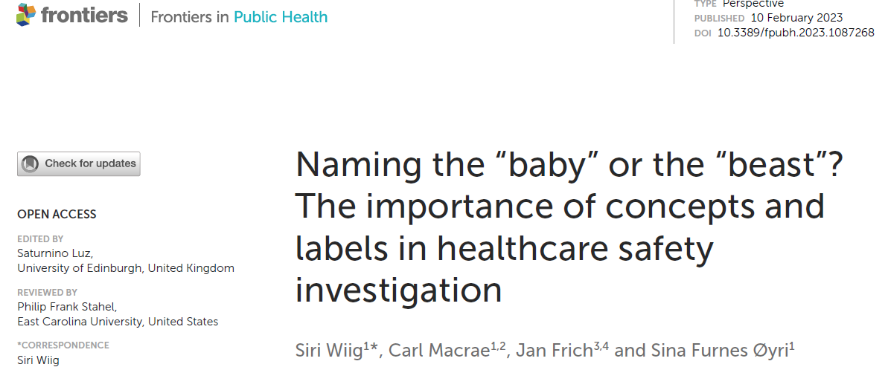
Understanding how relations and leadership are fundamental for safety
Notes:
First.
Leadership is key in regulation and dilemmas and tradeoffs needs to be solved
go into findings from Birtes thesis and Safe-Lead project on what we found on leadership, relations, and contextual understanding (contexting) and how regulators need this type of competence themselves and about the org they regulate and monitor.

Slide 24

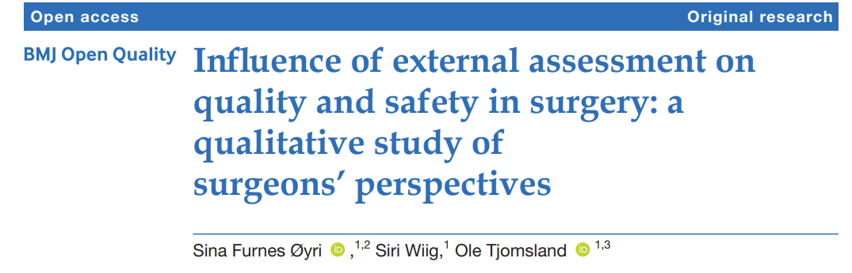
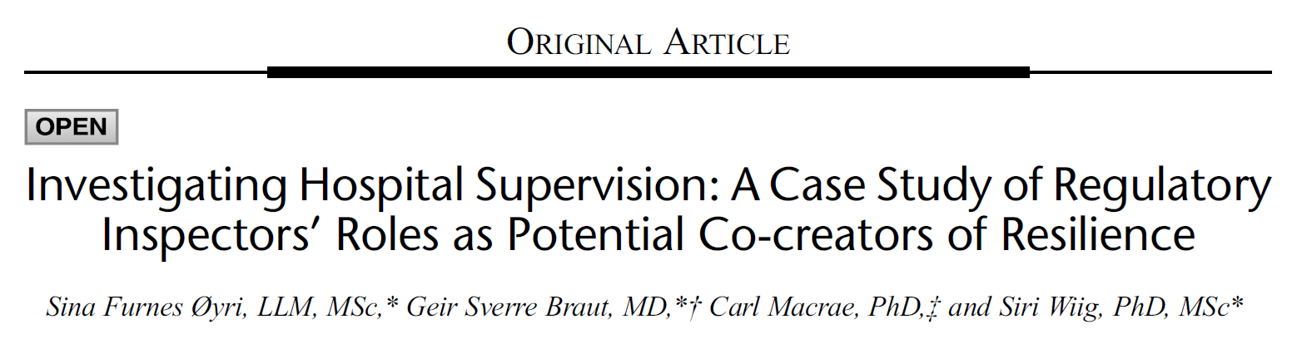
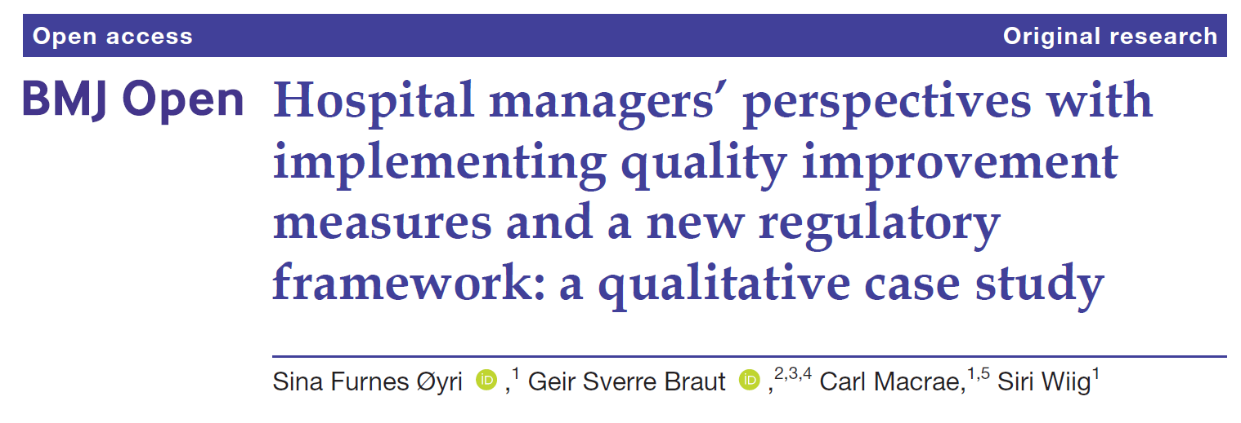
Contextual knowledge and understanding of own influence
Notes:
Second regulators need contextural knowledge and understanding of own role to be trusted and respected.
Regulators need stronger knowledge about context, how they influence on practitioners when intervening or sending letters, how regulatory practice is experienced by organisations and actors (indivudally and organisationally)
Being in a regultaory bubble is dysfunctional
We see this and a responsive approach is important – some need stick others carrot and guidance
You have room to manouver but it takes skills/knowledge/currage

Slide 25

Acknowledge diverse perspectives and prevent epistemic injustice in regulation
Notes:
Third
An element related to patients/familiy voices relate to reality vs retoric
Epistemic injustice is about asking for information from different stakeholders but using the information from only a few and listening to powerful voices and not others
This is relevant in relation to regulator of professionals and patients – which voice is listened to

Slide 26
Notes:
We have investigated into user involvement in regulation and regulation of adverse events resulting in patient deaths

Slide 27
Notes:
The key from our study

Slide 28
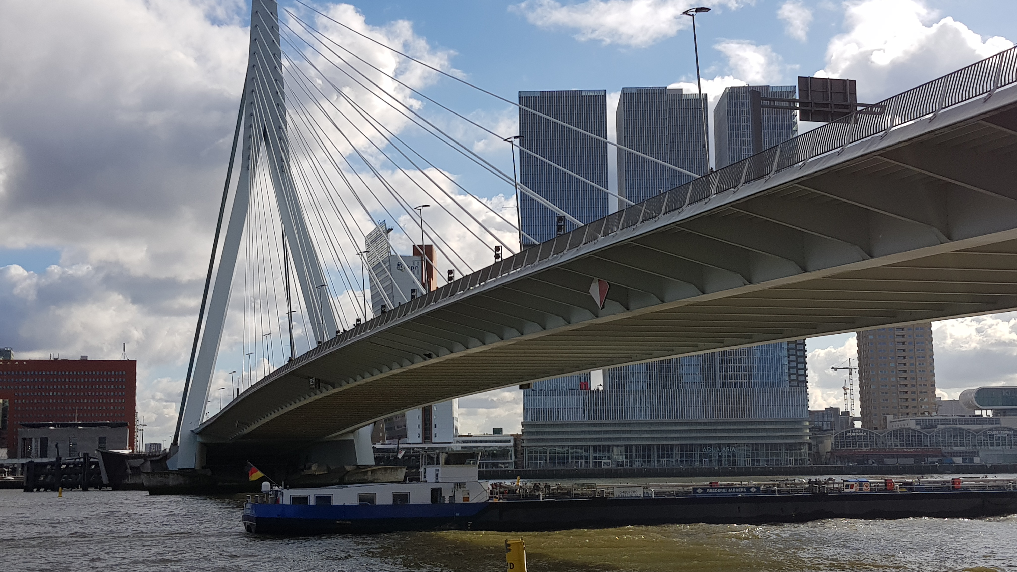
Involvement bridges understanding
Notes:
A key finding

Slide 29

Involvement of next of kin:
New information informed understanding of event, pathway, stakeholders
Changed conclusion
But: Whose voices are valued?
Notes:
When next of kin were given opportunity to inform the investigation we found that..

Slide 30

Regulation to promote involvement
Notes:
How can regulators work to improve involvement from patients and professionals

Slide 31
Regulation to promote invovement
Regulate involvement
Investigate and follow up of investigation reports
Use «soft signals»
Create reflexive spaces
Between families and service providing organisation
Between regulator and regulatee
Co-create legislation

Slide 32
Reflexive spaces
“Physical or virtual platforms in which reflexive dialogical practice occurs between people”.
Key in learning processes - bridges tacit and explicit knowledge
Tools: storytelling, reflexive conversations, metaphors, critical incident analysis, reflective journals, and concept mapping
Organisational structures – e.g. morning rounds
How regulators use tools may stimulate articulation of tacit knowledge and critical reflection
Notes:
Possible cut

Slide 33

How can realistic medicine help?
Notes:
Could add e.g principles and practices and how this approach can contribute to promote trust, relations, and mutual understanding of risk and reflect on regulators

Slide 34
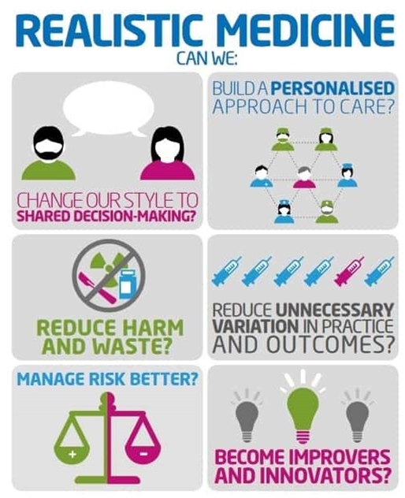

Slide 35

Road ahead

Slide 36

Possible regulatory approaches
Acknowledge soft signals as fundamental in safety processes
Promote reflexive spaces
Encourage tripartite collaboration
Articulate workarounds
Test embedded methods
Dialogue and debate oriented
Responsive regulation

Slide 37

Thank you!

Slide 38
