Slide 1
case
studies of
“data-driven enforcement”
36th EPSO pre-conference in Tallinn, Estonia (28th of May, 2024)

Slide 2
Agenda
I.
Identifying non-conformity situations through the web
Food safety sector and TripAdvisor
Increasing equity in inspections
Noise in food safety inspectors’ decision making process
III.
II.
Other potentially interesting tools Webscraper
Heatmaps and correlation (Tiziano Lattisi)

Slide 3
 | If lacking adequate data repository, one of the biggest challenges is identifying situations of non-compliance: How to acquire unknown information?
 | How to increase availability of data through social networks?
Using data from social networks

Slide 4
TripAdvisor – Lazio Region (Food Safety)
Q: Is the competent authority able to identify all risk situations? How to collect reports from citizens?
H: Based on international experiments (e.g., Las Vegas, San Francisco, New York), it has been proposed the use of restaurant reviews posted by customers on social networks

Slide 5
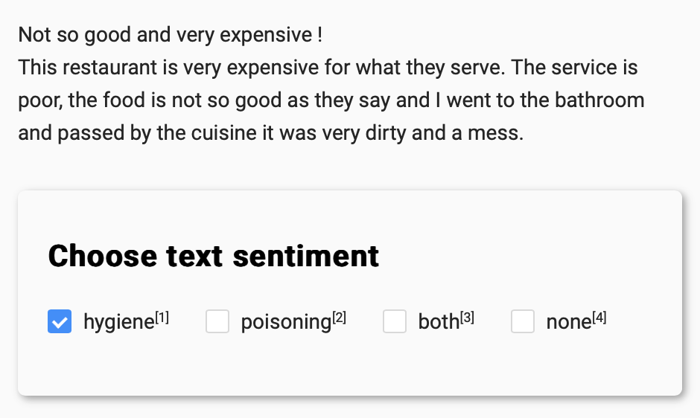
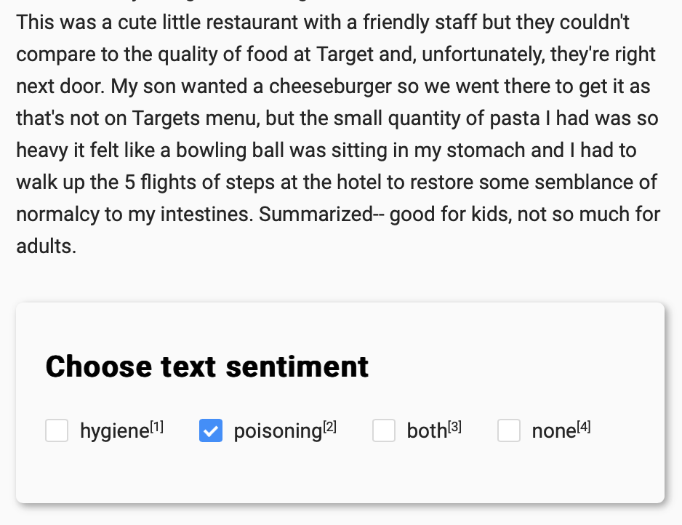
Hygiene and poisoning sentiment in reviews
random selection
dataset supervision
30% from keywords filter
24% from ★ reviews
2M reviews
19% from ★★ reviews
5k reviews
14% from ★★★ reviews
9% from ★★★★ reviews
4% from ★★★★★ reviews

Slide 6
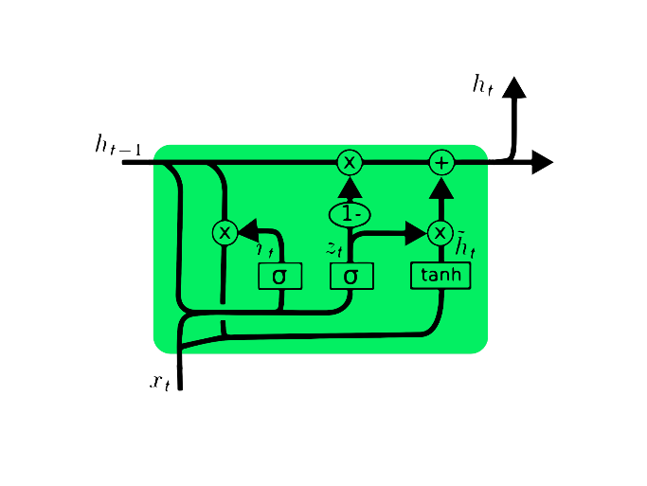
Hygiene and poisoning sentiment in reviews
5k supervised reviews
2M reviews
Recurrent neural network (RNN)
Prediction model
Alerts

Slide 7
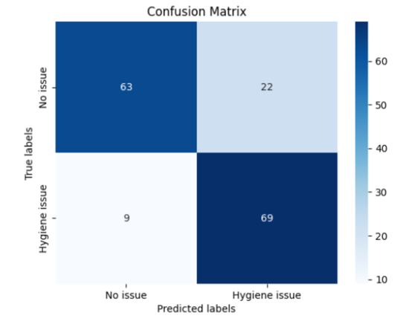
TripAdvisor – Lazio Region (Food Safety)

Slide 8
TripAdvisor – Lazio Region (Food Safety)

Slide 9
The Lombardy Region carried out an "audit" to identify differences in the inspectors' judgement in the inspection phase, correct them and thus standardise the decision-making process
Noise

Slide 10
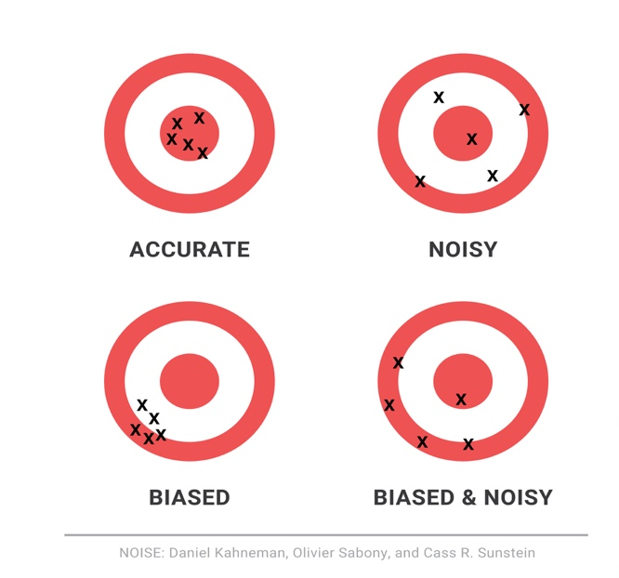

Slide 11
Goals
Uniformity of inspection pressure throughout the Lombardy region, with a risk-informed approach;
Consistent and uniform application of food tariffs!

Slide 12
…so?

Slide 13
Methodology – 1/2

Slide 14
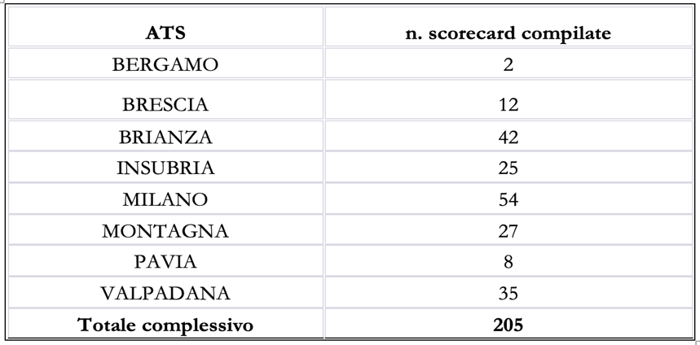
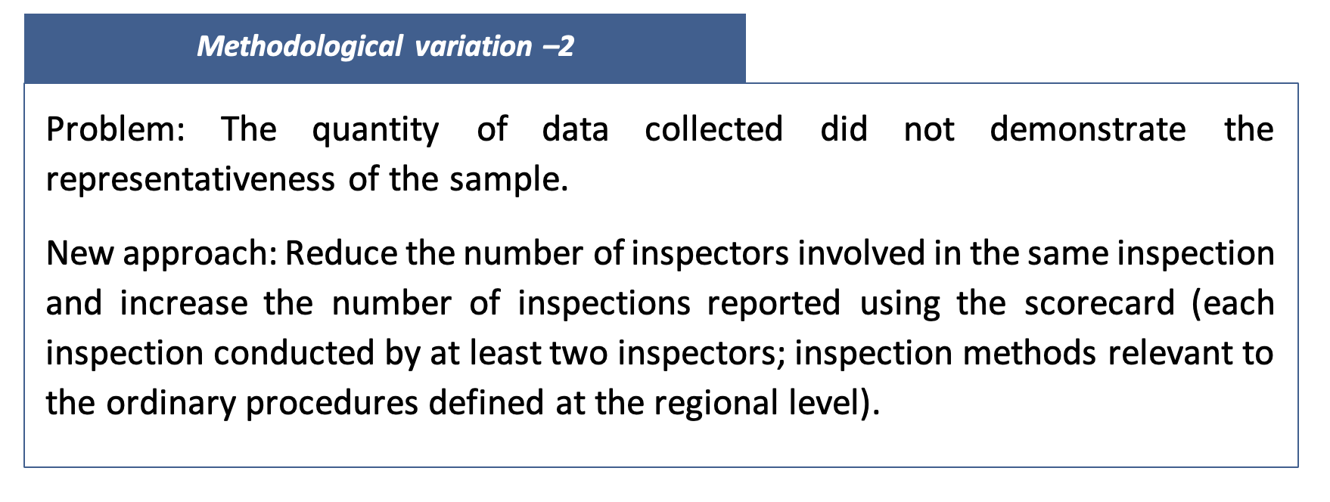
Variation

Slide 15
To be continued!

Slide 16
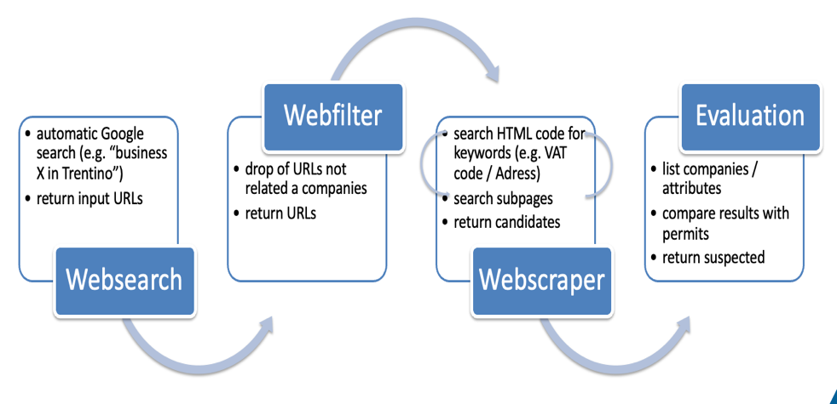
Web scraper – Provincial Agency for Environmental Protection (Trento)
Q: Are all businesses operating in the sector in possession of authorization? How to verify it?
H: Most businesses require an online presence for commercial and advertising purposes. By law, businesses in Italy must indicate their VAT number on their website, which can be compared with the registry held by the authority.

Slide 17
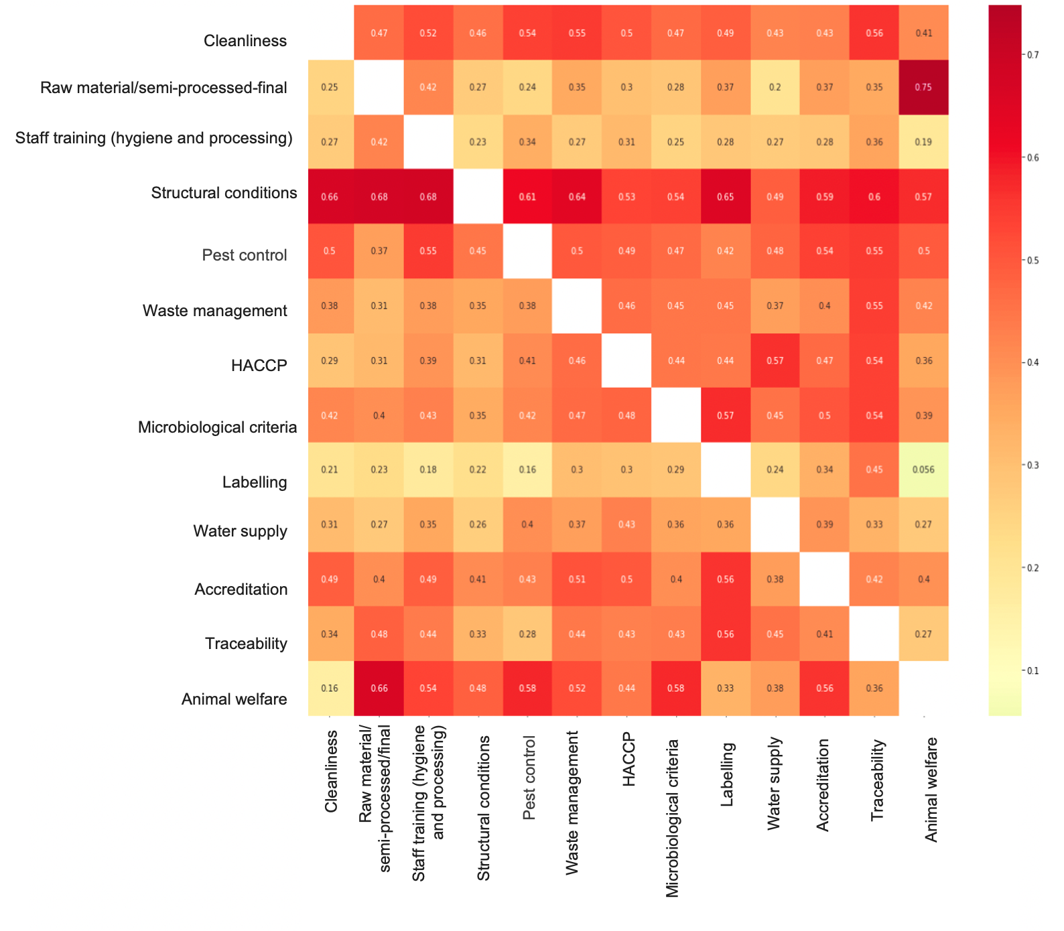
Campania and Lombardy: Heat Map
What is the map for?
Shows the degree of correlation between the findings of different inspections
General understanding of how strongly an instance of non-compliance is correlated with another unverified (in each region)
This initial model shows hypothesis and serves as a stepping stone for the construction of proper targeting tools
Inspectors have to verify the validity of “predictiveness” hypotheses shown on the map.
If hypothesis are proven to be true, linear regressive algorithms can then be constructed and trained to predict the occurrence of non-conformities (for each business operator).

Slide 18
Campania and Lombardy: Heat Map
How was the Map created?
The regions considered the inspection procedures as if they were interlinked and they developed a model analysing historical data
The map displays a correlation index between instances of non-compliance for different inspection items – with an index of 0.7 being high and 0.1 being low
The non-conformities on which the model is based are result of inspections carried out by different local authorities in these regions
Key to enhance inspectors’ consistency using case-by-case interpretation to improve model quality

Slide 19
Campania and Lombardy: Heat Map
Examples of correlations from the Map
Non-compliance on animal welfare has a very strong positive correlation with non-compliance on raw materials, semi-processed products and finished products (0.75)
However, it has a very weak correlation with the level of compliance on labelling (0.056)
…So what?
Non compliance on animal welfare clearly points to an unproved case of non-compliance on raw materials, but tell almost nothing about the labelling compliance

Slide 20
Lombardy: Decision Trees
2.

Slide 21
Lombardy: Decision Trees
Graphically show by what percentage the likelihood of finding non-conformities on a non-inspected item varies based on knowledge of other inspection results
1
P1
P < 0.001
Non compliant
Compliant
2
5
P3
P < 0.001
P3
P < 0.001
N = 1088
N = 769
N = 329
N = 3020
+ 5%
+ 60%
- 4%
- 60%
Target: P4 HACCP (Hazard analysis and critical control points)
Non-compliance baseline: 12%.
Previous inspection procedures with known results:
P1 Structural conditions
P3 Cleanliness conditions

Slide 22
Why is this relevant?
To better understand how a violation on given item
Inspection authorities may use information that are already available to them – the results of the previous inspections
Correlations
Can indicate the occurrence of an other one

Slide 23
Key ideas
3.

Slide 24
Key ideas – Leveraging Inspection findings
PRIORITISE
inspection activities
ENGAGE
private parties in the regulatory strategy on the ground
FOCUS
not only on targeting for punishing
HARNESS
preventive tools perhaps including self-assessment

Slide 25
Thank you!
Luca Megale
l.megale@lumsa.it (OECD email – luca.megale@oecd.org not working at the moment)

