Slide 1

“Effective Leadership - Staff Shortages in Ireland – How did Ireland (TUSLA) handle the issue of staff shortages – an actual update on the experiences from TUSLA Ireland”
Frances Haigney, Tusla People Strategy Lead, Tusla People and Change

Slide 2
Tusla – Child and Family Agency - Who are we
Since 2014, Tusla has been the dedicated State agency responsible for improving wellbeing and outcomes for children in our State. Employing almost 5,000 dedicated professionals, we operate under the Child and Family Agency Act 2013, a progressive piece of legislation with children at its heart and families viewed as the foundation of a strong healthy community where children can flourish.
Our Services:
Child Protection & Welfare
Alternative Care
Birth Information and Tracing & Adoption
Family Support
Children’s Services Regulation
Tusla Education Support Service
Domestic, Sexual & Gender Based Violence

Slide 3
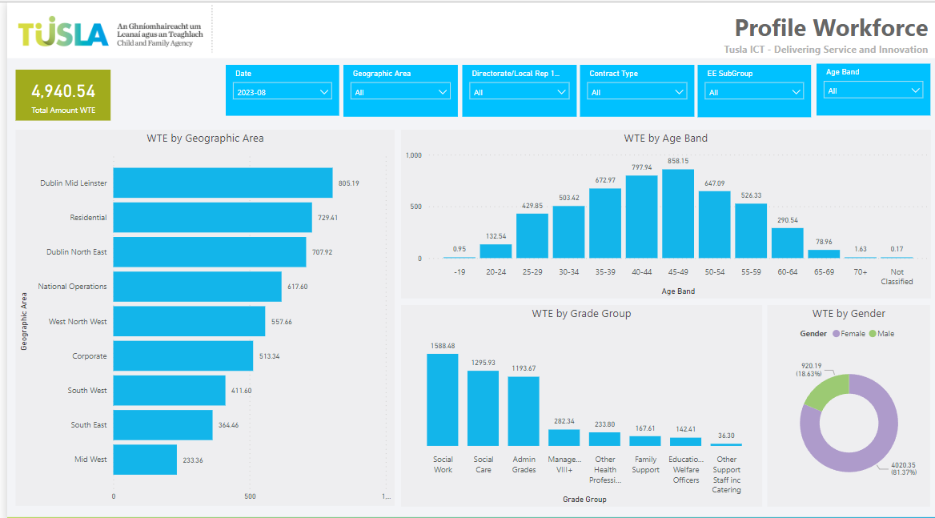
August 2023

Slide 4
Workforce Challenges
Childcare Act - increase in Demand
College places do not meet demand
Decline in students seeking SW college places
Increasing numbers of children in state care, decreasing foster carers
Social Workers in Child Protection - shorter retention
The variety of issues facing social work as a profession are multi-faceted and there is no single solution…

Slide 5


Initiatives to improve the supply include:
All Employers Social Work Forum
Diversifying the social work workforce
Sponsorship Programmes
Public Service Apprenticeship Recruitment Plan
Critical Skills List
Graduate recruitment
Overseas recruitment
Attraction initiatives
Tusla Reform Programme
People strategy 2022 – 2024

Slide 6
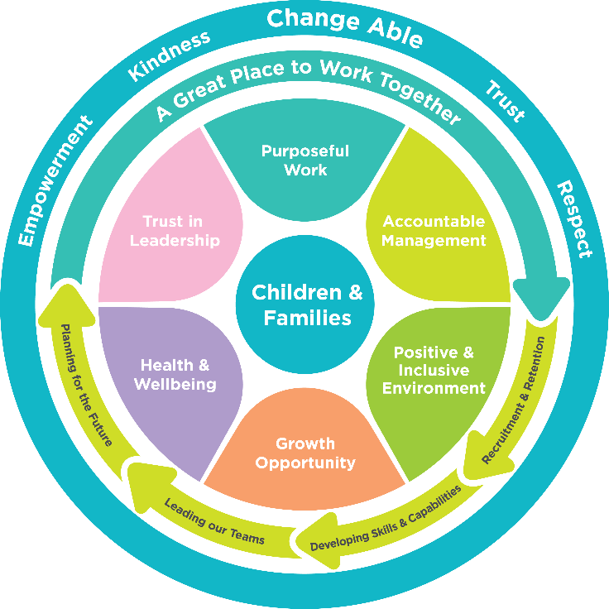
Initiatives to improve Retention include:
Developing from within
Leadership academy
Change champions
Values leaders
Coaching network
Employee Life Cycle
Increased student placement opportunities
National Student Induction Programme – ‘Supporting you in your first year of practice’
People strategy 2022 – 2024

Slide 7
We will measure success through:
• new hire turnover rate (tracking the number of new hires who leave in the first 2 years of employment at Tusla) showing a reduction by end 2025
• staff satisfaction surveys report work satisfaction to be increasing with participation above 60% by 2024
• over 70% of offered candidates accepting the role at the Agency
• total staff turnover in all teams across the Agency is below 6% by end 2024
• increased diversity amongst practitioners – representative of communities we serve
THANK YOU

