Slide 1

Seamless services in health and social care
20 October 2023
Matthew Tait
Head of Policy – Acute Sector and Systems
Care Quality Commission

Slide 2


Our role and purpose
The Care Quality Commission is the independent regulator of health and adult social care in England.
We make sure health and social care services provide people with safe, effective, compassionate, high-quality care and we encourage care services to improve

Slide 3


Unique oversight of care
23,215 adult social care services
138 NHS acute hospital trusts
294 independent acute hospitals
83 community health providers or locations
10 NHS ambulance trusts
129 Independent ambulance services
199 hospices
49 NHS mental health trusts
227 independent mental health locations
10,944 dental practices
6,430 GP practices
165 Urgent care and out of hours
Is it safe?
Is it effective?
Is it caring?
Is it responsive?
Is it well-led?

Slide 4

Seamless services in health and social care:
The challenge in England
One of the key problems that people experience in is poorly joined-up care between providers.
England’s NHS was set up to focus on treatment of single conditions.
The population has changed - many people have multiple, complex long-term conditions.
This can lead to fragments, poorly coordinated care.
Regulation may contribute to this. CQC regulates individual providers, not connections between them.

Slide 5
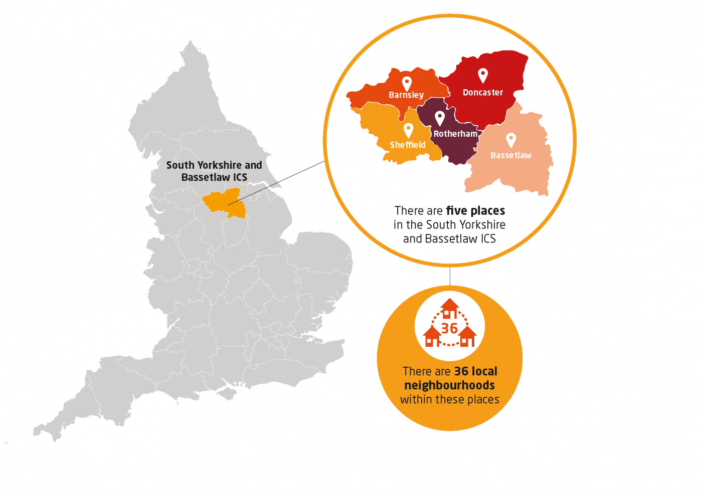
Integrated Care Systems in England
England has introduced Integrated Care Systems (ICSs) to try to address these issues.
Four aims of ICSs:
Improve outcomes in population health and healthcare
Tackle inequalities in outcomes, experience and access
Enhance productivity and value for money
Help the NHS support broader social and economic development
An example ICS

Slide 6

CQC’s strategy – Core Ambitions
Assessing local systems:
Reviewing how care provided in a local system is improving outcomes (including population health and prevention) and reducing inequalities.
Looking at how services are working together and performing as a whole.
Tackling inequalities in health and care:
Everyone in health and social care has a role to play in tackling the inequalities in health and care for people.
The strategy sets out our ambition
for how we can influence change.
Notes:
Assessing integrated care systems is a core ambition in our current strategy. It will enable us to provide independent assurance to the public of the quality of care in their area. Our aim is to understand how integrated care systems are working to tackle health inequalities and improve outcomes for people. This means looking at how services are working together within an integrated system, as well as how systems are performing overall. The Health and Care Act 2022 gives us new regulatory powers that allow us to offer a meaningful and independent assessment of integrated care systems. Our reviews will take into consideration the core purpose of integrated care systems, as referenced in NHS England’s design framework and the requirements of the legislation. They will focus on 3 themes: 1. Quality and safety 2. Integration 3. Leadership

Slide 7
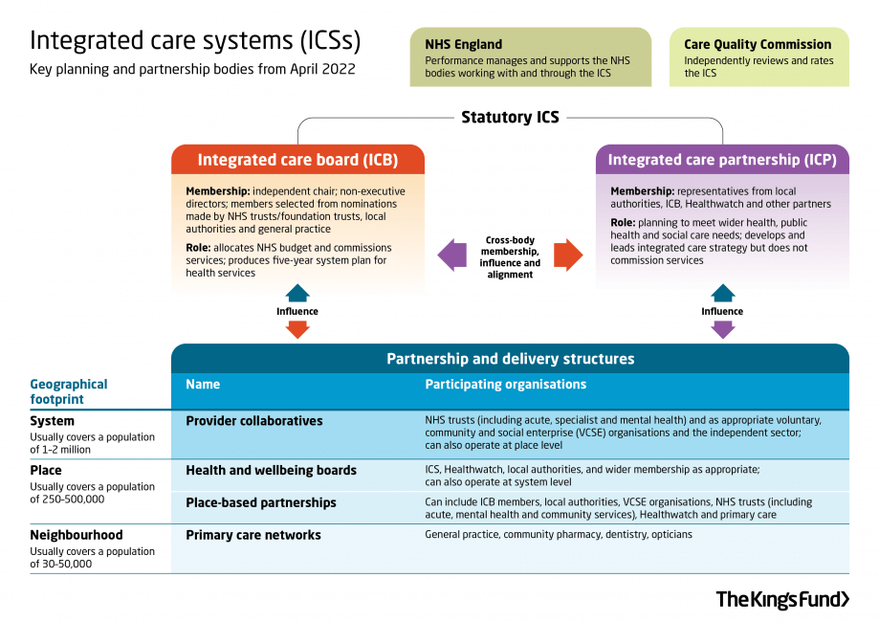
Structure and roles within integrated care systems

Slide 8
ICS assessment framework
The focus of our integrated care systems will be these across 3 themes, with relevant quality statements drawn from our Single Assessment Framework:
Leadership
Shared direction and culture
Integration
Safe systems, pathways and transitions
Quality and safety
Learning culture
Capable, compassionate and inclusive leaders
Governance and assurance
Partnerships and communities
Learning, improvement and innovation
Environmental sustainability
Workforce equality, diversity and inclusion
Freedom to Speak Up
Care provision, integration and continuity
How staff, teams and services work together
Supporting people to live healthier lives
Safe and effective staffing
Safeguarding
Equity in access
Equity in experiences and outcomes
www.cqc.org.uk/ICSguidance
Notes:
Interim guidance on our approach to assessing integrated care systems
This sets out the overall framework for our oversight of integrated care systems, focusing on the initial baselining period. It includes how we plan to gather evidence, report on findings and award ratings if requested to by HM Government.
The guidance focuses on:
Themes and quality statements
Evidence categories
How we will assess integrated care systems
Reporting and sharing information
Intervention and escalation
As we develop our model and transition to ongoing assessment, this guidance will include more detail. It will form the basis for comprehensive guidance on our regulatory processes.
You can now read our current interim guidance for assessing integrated care systems in the link provided here.

Slide 9

Our approach this year
This year we are beginning to use our new duties to oversee ICSs, as we lead into full implementation of the assessment approach.
Reviewing data and published documentary evidence across all ICSs with a focus on the Equity in Access quality statement.
Piloting our approach with some integrated care systems before starting formal assessments
Evaluating and further developing our assessment approach and publishing guidance.
Working closely with the Department of Health and Social Care on how we will deliver further assessments.
We are…
www.cqc.org.uk/ICSnews
Notes:
April to July 2023
We propose a similar approach to assessing integrated care systems as that outlined for local authority assessment.
For integrated care systems, we will start to form a national view of performance, initially focused on themes in this quality statement:
Equity in access
This would show whether systems are working together to support people to access the care, support and treatment they need when they need it. It includes how they are responding to inequalities of access across their populations. Our findings will inform our annual 'State of Care' publication.
Going forward from this point, we plan to pilot our approach with some integrated care systems before starting formal assessments. We will carry out further assessments of integrated care systems, taking into account the learning from our pilot approach and our national view of equity in access.
We’re working closely with the Department of Health and Social Care on how we will deliver further assessments beyond this point.

Slide 10
Integrated care system pilots
Pilots for ICS assessments will take place from Autumn 2023
They are testing the quality statements in our single assessment framework, tailored to integrated care systems.
Will include reflecting on recommendations from the Hewitt review for our methodology, and work with NHSE including re. ICB assessments.
We’ll work closely with our expert advisory group, integrated care systems and stakeholders to test and evaluate our work
The learning and evaluation will conclude with a final published approach to start our formal baseline assessments of all integrated care systems

Slide 11







What we’ve found so far
Partnership working: How we work with systems and other regulatory bodies is key to making our oversight effective and avoiding duplication.
Skills and capability: System leadership is complex and new. We need to work with partners and bring in external experts.
Understanding systems: There is wide variation in how systems are structured and their levels of development. We need to understand the context of each system.
Focus on people: Systems have a lot of priorities and face major challenges. At the heart of what they do is the aim to improve health outcomes and address inequalities. That should be at the core of how we approach system oversight.
Improvement focus: Comparing about systems will be challenging. Focus our oversight on identifying good practice and supporting improvement.

