Slide 1
Testing & Contact Tracing Oversight and insights for regulatory & supervisory organisations
Notes:
HSE Slide Templates

Slide 2
Overview of Test and Trace in Ireland
Notes:
HSE Slide Templates

Slide 3
Key features of T&T service
National service – population of c. 5 million
End to end – referral to result
Approx. 4,000 staff (Swabbing, labs and contact tracing)
Serial and mass testing – long term care, food production, education
37 swabbing sites and 6-12 mobile pop-ups
Standing capacity for 25,000 tests per day with surge capacity up to 35,000
National integrated system – Covidcare
PCR testing with antigen for acute hospitals
Private testing services available

Slide 4
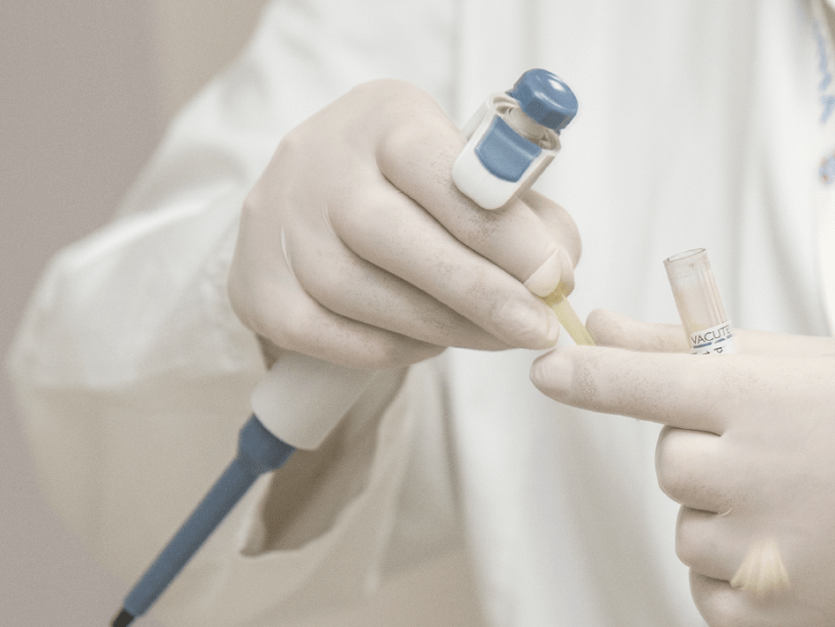
Testing and Contact Tracing Headlines – over 3 Million tests completed to date
1.4 days
1.9 days
138,770+
141,690+
14,335+
Community - median end to end for a not detected result
Community - median end to end for a detected result
Total Swabs last week
Total number of laboratory tests last week
Total number of Contact Tracing calls made last week
Note: The above TaT and volume metrics refer to the seven day date range from 20th – 26th of January.

Slide 5
Oversight of Monitoring and Oversight
Notes:
HSE Slide Templates

Slide 6
KPI suite and dashboard
National integrated governance end to end
Operations monitoring function established
Overarching QA system in development – local in place
Programme Management Office - tracks improvement
Oversight and monitoring systems

Slide 7
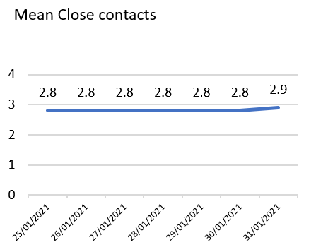
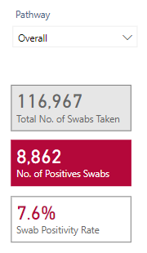
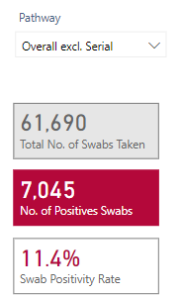
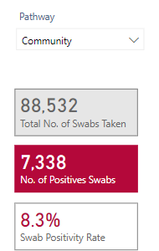
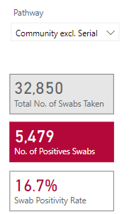
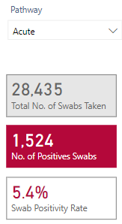
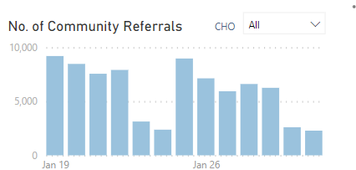
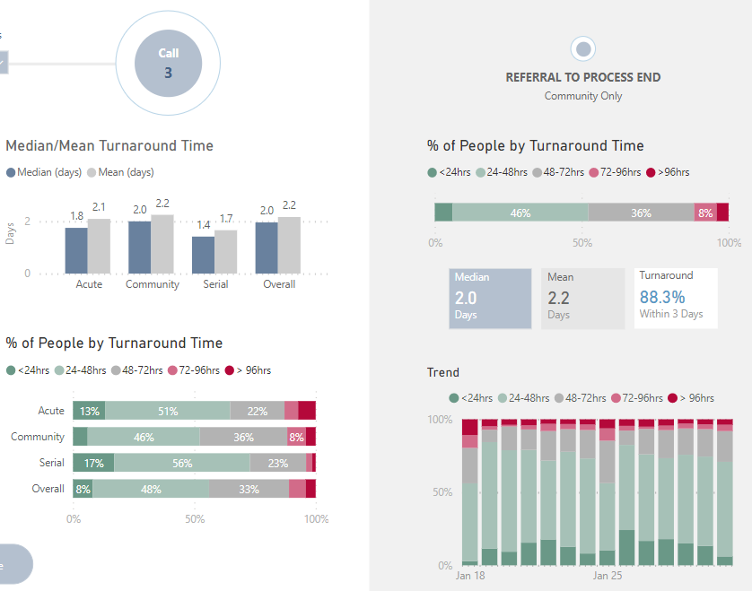
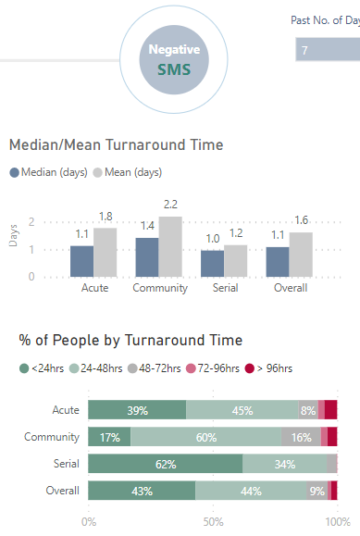
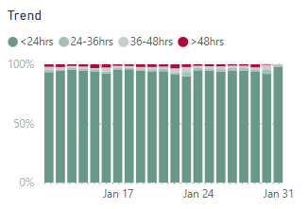
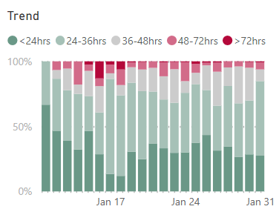
Test & Trace Performance Monitoring
RAG Status
HSE | Daily KPI updates (ISS COVID-19 Dashboard) – Feb 1st
 | < 75%
 | >=75% & <90%
 | >=90%
Overall Status:
# of Community Referrals
Mean Close Contacts
Positivity rate (Last 7 days): 7.6%
(Jan 31st: 2287
End to End Turnaround Time
Community Referral to appointment: Green
Swab to Communication of Result (Community): Green
Target: 90% in 24 Hours
Actual: 98%
Target: 90% last 7 days
Actual: 94%
Target: 90% in 48 Hours (Last 7 days)
Actual: 94%
Page 2

Slide 8
Insights for regulators/inspectorates
Notes:
HSE Slide Templates

Slide 9
Effective
Underpinned by evidence
Well-led
Doing the basics
Responsive
Turn around times – KPIs and meeting them
Patient queries
Changes in science
Provision of information to decision makers and public in a timely manner
Quality assurance systems
Clear purpose and roles and responsibilities
Clear operational model
Validation
End to end risk management
Information management systems
Operational plans based on scenarios
Clinical leadership
Systems to learn and improve – rapidly
Evaluate impact on spread and protecting health etc
Use of data
Good integration end to end
Safe recruitment
Demand planning and activation of responses
Contact tracing – when most effective and comprehensive

