Slide 1
Risk-based supervision on GP-structures
Bas Kluitenberg
Adviser risk detection
Dutch health care inspectorate

Slide 2
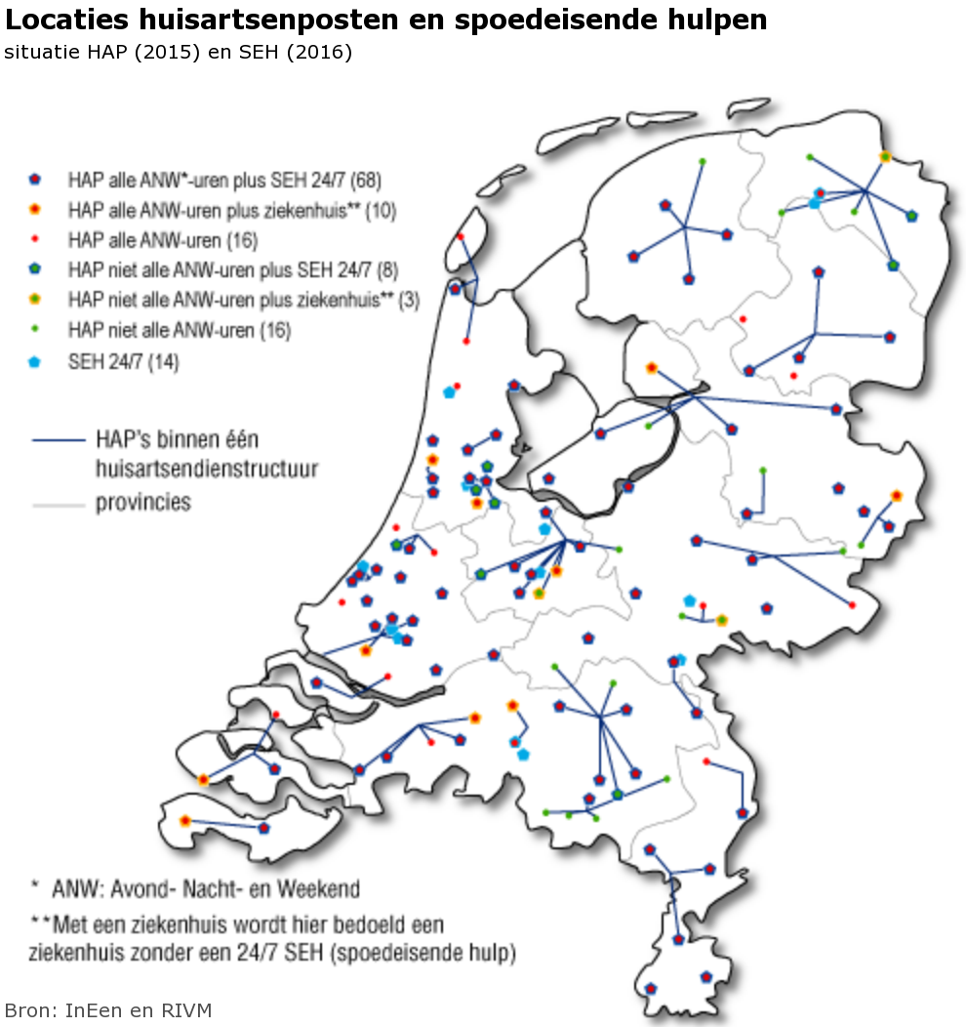
GP structure in the Netherlands
Around 9100 GPs in the Netherlands
Supervision by 15 inspectors
Impossible to visit all GPs individually
GPs are organized in centers
which are organized in 52 structures.
All GPs are connected to a center.
GP centers can only be used for
out-of-hours emergency assistance.

Slide 3
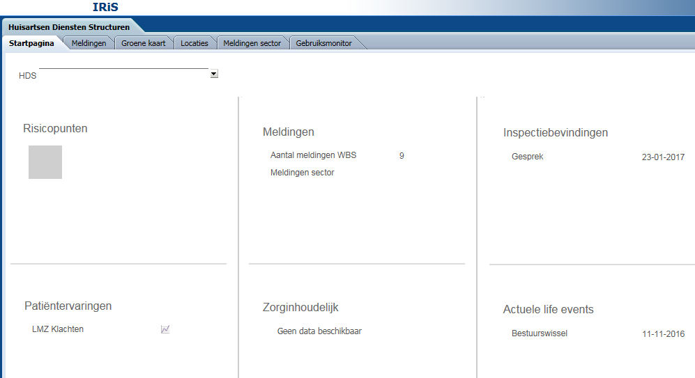
Risk-based supervision on GP structures

Slide 4
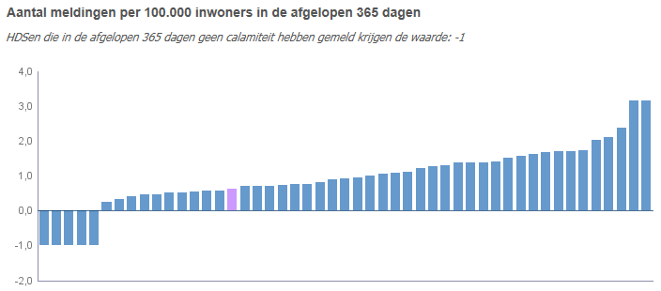
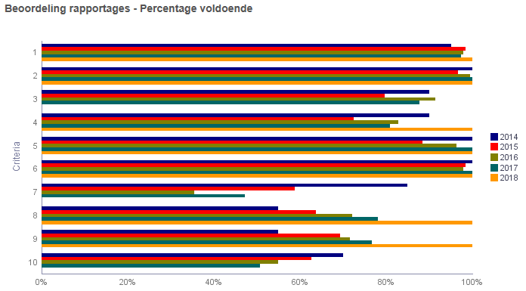
Incident reports – learning capacity
Relative number of incidents reported in the past 365 days
Overall quality of incident reports over time

Slide 5
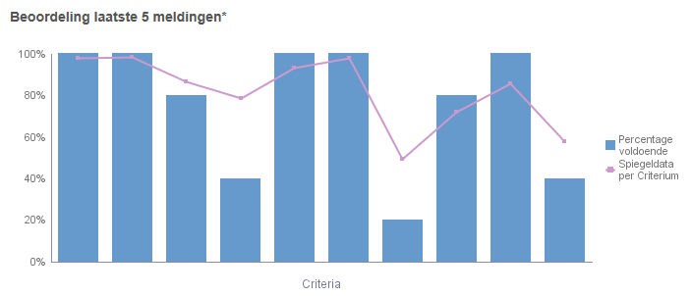
Rating quality of incident reports/investigation

Slide 6
Web based survey GP structures
Main themes:
General information (number of GPs and habitants)
Financial health
Employee inflow/outflow
Accessibility
Risk-model
Visit
Incident reports
Survey results
Patient experiences

Slide 7
Future plans
Update indicators in survey for GP structures.
Start risk-based supervision on individual GPs
Keeping administrative burden low
Strengthen relationship with occupational groups
Possible to derive useful indicators from healthcare insurance data?

