Slide 1
Social Isolation and Loneliness in Japan
A policy approach in Japanese social care for the aging society
Shin Ushiro M.D., PhD.
Kyushu University Hospital
Japan Council for Quality Health Care（JQ）
International Society for Quality Health Care (ISQua)
Asian Society for Quality in Healthcare (ASQua)

Slide 2

Why Has Loneliness and Social Isolation Become a Major Policy Issue in Japan?
Japan’s own social challenges;
  Growing numbers of older people living alone
  Rising rates of non-marriage
  Weakening local communities
  Social withdrawal “Hikikomori”*
  The “8050 problem” (elderly parents (80s) supporting middle-aged (50s) socially withdrawn children)
  Young carers**
  Increasing non-regular employment
  Persistent concerns about suicide
Issues particularly serious;
  Older people living alone
  Middle-aged and older “Hikikomori”*
  Solitary deaths (“Kodokushi”)
“Hikikomori”
Game
Used plates after meal
Manga
* Hikikomori; A behavior to stay at all times in one’s room refusing any interaction with external parties including family members. Time is mostly spent on games, internet, and “Manga”.
** Young carer; Youths who take care of sick parents or family members with little time to interact with friends. Most of young carers are in poverty with food problems.

Slide 3
National Survey for Ascertaining People’s Loneliness and Social Isolation (2021-*)
Objective
* Data presented in this slide is the outcome of 2024 survey
Outline
In order to ascertain the latest status of loneliness and isolation and collect fundamental data, the annual survey has been conducted since FY2021.
Survey targets: 20,000 persons aged 16 or more in Japan
  *Number of valid responses: 10,876 (Valid response rate: 54.4%)
Survey method: The Cabinet Office sent questionnaire documents to the survey targets. Survey targets respond online or by post.
Questionnaires: Matters related to loneliness and isolation, attributes such as age and gender, etc. (33 questions in total)
Findings
Of all respondents, 4.3% feel lonely “often or always,” 15.4% “sometimes,” and 19.6% “occasionally.”
  → Approximately 40% of respondents answered that they felt lonely.
Status of “Isolation”
(1) Frequency of communication with family and friends
Of the respondents, 9.3% said they “never talk” face-to-face with family members who do not live with them and with friends
n=10,871
The percentage of respondents who feel lonely “often or always” was high among respondents in their 20s and 30s.
2024
(2) Participation in social activities
Of the respondents, 50.6% answered that they did not participate in any specific activities, and 46.6% said that they participated in some activities.
n=10,871
2024
Events cited frequently which have account for present loneliness by respondents who feel lonely “often or always,” “sometimes,” and “occasionally” (those with a relatively high sense of loneliness) include (1) “family bereavement” (cited most frequently, or by 24.6%), (2) “living alone” (18.8%), and (3) “school transfer, job change, job separation, retirement (excluding job loss)” (14.7%).

Slide 4
History of Measures to Address Loneliness and Isolation in Japan
Dialogue and Collaboration with Private Organizations and NPOs
February 2021: Appointment of Minister in Charge of Measures for Loneliness and Isolation
Establishment of the Cabinet Secretariat’s Office for Policy on Loneliness and Isolation
Minister appointment Headquarters
March 2021: Support starts for NPOs and other organizations working to tackle loneliness and isolation measures
Securing a budget
December 2021: A nationwide survey to ascertain the actual state of loneliness and isolation
Finding facts
December 2021: Decision on “the Priority Plan to Facilitate the Promotion of the Policies Regarding Measures to Address Loneliness and Isolation”
Policy and Priority Plan
February 2022: Establishment of the Public-Private Coordination Platform for Loneliness and Isolation Measures
FY2022: Commencement of local Public-Private Coordination Platforms for Loneliness and Isolation Measures
Promoting local public private coordination
May 2023: Enactment of “the Act on the Advancement of Measures to Address Loneliness and Isolation” April 2024: Enforcement of the Act, establishment of “the Headquarters for Advancement of Measures to Address Loneliness and Isolation”, headed by the Prime Minister and composed of all cabinet ministers
Legislation
Headquarters
Enhancing publicity and awareness
May 2024: “Loneliness and Isolation Prevention Month” campaign
June 2024: Adoption of the Priority Plan based on the Act
Policy and Priority Plan
May 2025: Revision of the Priority Plan based on the Act
Responding to imminent and medium to long-term issues

Slide 5

Headquarters for Promoting Measures to Address Loneliness and Isolation
Members of the Headquarters
Head: Prime Minister
Deputy heads: Chief Cabinet Secretary and Minister of State for Measures for Loneliness and Isolation
Members: Minister for Internal Affairs and Communications
Minister of Justice
Minister of Education, Culture, Sports, Science and Technology
Minister of Health, Labour and Welfare
Minister of Agriculture, Forestry and Fisheries
Minister of Land, Infrastructure, Transport and Tourism
Minister of the Environment
Added to the above are any persons designated by the Prime Minister from among the Ministers of State other than the Head and Deputy Heads of the Headquarters.
⇒ All Cabinet ministers are designated as members
Members of the Council
Chair: Minister of State for Measures for Loneliness and Isolation
Acting Chair: State Minister of the Cabinet Office in charge of Measures for Loneliness and Isolation
Vice Chair: Parliamentary Vice-Minister of the Cabinet Office in charge of Measures for Loneliness and Isolation
Members: Directors-general and deputy directors-general of all government agencies

Slide 6

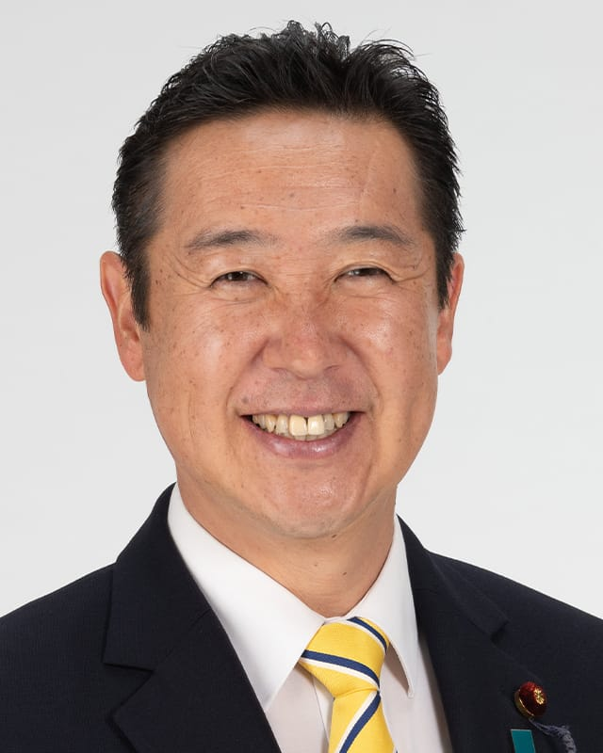
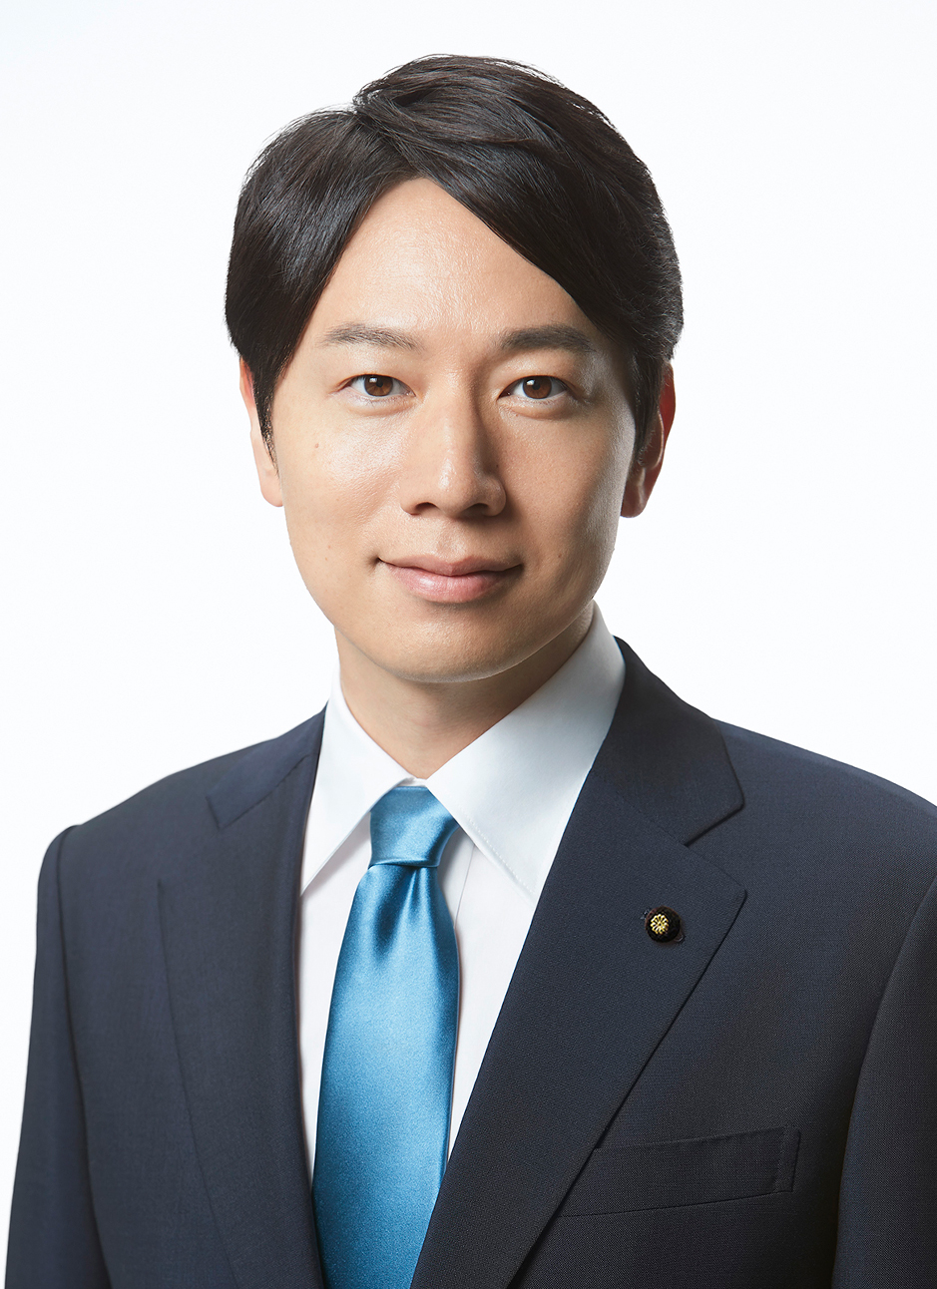

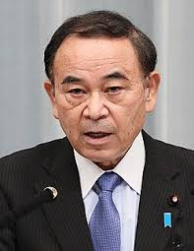

Ministers in Charge of Addressing Loneliness and Isolation (2021–2026)
Junko Mihara
Oct 2024-Oct 2025
Hitoshi Kikawada
Oct 2025-Present
Masanobu Ogura
Aug 2022-Sep 2023
Ayuko Kato
Sep 2023-Oct 2024
Tetsushi Sakamoto
Feb 2021-Oct 2021
Seiko Noda
Oct 2021-Aug 2022

Slide 7


Act on addressing loneliness and isolation (2024, enacted)
Outline
Fundamental Principles
Establishes the following basic principles regarding measures to address L/I (prevent L/I, provide swift and appropriate support to persons facing L/I, and otherwise facilitate their efforts to get out of the troubled situation).
  It is important to develop measures to address L/I across all societal sectors as any person is trapped in such a situation at any point in life.
  It is essential to provide continuous support tailored to the individual circumstances of persons going through L/I, including their family members ("concerned parties").
  It is essential to provide necessary support to the concerned parties with aim of enabling them to get out of their L/I to live a happy daily and social life, by fostering their interactions with society and others in consideration of their preferences.
Responsibilities of the National / Local Government and Other Matters
Outlines the responsibilities of the central and the local governments, the cooperation of the people and organizations, the coordination and collaboration among relevant persons, and other matters pertinent to policies on L/I.

Slide 8
Act on addressing loneliness and isolation (2024, enacted)
Basic Policy
Create "Priority Plan" on measures to address L/I.
Call people for attention and raise awareness which contributes to the autonomous activities of the diverse members of society participate relating to, the policies to address L/I.
Encourage support for counselling (providing the necessary information, advice and other forms of assistance in response to consultations from the concerned parties.).
Promoting the coordination and collaboration among relevant parties (the central and local governments, those who provide support to the concerned parties, local residents, and other relevant persons).
Recruitment, training, and enhancement of personnel who provide support to the concerned parties.
Assist the local governments as well as those who provide support to the concerned parties.
Promote research and studies into the actual circumstances of persons experiencing L/I.

Slide 9
Act on addressing loneliness and isolation (2024, enacted)
Framework for promotion
  Establishes the Headquarters to address L/I (produces priority plan, deliberate pivotal issues, collects voices of relevant parties) within the Cabinet Office as a special organization.
  Local governments are to strive to establish a local council for L/I measures joined by the relevant organizations, bodies related to concerned parties, persons engaged in support-related professions, and other related persons, exchanges the necessary information, and holds discussions regarding the particulars of support.
  Establishes a duty of confidentiality on those who is or was engaged in the activities of a local council and a punishment for who breaches the duty.
The Effective Date: April 1, 2024

Slide 10
Outline of revised “Priority Plan to implement the Act on Addressing Loneliness and Isolation”(adopted 11th Jun 2024; revised 27th May 2025)
Rationale of the “Priority Plan”
It is adopted by the HQ established grounded in the Act on Addressing L/I which was enacted on 1st April 2024 (Serial Law Number 45, 2024) .
The Act requires to launch fundamental principles and define measures that the government needs inclusively and systematically to implement. Particularly, the government needs to set concrete goals and specific period to achieve them in principle for prioritized measures.
Current status
Issue on L/I still exist even after COVID-19 pandemic. Specifically, It is significantly worried that suicide if school i.e. Primary/Junior/High School, children hit record high. L/I issue predictably worsens with the suicide numbers as well as growing number of household with a single resident including the elderly.
Effort shall be made thoroughly across every corner in the society through partnership of the central/local governments and NGOs.
HQ shall reinforce implementation of the measures according to the Priority Plan under the leadership of the designated Minister.

Slide 11
Statistics on Imminent and medium-to-long term issues captured in the Priority Plan 2025
Imminent Issues
The annual number of suicides among elementary, junior high, and senior high school students has hit an all-time high.
  In 2024, the number hit the all-time high of 529.
  The number of suicides among junior high and senior high school girls increased.
Medium-to Long-Term Issues
Single house holds and single elderly house holds are expected to increase
The number of people at risk of L/I is also expected to increase.
  The number of single house holds will increase in the future, accounting for 44.3% of the total in FY 2050 (estimated)
Estimated number of solitary deaths*: about 22,000
  The estimate for 2024 was given by the Cabinet Office’s working group on solitary deaths.
*“Solitary deaths” refers to people who are thought to have died alone at home at least eight days before discovery after remaining socially isolated during their lifetime, among the corpses handled by the police.

Slide 12
Outline of revised “Priority Plan to implement the Act on Addressing Loneliness and Isolation”(adopted 11th Jun 2024; revised 27th May 2025)
Basic principles (Article 2, The Act for Addressing L/I)
1.Take measures to both issues of “Loneliness” and “Isolation”, 2.Measures shall be implemented from the viewpoint of those who suffer L/I, 3.Measures shall be implemented so that assisted people would feel “involved” and “connected” in the society.
4 Basic policies
Create a society where it is easy for people to ask for support in times of L/I
Ascertainment of the actual situation of loneliness and isolation
Establishment of a portal site that offers comprehensive support information and timely information provision
Development of an environment in which it is easy for people to ask for support and be approached
Connecting to seamless support to receive counselling tailored to the situation
Improvement of the support system for counselling (promotion of 24-hour consultation by telephone and SNS, etc.)
Support for human resource development, etc.
Creating communities where people can feel connected to each other by securing places and opportunities to care and interact with each other
Secure places where people can feel bonds with others
Establishment of an outreach-type support system
Promotion of cross-sectoral coordination to enhance the synergetic effect of policies
Promotion of regional inclusive support systems
Provision of meticulous support for NGOs working on measures to address L/I, and strengthening of coordination between the public, private, and NGO sectors
Support for NPO and other activities
Promotion of dialogue with NPOs, etc.
Formation of a platform as a foundation of coordination
Development of a system to promote measures to address loneliness and isolation in administrative organizations

Slide 13
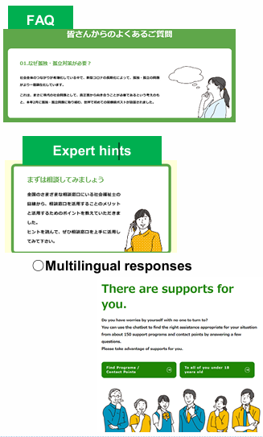
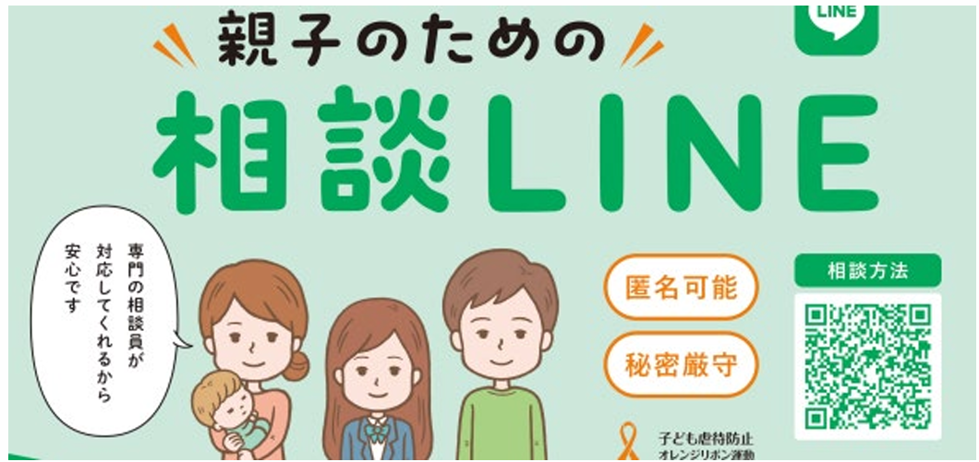
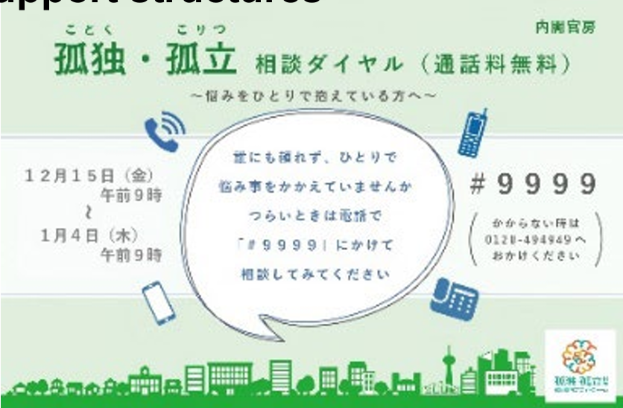
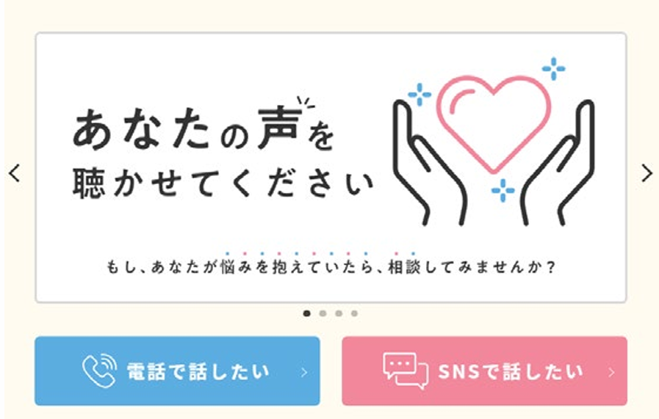
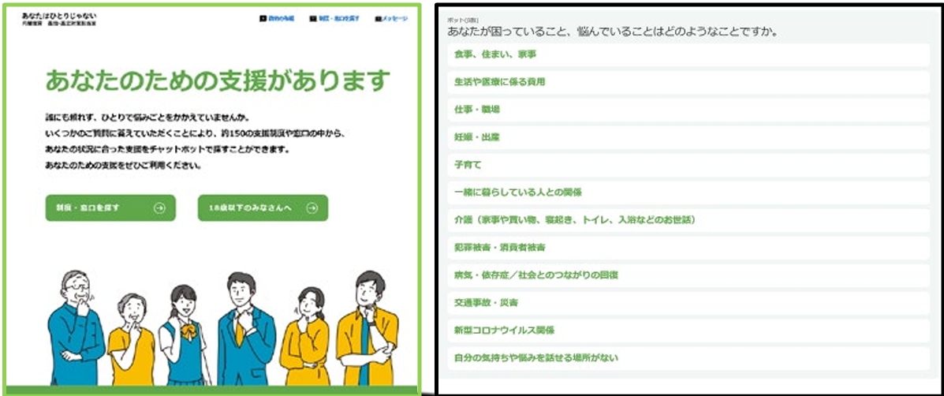

Specific Initiatives for Measures to Address Loneliness and Isolation (i)
Development of enabling environment for people to have access to support/consultation
Loneliness and Isolation Prevention Month (May, 2025)
Online anonymous consultation (SNS) Children and Families Agency)
One-stop consultation system (Cabinet Office)
Comprehensive support through integration of consultation/ cohesiveness creation services
Integrated implementation of support for counselling /cohesiveness creation programs at community level in order that various support bodies and centers can smoothly provide support surpassing their attributes.
The relevant ministries’ fiscal supports are integrated to collectively implement initiatives related to services for the elderly, disabled, children and those living in poverty.
24/7 support through phone and SNS (MoH)
Chatbot to tailor service(s) (Cabinet Office)
“Perhaps it’s my own fault that I feel lonely.”
I don’t want others to know I’m isolated.
I don’t think I need consultation on my sense of loneliness.
I don’t know where I should go to get consultation.
Procedures will be just troublesome.
Any person can potentially be in a state of L/I at any point in life
Creating a social awareness that this is an immediate issue
Development of environment in which it is easy for people to ask for support and be approached
Development and publicizing of consultation support structures
Development of an environment in which it is easy to consult

Slide 14



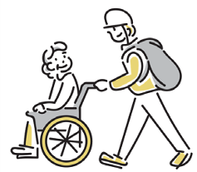




Initiatives for Measures to Address Loneliness and Isolation (ii)
Promotion of cross-sectoral coordination to generate synergy in creating people’s bond
Creation of bonds and environment (Examples)
Close the gap between people and community i.e. bonds
“Park” as a place to formulate person-community bond (environment)
Specialists including those in healthcare, medical care, welfare and education
Synergy
Mitigation and prevention of L/I
Encourage to use various relevant initiatives and infrastructures
Revitalization of community activities
Community volunteer circles, sports/culture/arts/hobby
groups etc. (town planning, welfare)
Local physicians, link workers (medical care)
Community General Support Centers/life support
coordinators (home care)
Community coexistence managers (welfare)
School social workers (education)
Probation offices (rehabilitation)
Community bonds at museums/public
halls/libraries (cultural facilities)
Local residents
Citizens and private businesses
Commissioned welfare volunteers/commissioned child welfare volunteers (welfare)
Volunteer probation officers (rehabilitation)
Administrative counselors (consultation acceptance
Tsunagari supporters (loneliness & isolation measures)
“Ibasho” (places where one feels comfortable, safe and accepted) for children such as child cafeterias, places for interaction beyond age groups (children/food education)
Protection through housing support corporations, consumer protection advocators/relevant bodies/the community (housing, consumer protection, environment)
Awareness-raising through cross sectoral publicity/consultation points
Prevention of consumer damage
Administrative consultation
Utilization of the local Public-Private Coordination Platforms for Loneliness and Isolation Measures, sharing of various policy information, encouragement of cross-sectoral coordination to generate bonds between people

Slide 15

National Coordination Platform for Loneliness and Isolation Measures
Organization Member organizations: 675 (as of Jan 1, 2026)
  Members (449): NGOs, other support groups, relevant government agencies
  Cooperating members (171): Economic organizations, local governments
  Supporting members (55): Private organizations, subsidized organizations
Primary Activities
Activities to enhance multiple and broad-range collaboration
Holding subcommittee meetings on specific themes
  (1) Initiatives for a society where people can solicit for support at any time and be approached
  (2) Roles of central and local governments, private sector, and NGOs for meticulous support and local comprehensive support
  (3) Practical mutual collaboration in consultation support
Nationwide outreach for robust implementation addressing L/I issues
  Holding symposiums on L/I measures
  Loneliness and Isolation Prevention Month (May)
  “TSUNAGARI” Supporters (Human-to-Human bond facilitator)
Knowledge sharing and awareness-raising activities
  Sharing and providing relevant information for members
  Conducting surveys on L/I

Slide 16


Framework for Promoting Loneliness and Isolation Measures in Local Governments (Overview)
Regional versions of the Coordination Platform for Loneliness and Isolation Measures
A regional platform helps relevant parties form close, face-to-face and promotes horizontal coordination where people connect on equal, mutual terms.
A regional platform also offers a horizontal coordination framework that aims to facilitate mutual learning and empower participating groups, primarily by making it possible for communities to share information on their resources, develop social resources, forge face-to-face relationships, provide residents with information, raise awareness, and share information on local issues with L/I.
Local agendas
Local governments
(administrative departments)
Private organizations providing support for persons who are in a state of L/I
Local residents and organizations
Private companies
Other relevant organizations
Local Councils on Measures For Loneliness and Isolation
Consisting of relevant parties that support persons who are captured in L/I and others, these local councils meet to exchange information and discuss approaches to and methods of providing support.
Note: Persons who are/were involved in the administration of these local councils are bound by the duty of confidentiality (with penalties).

Slide 17
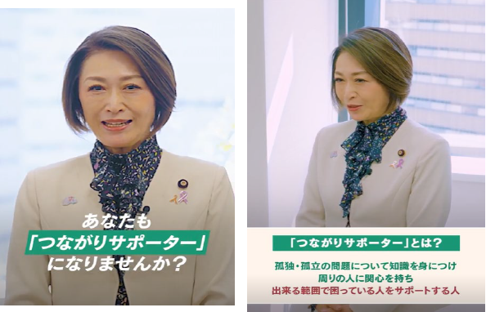
“Tsunagari”(Facilitation of human bond) Supporter Training Course
Who is “Tsunagari” Supporter?
Message from Minister Mihara
A “Tsunagari (Facilitation of Human Bond) Supporter” is someone who understands the challenges of L/I (for example, that around 40% of people experience loneliness and that it can affect both mental and physical health), takes an interest in the people around them, and offers support to those in need whenever possible.
“Nobody can blame others just for being alone, but I am concerned about you when your are afflicted by significant worries because they may be just heavier enough to irk you.”
“You will help those who are in troubled situation and in need for help through the learning in the course.”
“I believe that just a small connection means a lot in our society.”

Slide 18
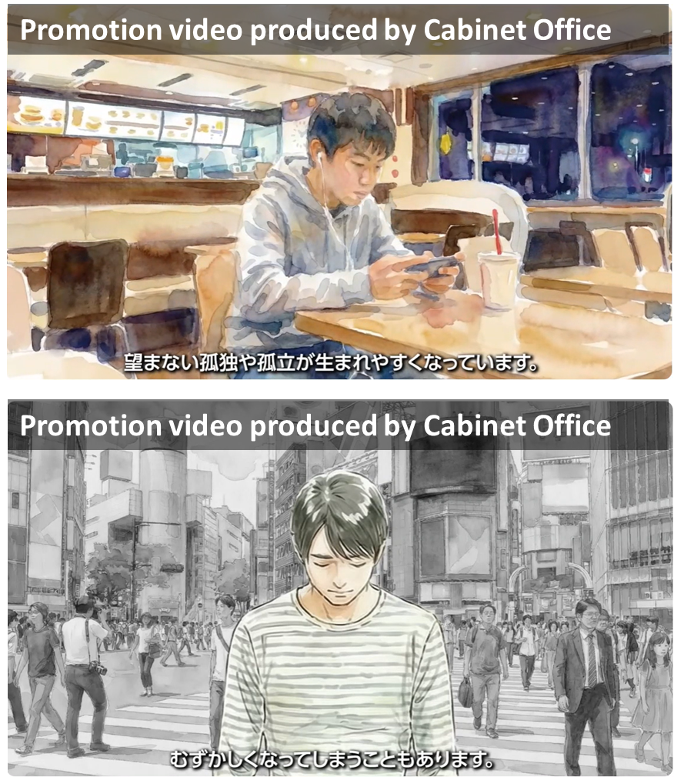
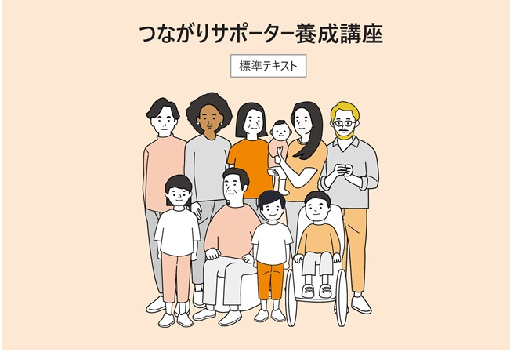
“Tsunagari”(Facilitation of human bond) Supporter Training Course
Main contents of the training course
Textbook on “Becoming Tsunagari Supporter”

Slide 19
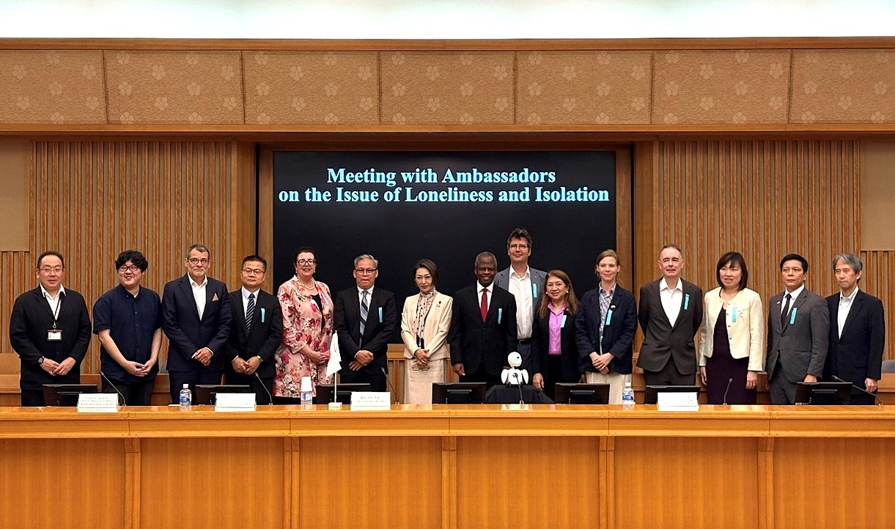
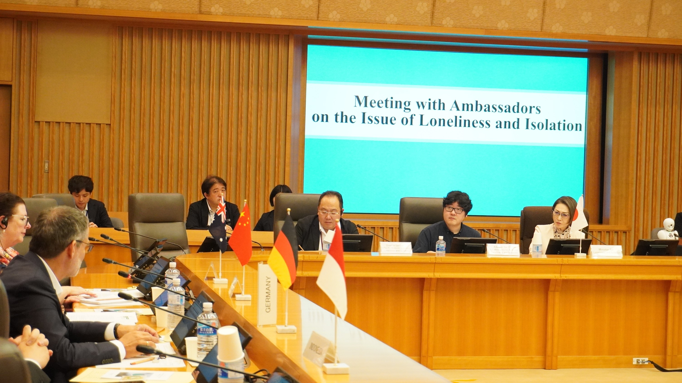
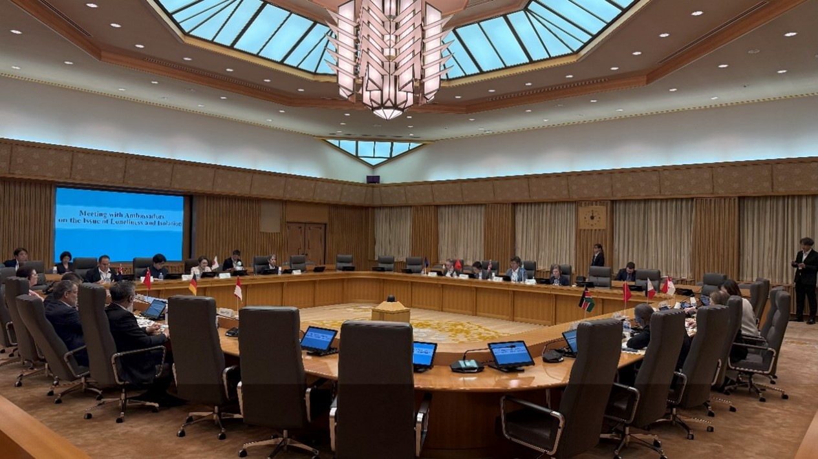
Ambassadors’ meeting on Loneliness and Isolation issue, 26 Jun, 2025
JPN Minister in charge exchanged views with ambassadors and representatives from 11 countries and regions on how to address these issues.
Japan shared its current efforts and approach as well as collaboration among government, private, and NGO sectors to address Loneliness and Isolation. Ambassadors and representatives from participating countries and regions also introduced their own national efforts and private sector initiatives.
Participating Countries and Regions;
Australia, China, Germany, Indonesia, Kenya, Philippines, Singapore, Sweden, United Kingdom, Vietnam, and the EU

Slide 20

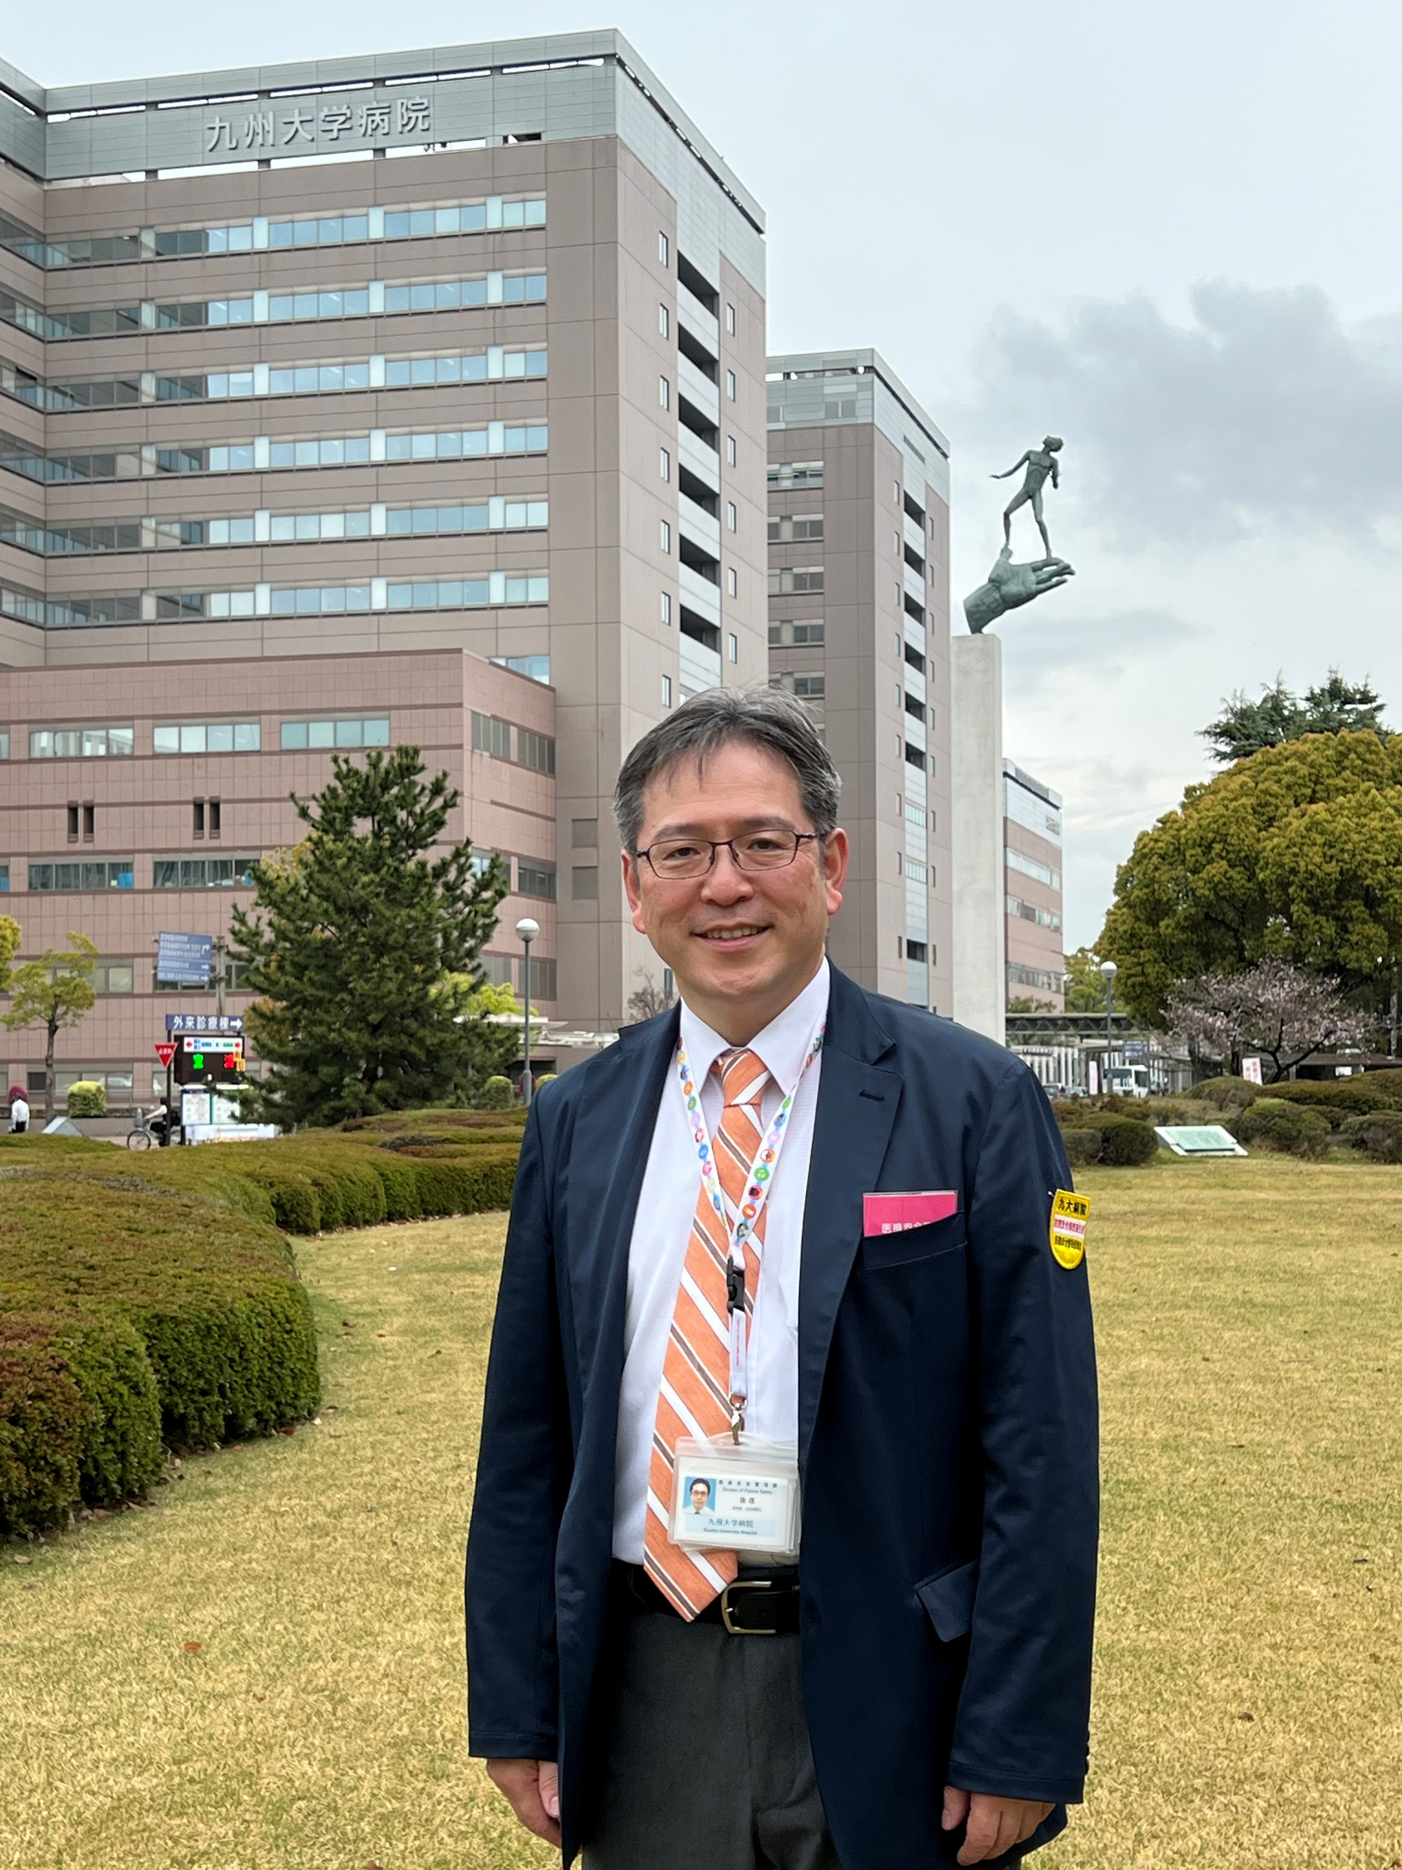
Thank you for listening !
Kyushu University Hospital, April 2026

